Slide 1

10. PREPARING YOUR HEALTH FACILITY

Slide 2


OBJECTIVES
Demonstrate knowledge on how to ensure the health facility is ready to provide care to survivors
Gain the knowledge and skills to prepare the health facility and set up a consultation room
Map out current patient flow and response to sexual assault survivors and identify areas for improvement.
Describe what referral resources are needed for sexual assault survivors.

Slide 3
PREPARE THE HEALTH FACILITY

Slide 4

PREPARING THE HEALTH FACILITY
Decide on an ENTRY POINT AND CARE PATHWAY for survivors of rape, sexual assault and intimate partner violence
Decide on and prepare the CONSULTATION ROOM
Ensure PRIVACY AND CONFIDENTIALITY
Notes:
Explore and decide on an entry point, care pathway, patient circuit
Ensuring that the number of places that the survivor will need to go to, the number of people they will need to speak to and the number of times they will need to disclose the violence are minimal.
Think of a code word, colour, image, coupon, CHWs or women’s friendly/safe space giving out a green coupon, white flower so the survivor does not need to say anything or disclose an experience of abuse.
Decide on a consultation room to ensure privacy, confidentiality and accessibility— a separate room with 4 walls and a door, where the patient cannot be seen and overheard from outside the consultation room.
Ideally, all medical care and psychosocial support will be offered in one accessible, safe, private and confidential location
The consultation room should feel welcoming, comfortable, friendly, non-threatenng and non-threatening. Consider how to make the space child and adolescent friendly.
Prepare sign for the door ‘Do not disturb’ to improve privacy and confidentiality.
If resources permit, consider having a private, separate or outside entrance to the examination and consultation room, access to a toilet or latrine, and creating a space where children accompanying their mothers can play, watched by other health facility staff. Or Consider changing patient flow so that women can bypass public waiting areas. If this is not possible, instruct staff to ask intake information only in a private space or in writing. Reduce stigma by avoiding explicit names and signs that indicate that those who enter the exam room have been subjected to violence.
Ensure a confidential space to safely secure documents.

Slide 5

ACTIVITY -
STRING EXERCISE – PRIVACY
MAPPING – PREPARE THE ENTRY POINT, CARE PATHWAY AND CONSULTATION ROOM
Notes:
See
Activity 10.1 String exercise – privacy
And/or
Activity 10.2 Mapping – Prepare the entry point, care pathway and consultation room
NOTE: The activity privacy may be done in the module “What every clinic worker needs to know” so do the activity only once in the week either in the module “What every clinic worker needs to know” or here.

Slide 6

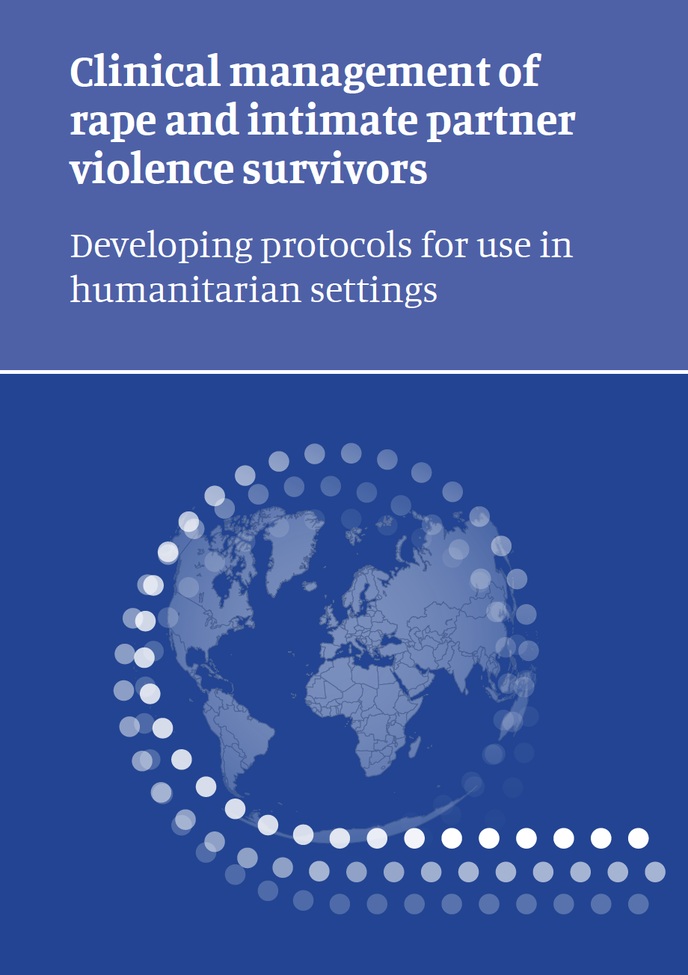

ESSENTIAL HEALTH FACILITY RESOURCES
MEDICINES, SUPPLIES AND EQUIPMENT
DOCUMENTATION
Supplies for FORENSIC EVIDENCE COLLECTION (if applicable)
Consider the possibility OF CHILD FRIENDLY ROOM AND ANATOMIC DOLLS (male and female)
MEDICAL PROTOCOLS (on the wall) and printed clinical guidelines
Notes:
Prepare medications, supplies and equipment
HIV test and HIV PEP
STI medication
Pregnancy tests, emergency contraception
Vaccines, needles, syringes
Analgesia, antiemetics, wound care supplies
Documentation, medical certificate
Protocols and job aids
Lights, an examination bed
Sheets, blankets, sanitary pads.
Do you have SRH services? Obstetrical care? X-ray? A lab? Counsellors? Mental health services? ARV services? Ensure you can offer referral to other services.
Ensure adequate and continuous stock of medical products.
Provide the checklist of medical products to the department caring for sexual assault survivors and ask them to order the individual items in required quantities.
Instruct the responsible health-care providers to gather equipment and medicines on a shelf, in a file cabinet or in a mobile kit. Establish processes to restock after each client and to check medication expiration dates.

Slide 7

PREPARE DOCUMENTATION
Consent, medical history and examination forms with pictograms
Medical certificates
Follow-up cards and confidential referral forms
Registration book with coding system
LOCKED FILING CABINET to keep confidential records
Notes:
• Ensure documentation is safely, securely and confidentially stored.

Slide 8
ACTIVITY -
CHECKLIST FOR CLINICAL CARE
Notes:
See Activity 10.3 Small group discussion – Checklist for clinical care

Slide 9
PREPARE AND TRAIN STAFF TO CARE FOR SURVIVORS

Slide 10
IDENTIFY AND TRAIN STAFF
Identify staff, decide on roles and responsibilities
There should be at least 1 health care provider trained to care for survivors on duty or on-call at all times
Train all clinic staff on the basic principles of responding to violence
Train translators and partner organizations supporting survivors
Train care providers who will care for survivors including mental health counselors and social workers
Notes:
Identify, sensitize and train staff based on their roles and responsibilities. Develop a training plan
Identify a focal person in the health facility to be responsible for the response to violence, to coordinate, manage and deliver services for women subjected to violence
A health-care provider (nurse, doctor or equivalent) trained in sexual assault care and examination should be available at all times of the day and night (at location or on-call). Identify who on
your staff can be assigned and offer training for this role. An on-call roster system (with appropriate remuneration) may be useful.
Offer regular follow-up, mentoring and supervision after training.

Slide 11
IDENTIFY AND MAP YOUR REFERRAL NETWORK

Slide 12
PREPARE FOR REFERRALS
Survivors have multiple needs, and referrals to support services should be available
Identify and map the available services or organizations in your community
Medical care
Psychosocial support
Community support
Legal support
Safety and security
Economic support
Child protection
Practical needs
Notes:
Survivors of IPV and rape often have multiple needs. We should offer support for medical needs and referral to further support services.
Establish coordination and referrals between health services and services of other sectors
Identify and map the available services or organizations in your community - particularly those that are reasonably accessible in terms of distance, availability of transport and cost. This includes:
Medical care
government supported, faith based, INGO or NGO supported and private health facilities, pharmacies, traditional healers and traditional birth attendants,
Primary care, HIV care, ART, safe abortion care, antenatal and obstetrical care, surgical services are available? X-rays, orthopaedic services? Burn care? forensic medicine services
Mental health and psychosocial support
Psychosocial support, Mental health counsellor, social worker, psychologist, Counselling
Psychiatrist or mhGap trained health care worker
Support groups
Safe spaces, social or recreational activities
Community support
Peer groups,
Traditional healers, religious leaders, religious groups, community leaders or community groups
Women’s groups, peer support groups, faith-based organizations and organizations working with marginalized groups or special needs populations or people with disabilities
Women safe or friendly spaces
Legal support
Legal aid, Legal Assistance Services – information about their rights, representation in courts for protection, divorce or child custody
Courts
Protection, safety and security
Safe accommodation, safe House, shelter housing
Police
Police, law enforcement, security actor, investigators
• forensic/medico-legal investigations
Education, economic support
Financial aid including livelihood or income generation, vocational training, microcredit loans
food assistance, material support
Child protection services foster services
Practical needs
securing/replacing identity documents
transportation assistance
child care
interpreters
Other
Crisis centre, one stop centre

Slide 13
KNOW YOUR REFERRAL PARTNERS
What services they do provide and what they do not
Hours of operation are
Specific contact information
What their target population is (female, children, refugees)
Any pre-requirement for intake (police report, ID card, a fee)
A specific person you could call for survivor-related questions or to update information.
Notes:
Assess the accessibility and quality of the support services, consider: Accessibility, cost, opening hours, wait times, availability of transport, barriers to access, possible groups being discriminated against or excluded in service provision, whether there are any mandatory reporting requirements associated with the referral (for example, whether referral for medical treatment will require the doctor or nurse to report the case to the police)

Slide 14
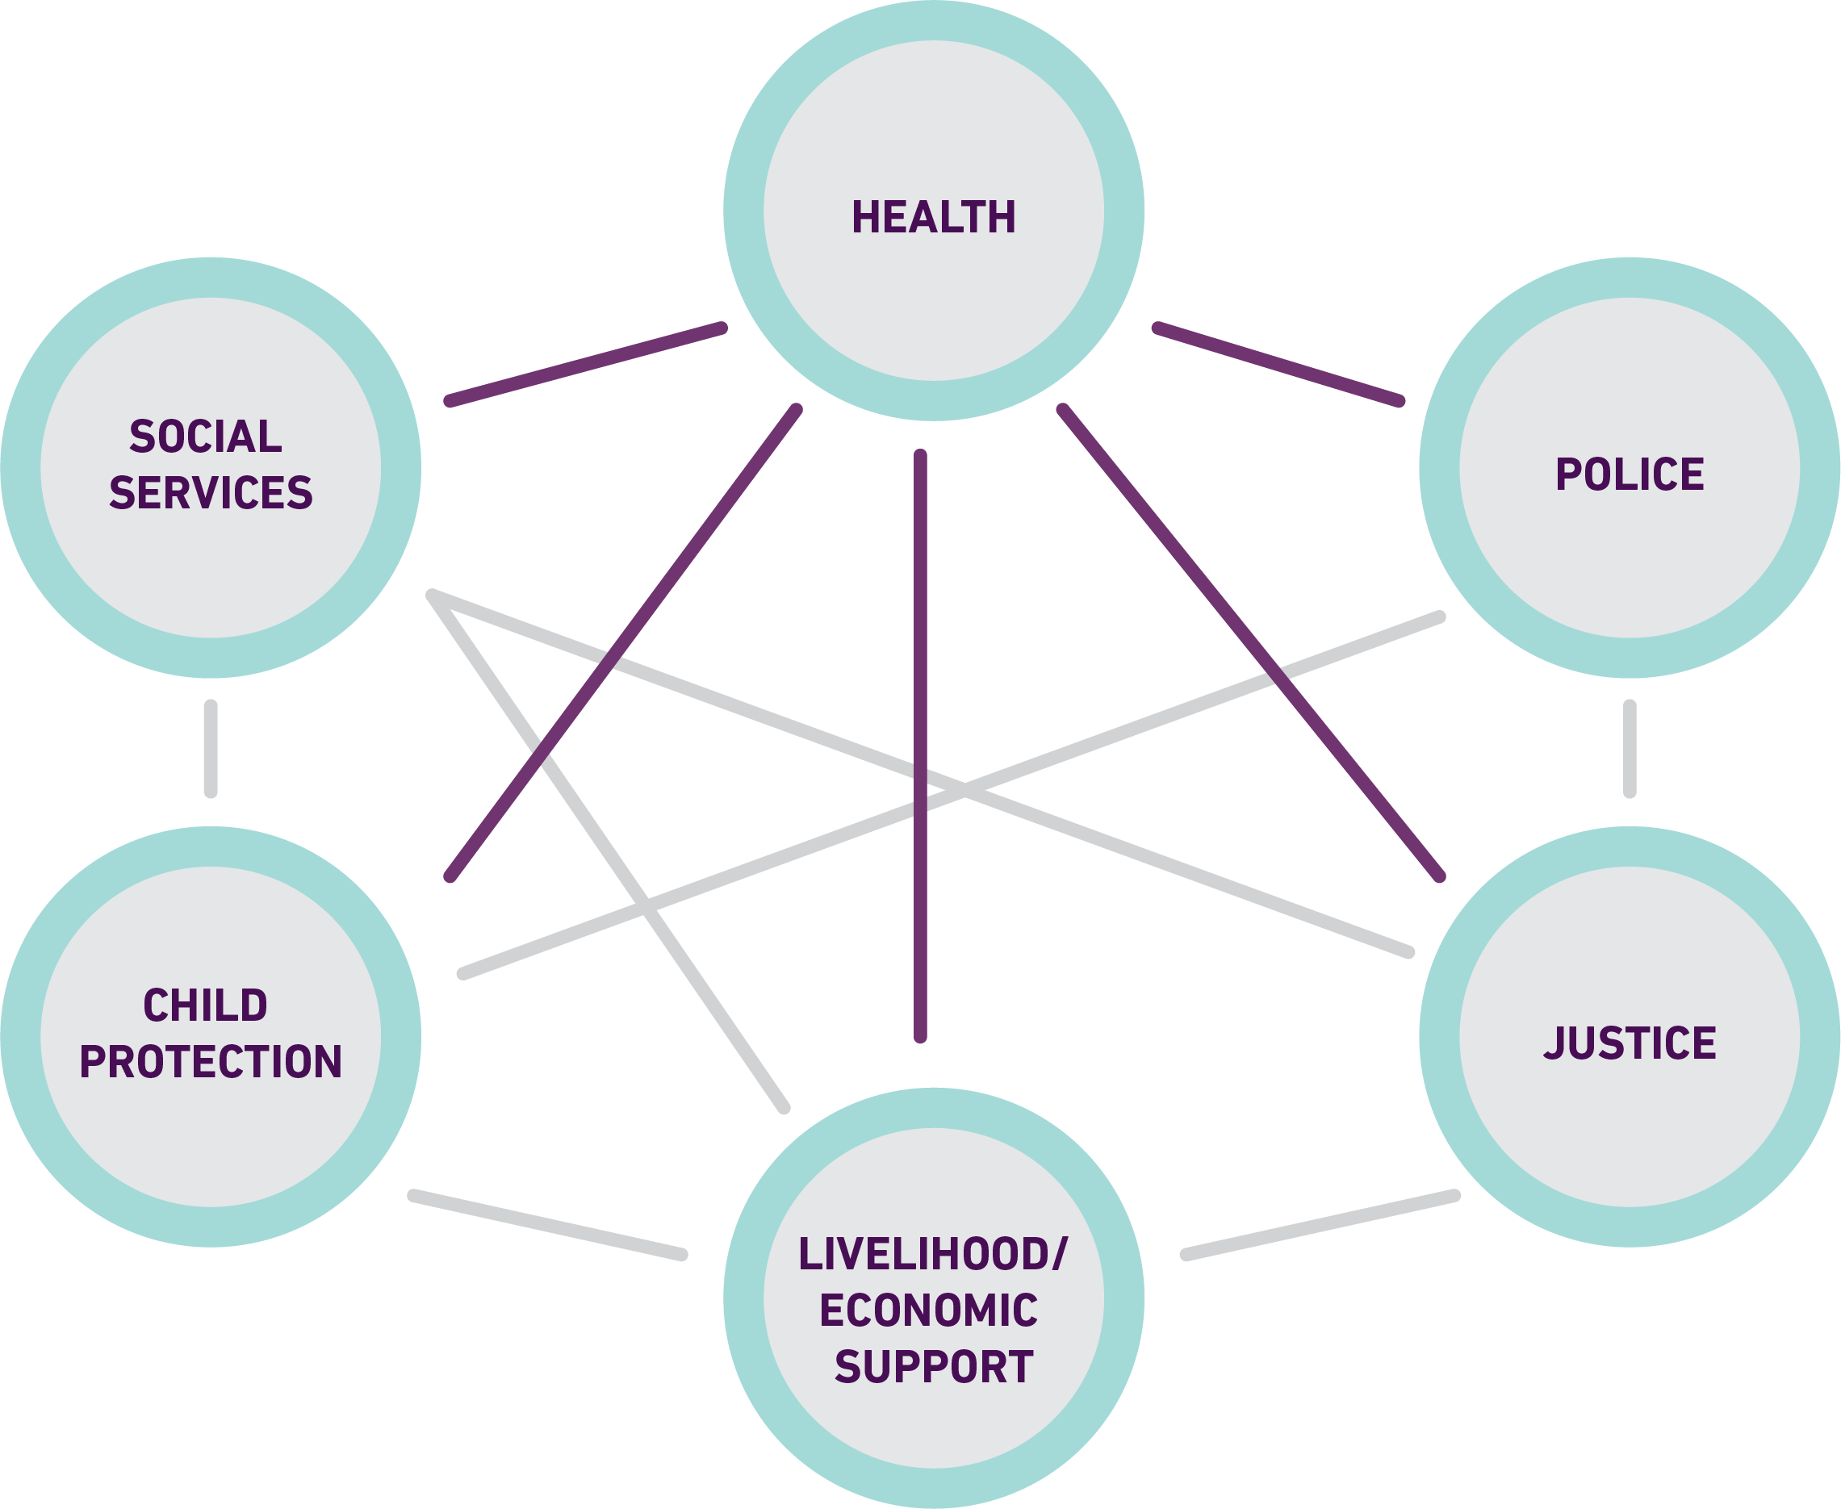
REFERRAL PATHWAY
Develop a list and referral pathway
Notes:
Develop a list
Name of the support service, Contact name, Contact number, E-mail of a focal person in each referring and receiving service, Address, Type of support service, Description of services provided, Hours of operation, Cost (if any), Procedures to access and obtain services, Population served, Possibilities and limitations for collaboration
Know at least one person at that service
Be able to refer to these people by name
Know what services are provided, so that you can tell patients
Ensure that all health facilities have a copy of the directory and if possible develop personal contacts with receiving services.

Slide 15
PREPARE FOR REFERRALS
Referral pathways should adhere to guiding principles:
respect self-determination and autonomy
privacy and confidentiality
maintain safety of the survivor
Identify a focal point to facilitate referrals
Prepare to monitor referrals
Coordinate between support services
Notes:
Consider privacy and confidentiality - minimize points of care and retelling of the story, protect the and confidentiality of her information
Identify a focal point for coordinating referrals – who facilitates referrals, access to care, can follow-up, can improve relationships with other agencies, address any challenges
Their roles should be to:
maintains an updated referral directory with contact details of referral services
refers client for services not provided onsite
follows up with client and receiving organization
documents referral activity
conducts quality assurance.
Prepare to monitor referrals - Develop tools for monitoring referrals and coordination including referral cards and documentation forms that assure confidential transfer of medical information, and that enable you to monitor whether women are able to access different services and receive quality care. You can ask stakeholders from the different services, as well as clients, for their views on how the referral process of the health service or facility could better meet the needs of women subjected to violence.
Improve coordination, participate in multi-sectoral coordination mechanisms, or develop this with other support services – establish a common aim, agree on guiding principles (do no harm, respect autonomy and choice, privacy and confidentiality), establish roles and responsibilities, establish informal or formal agreements (memorandum of understanding (MOU) among services, maintain relationships through hosting cross-trainings, workshops or regular meetings, identify gaps and challenges.

Slide 16
OFFER REFERRALS
Provide information about the referral
Available support, location, how to get there
Benefits and risks
Offer support in the referral
Notes:
Provide information to the survivor about available supports:
What support will be available, location, how to get there, who she will see.
The benefits and risks of the service (and whether there are any mandatory reporting requirements associated with the referral
That the person has the right to decline or refuse any part of an intervention provided by the caseworker and/ or referral agency
What information will be shared about the case in the referral process and with whom.
Ask if they have questions, always check to see if she has questions or concerns and to be sure that she has understood.
Ask if they want to be referred to a service, and get informed consent..
If she accepts a referral, here are some things you can do to make it easier for her:
Offer to telephone to make an appointment for her if this would be of help (for example, she does not have a phone or a safe place to make a call).
Offer to help make an appointment, if it help: Offer to call on her behalf OR Offer to make a call with her OR Offer a private place where she can call.
Offer to provide information or documentation to survivor for the service provider, so that survivor won’t have to repeat information – including what happened.
If she wants it, provide written information – time, location, how to get there, name of person she will see. Ask her to think how she will make sure that no one else sees the paper.
If possible, arrange for a trusted person or staff to accompany her on the first appointment. You should talk this through carefully with the survivor, always thinking about safety risks. In some settings, GBV caseworkers are known in the community, so walking a survivor to a medical facility or a police station automatically raises curiosity and may inadvertently put the survivor at risk. If you will not accompany them, is there someone else they trust who can?
If possible, discuss child care and who can care for her children
Discuss what might happen if her partner or family finds out she is going to the support services.
Discuss transport, considering offering transport or payment for transport.

Slide 17
ACTIVITY -
DRAWING A REFERRAL PATHWAY
DEVELOP AN ACTION PLAN
Notes:
See
Activity 10.4 Drawing a referral pathway
Activity 10.5 Develop an action plan

Slide 18

KEY MESSAGES
Prepare your health facility
Entry point, care pathway, consultation room
Medications, supplies, equipment, documentation, protocols
Trained staff
Identify support services, create a referral directory, coordinate between support services to meet survivors’ multiple needs and offer referral to survivors

