Slide 1

11. SELF-CARE FOR PROVIDERS

Slide 2


OBJECTIVES
Build an understanding of the various types of traumatic stress and how they impact you.
Gain awareness of the signs of burnout and vicarious trauma.
Demonstrate knowledge of how to access resources, support for ourselves and practice self-care
Understand how to utilize tools and methods for staff care and managing stress.
Notes:
Introduce the objectives for this training.
Understand definitions of various forms of GBV
Understand core concepts related to GBV - gender, power, use of force, and consent.
Understand the health consequences of GBV
Understand the barriers survivors face to accessing care, and why GBV is underreported
Understanding the survivor’s experience, reflect on values and beliefs
Demonstrate behaviors and understand values contributing to a safe & supportive service culture.
Recognize the importance of compassion and empathy of supporting survivors to heal
Understand the role of clinic staff
Know the guiding principles and understand how to apply them in practice

Slide 3

ACTIVITY -
SELF CARE FOR CARE PROVIDERS
Notes:
See Activity 11: Self care for care providers
Option 1: Do the entire activity now
Or
Option 2: Explain the entire activity, but start with Activity 11.1 question only - Our work environment can be a major source of stress. What do you see as the biggest stressors in your work?

Slide 4

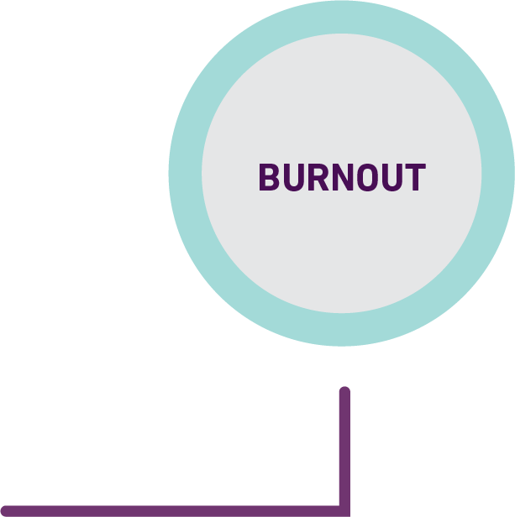
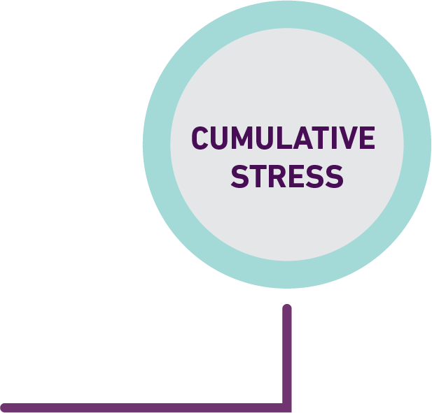
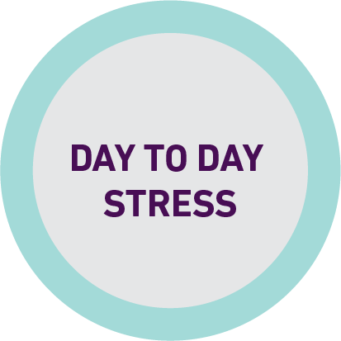
STRESS
An immediate, biological and psychological alarm-reaction, when confronted with something that might be a threat.
Caused by changes to our environment and we have to adapt and cope.
People react differently to stress, and people have different stress thresholds
Notes:
Stress is a normal and natural response designed to protect, maintain and enhance life. We may find stress to be a positive if how we manage stress is adaptive and healthy, and we have the feeling that we can control stressors. It motivates us to get up in the morning, accomplish tasks, and seek out the new projects and relationships which we enjoy.
Stress that we cannot manage or control well is experienced more negatively.

Slide 5

CUMULATIVE STRESS
It occurs when we suffer PROLONGED EXPOSURE TO A VARIETY OF STRESSORS.
Usually a combination of personal, work, and incident-specific factors.
When not recognized and managed, LEADS TO BURNOUT
Notes:
Cumulative stress is the result of prolonged, accumulated, unrelieved exposure to stressors. It is the ,ost common form of stress experienced by humanitarian workers. When not recognized and managed, cumulative stress leads to burnout.

Slide 6

CRITICAL INCIDENT STRESS
An event which has the effect of overwhelming a person’s usual coping ability.
Such events are usually sudden, violent, and unexpected.
They often present a threat to safety and well-being and are not part of the expectable routine life experience.
Notes:
Critical incident stress is caused by extraordinary events which provoke high level of stress. These events may be sudden and disruptive; it involves an actual or perceived threat or loss; it causes a sense of vulnerability; and it disrupts our sense of being in control and perception of world as safe and predictable.
While not everyone will experience the stress the same way, critical incident stress is commonly understood as a response to an event in which nearly everyone involved has a stress reaction.
When we think of “trauma,” we typically are thinking of events that would cause a critical stress reaction.

Slide 7
ACTIVITY -
SELF CARE FOR CARE PROVIDERS
Notes:
See Activity 11. Self care for care providers, Question 11.2: impacts of work - How do you find this work – supporting survivors of sexual violence and intimate partner violence – impacts your emotional well-being, mental health and relationships? What do you notice about yourself when you feel overwhelmed, exhausted, drained or burnt-out related to work?

Slide 8
BURNOUT
A response of our body and mind to prolonged occupational exposure to stress.
Specifically, burnout is a reaction to DEMANDING INTERPERSONAL SITUATIONS that produce psychological strain and provide inadequate support.
Notes:
Burnout is a type of cumulative stress reaction that occurs over time after prolonged exposure to occupational stressors. When we are regularly exposed to demanding situations with inadequate support, over time we may no longer have the resources to be able to deal with the stress. This can result in burnout.

Slide 9
SECONDARY TRAUMATIZATION
Repeated exposure to patients’ experiences of violence CAN AFFECT YOUR OWN HEALTH AND WELL-BEING
Strong REACTIONS OR EMOTIONS when listening to or talking with women about violence…especially if you have experienced it yourself
Can cause changes in thoughts, feelings, and behaviors that are similar to those of trauma survivors
Over time causes changes in your physical, psychological, emotional, and spiritual well-being.
Notes:
You may have strong reactions or emotions when listening to or talking about violence with women.
This is especially true if you have experienced violence yourself.
Health-care providers can develop stress- related conditions, such as burnout, compassion fatigue or vicarious trauma.

Slide 10
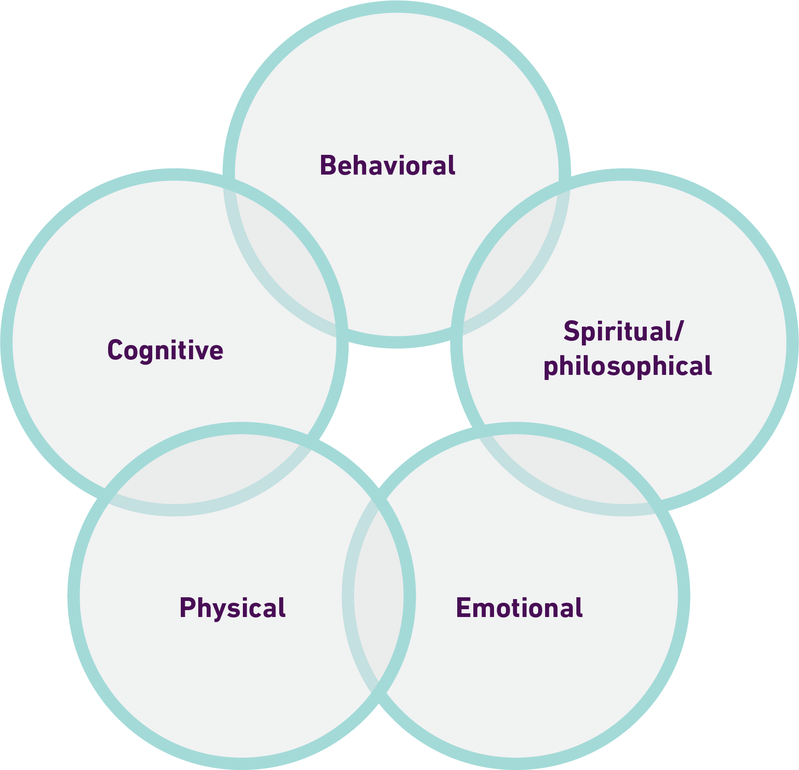
SIGNS OF SECONDARY TRAUMATIZATION
There are many different signs of stress, and they manifest in many different ways depending on the characteristic of the person and the stressor.
May be physical, cognitive, emotional, behavioral, or spiritual/philosophical.
May be immediate, or may be delayed.
Notes:
Examples:
Fatigue, guilt, powerlessness, despair, loss of compassion and empathy, cynicism, resentment, aggression, anger
Feeling overwhelmed, diminished sense of enjoyment, lack of time or energy for oneself, hypervigilance, sleep disturbances, nightmares
Intrusive thoughts of patients, families. nightmares, recurring images, or vivid mental replaying of client’s trauma.
Feeling very emotional during or after working with a survivor or having no expression of emotions, no matter what you experience (flat affect).
Taking your work “home” with you. Even when you are not at work, when you are home or with your own family, you are unable to stop thinking about work.
Negative impacts on personal lives • Social withdrawal or isolation from family and friends
Absenteeism or repeated, prolonged or unexplained sick leaves from work

Slide 11
ACTIVITY -
SELF CARE FOR CARE PROVIDERS
Notes:
See Activity 11: Self care for care providers, question 11.3: self-care What you can do to care for yourself? What do you do to take care of yourself, to care for yourself when you feel overwhelmed or burnt out?

Slide 12
SELF-CARE
Meet with others, call a friend, spend time with family
Wear a nice dress
Exercise, move, stretch, go for a walk, run, dance, swim, ride a bicycle, play a sport.
Meditate, be open to inspiration, pray, go to church, mosque or place of worship, read a religious or spiritual text.
Taking a bath or shower.
Do something to feel good about yourself. Put on your favourite clothes, paint your nails, put on lipstick, do your hair.
Watch sports, television shows or a favourite movie.
Get enough sleep
Have a cup of tea
Eat good, healthy, comforting foo
Play an instrument, make music, sing, listen to music.
Journal or write.
Paint, draw or do other creative activities.
Knit, crochet, sew, make something.
Get fresh air, open a window
Go outside, get sunlight, garden, embrace and enjoy nature.
Read a good book.
Notes:
Remind providers to practice self-care not only for themselves, but also as an example to their colleagues and patients.
If you are working with survivors, be aware of these risks and take action to maintain your well-being in the face of work-related stress.

Slide 13
SELF-CARE
A – AWARENESS – Be aware of your needs, limits, emotions and resources. Practice self-acceptance. Look for early signs of secondary stress, focus on self-care to prevent further problems. Develop the habit of “checking yourself.”
B – BALANCE – Maintain a healthy balance. Balance work, family life, rest and leisure. Remind yourself that you deserve to have a meaningful and enjoyable life outside of work.
C – CONNECTION – Maintain supportive relationships. Establish positive relationships with co-workers, friends and family for support and avoid isolation.
Notes:
Communication with others breaks the silence of unacknowledged pain. Connections can also increase feelings of hope.

Slide 14
ACTIVITY -
SELF CARE FOR CARE PROVIDERS
Notes:
See activity 11: Self care for care providers, question 11.4: workplace prevention and support
What your team can do together for mutual care and support? What your organization or supervisor can do to support your well-being? What can your supervisor, colleagues and workplace do to support you to prevent Secondary Traumatization? Or support you if you are experiencing secondary traumatization? These could be things that are already happening, or things you would like to see.

Slide 15
TEAM CARE & SUPPORT
Regular recreational and team support activities, rotating responsibility for planning activities.
Regular staff discussions on the impact of working with survivors, stress management, self-care and coping strategies
Create a workplace culture of teamwork, support, trust and safety to share
Provide opportunities for peer support
Notes:
On the level of team care and support, it is important to create and enforce time and space for staff to participate in recreational, relaxation or well-being activities. This time should be structured into work-plans so that they are considered part of the work, and supervisors should support their staff to participate, even (especially) when workloads are high. Team members can have rotating responsibility for planning simple activities.
You can also work with others in your team to gain support for, and hold yourself accountable to, your own self-care activities. In the previous activity you identified some techniques that you can use to support your own well-being. Outside of the training, you can choose to share those plans with someone on your team (a ‘well-being buddy’) that you trust, so that they can support you, check in with how you’re feeling and ask how you’re doing with your techniques. This is optional, but something that supervisors should encourage and support if staff choose to do
Routinely debriefing on challenging cases with trusted colleagues can be an important way to create a culture of safety and caring and to ensure that providers receive sufficient support after handling difficult cases. This process of debriefing can also improve the response
Part of self-care is building an institutional/workplace culture that supports providers who respond to women who experience violence.

Slide 16
TEAM CARE AND SUPPORT
Provide information about where to receive formal support
Encourage rotation of roles and responsibilities
Monitor and manage workload fairly
Provide clinical support and supervision

Slide 17

KEY MESSAGES
Health care providers may be at risk of burnout or secondary trauma
Health care providers should be aware of the potential signs of burnout and secondary trauma
Self-care is an important way to prevent or manage burnout or secondary trauma
Workplaces should support staff through staff care

