Slide 1

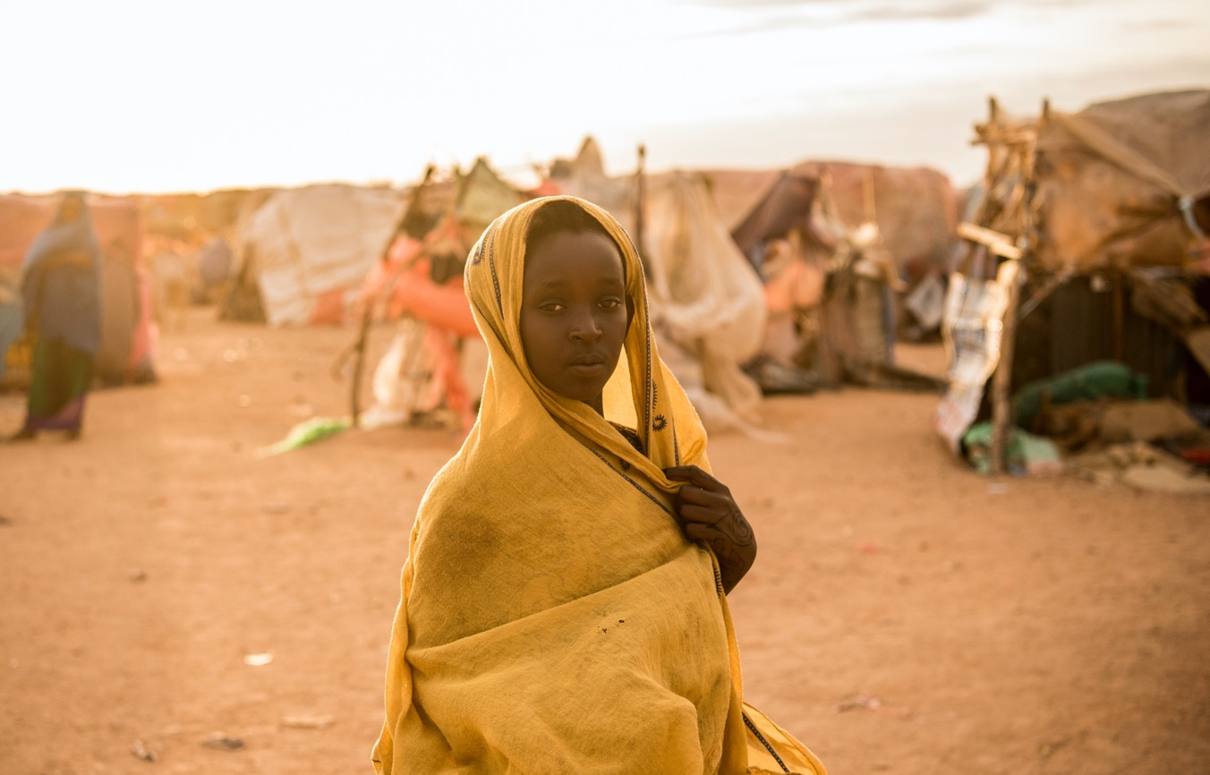

ENGAGE
MODULE 1: CORE TRAINING MODULE

Slide 2


Session 1: Introduction to the Training
2 HOURS
Notes:
Say a few words of welcome to all of the participants and introduce yourself.

Slide 3



LEARNING OBJECTIVES FOR SESSION 1
Introduction to the Training
Participants get to know each other and understand the objectives of the modular training approach
Participants are provided with a basic overview of the toolkit and activities
Participants will share expectations and agree on ground rules
Notes:
Show slide 3 and explain that each session of the training has specific learning objectives, which we will read together before each session begins.
Read the learning objectives of the session to the participants.

Slide 4



TOPIC 1.1
WELCOME AND INTRODUCTIONS
60 minutes
Notes:
Tell participants that they have 5 minutes to meet 5 people and note the answers to the following questions:
What is your name?
What is one fun fact about yourself?
What is your experience related to working in preventing and/or responding to CEFM?
After 5 minutes, announce that time is up. Explain that each person is to introduce one person that they met, and share their name and fun fact, until everyone has been introduced.

Slide 5
Overview of the 4 modules of training
MODULE 1
Core training modules including introduction to the training, staff reflection and transformation, Child, Early and Forced Marriage (CEFM), Adolescent, Sexual and Reproductive Health (ASRH), social norms, Theory of Change (ToC) and monitoring and evaluation
MODULE 2
Facilitation Skills including Do No Harm, staff and self-care, facilitation skills
MODULE 3
Implementation of the service delivery components, including case management, life skills for adolescent girls and boys, and focused care sessions
MODULE 4
Implementation of the community outreach components, including caregivers’ sessions, religious leaders’ and teachers’ workshops, and community dialogues and social norms change programme
Notes:
Show slide 5 and explain the overall organization of the training:
Tell participants that depending on their job description, they will follow different training paths. Staff focused on service delivery and community outreach will participate in the first two modules together, and then complete either module 3 or 4, depending on their role. The training will take 4 weeks in total however may be spread out over a period of time.
Distribute the training agenda and ask participants to review it and give an opportunity to ask any questions.

Slide 6
TOPIC 1.2
INTRODUCING THE TOOLKIT
30 minutes
Notes:
Show slide 6. Say that the ENGAGE toolkit is on the prevention, mitigation and response to child, early and forced marriages (CEFM) in humanitarian settings, focusing on settings impacted by conflict and displacement. The toolkit is twofold, a) changing norms through community outreach (prevention) and b) service delivery (response).

Slide 7


Toolkit Overview
The toolkit is on the prevention, mitigation and response to child, early and forced marriages (CEFM) in humanitarian settings.
The toolkit is twofold, a) changing norms through community outreach (prevention) and b) service delivery (response).
There are 3 parts which consists of:
PART 1
IMPLEMENTATION GUIDE
PART 2
CURRICULA
PART 3
TRAINING MATERIALS
Notes:
Show slide 7. Introduce ENGAGE to the participants by saying that there are 3 parts which consists of:
Part 1: Implementation Guide – a comprehensive manual used to guide managers and facilitators in the implementation of the program;
Part 2: Curricula – Service delivery and community outreach tools to be used by community outreach workers and facilitators
Part 3: Training materials – Facilitators guides, PowerPoint slides and participant’s workbooks used to conduct the essential training before staff begin the program
Refer to Annex 2: CEFM Program Structure and briefly read through it with the participants.
Say that the curricula are divided into two different components: Community Outreach and Service Provision Tools. The sessions are designed in a way which they can be adapted to the context and flexible while retaining the fidelity of the tool.

Slide 8




COMPONENT 1 Community Outreach
Objective: Prevent CEFM from happening in the future by changing the social norms that enable it to occur.
TEACHER’S WORKSHOP*
A full day or two half day workshop for teachers of adolescent girls and boys.
COMMUNITY DIALOGUES
32 sessions delivered bi-weekly over 16 weeks targeting opinion leaders and influential community members.
2
CAREGIVER’S SESSIONS
22 sessions delivered weekly or bi-weekly for male and female caregivers of adolescent girls aged 10-17 (unmarried and married)
1
RELIGIOUS LEADER’S WORKSHOP*
6 sessions delivered once every two weeks for 12 weeks.
Implementation phase
* Optional activities
Notes:
Explain that the main goal of the community outreach activities included in the toolkit is to prevent CEFM from happening in the future. The activities seek to achieve this goal by changing the social norms that enable CEFM to occur.
​
The community outreach component of the programme includes four activities delivered in two implementation phases​
​
In Implementation Phase 1, the caregiver’s sessions, religious leader’s workshops and teacher’s workshop activities can all be facilitated at the same time as with the service delivery activities in Component 1. ​
​
In Implementation Phase 2, community members and opinion leaders come together for a series of community dialogues, which concludes with the development and implementation of community-level social norm change action plans.
The community-level social norms change programme supports the following initiatives:
Religious leaders deliver messages about CEFM in sermons.
Religious leaders discuss CEFM with congregation members using conversation starters.
Community dialogue members create action plans and conduct campaigns.
Community dialogue members conduct advocacy to develop or change local and customary laws through participation in meetings with local authorities.
Community dialogue members identify and refer girls at risk of CEFM to the GBV team.

Slide 9


COMPONENT 2
Service Delivery
Objective: prevent, mitigate and respond to CEFM and minimise the harm caused to women and girls who have experienced it or are at risk of experiencing it.
LIFE SKILLS WORKSHOPS
Delivered to adolescent girls and boys (in separate groups)14 session delivered weekly or bi weekly
Delivered to small groups of adolescent girls who are betrothed, already married, widowed or divorced 7 sessions delivered over 7 weeks
REFERRAL PATHWAYS
FOCUSED CARE SESSIONS
CASE MANAGEMENT AND REFERRAL
Optional for participants who have complex needs and require additional support.
Notes:
Show slide 9 and explain that the main goal of the service delivery activities included in the toolkit is to prevent, mitigate and respond to CEFM and minimise the harm caused to women and girls who have experienced it or are at risk of experiencing it. The activities seek to achieve this goal through providing life skills training to build assets, create awareness and promote positive coping mechanisms. ​
​
Say that the life skills component consists of consists of three tools:
1. Adolescent boys life skills
2. Adolescent girls life skills for girls who are unmarried and at risk to early and forced marriage and girls who are at imminent risk / already married / divorced / widowed girls
3. Focused care for girls at imminent risk / already married / divorced / widowed girls
Explain that the service delivery activities are designed for adolescent girls and boys (life skills
workshops only) aged 10-19 years old. Participants will be grouped depending on the needs, age,
sex and marital status. Explain that in keeping with the ‘stepped care’ approach to service delivery,
the activities have been designed to complement/build on each other, therefore, adolescent girls
may participate in the life skills workshops and afterwards be referred to the focused care sessions.
Explain that the life skills workshops consists of 14 sessions (1 session per week over 14 weeks or
2 sessions per week over 7 weeks) for adolescent girls and boys, with adaptations according to
chronological and developmental age and marital status of adolescent girls.
The focused care sessions consists of 7 sessions for adolescent girls who are at imminent risk, already
married, widowed, and divorced. These sessions are designed to build their assets and develop positive
coping mechanisms for challenging situations. Participants should only be referred to participate through
case management services.
Explain that the life skills workshops and focused care sessions activities are delivered in cycles,
which means that a group of 9-12 participants begin and complete the activity together. Once
enough eligible participants have been identified, a new group begins the activities (and so on).
The life skills workshops and focused care sessions activities follows a ‘stepped care’ approach, whereby
the activities are delivered sequentially (starting with the life skills workshops, then followed by
focused care). Adolescent girls can attend one or both activities, depending on the level of support
required. The case management is delivered on an ongoing basis, as required for adolescent girls
who require individual support.

Slide 10
TOPIC 1.3
SETTING GROUND RULES
30 minutes
Notes:
Show slide 10. Explain to the group that as adults, the participants should develop and agree on their own ground rules for the workshop.
Ask participants to think about important factors for them to be able to participate to their full potential. This will ensure we create a safe and respectful environment where everyone can share and learn together

Slide 11

EXERCISE
SETTING GROUND RULES

Slide 12
EXERCISE
SETTING EXPECTATIONS

Slide 13
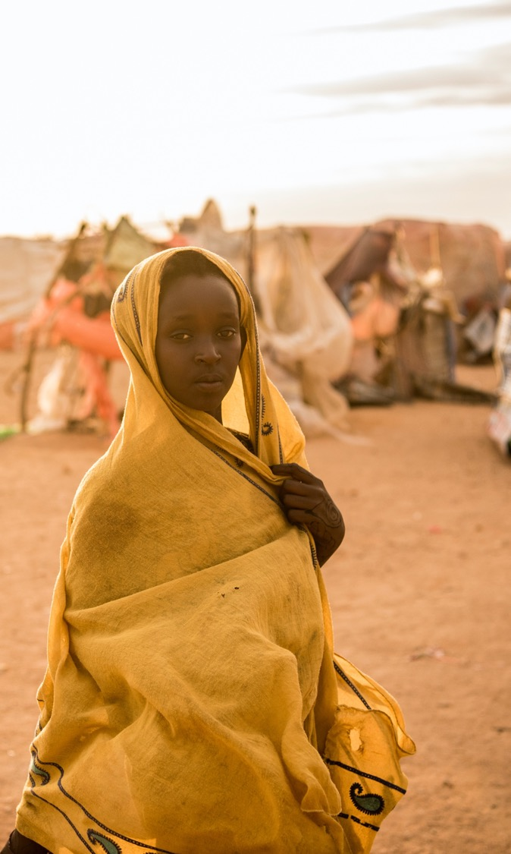

Session 2: Staff Reflection and Transformation
2 HOURS

Slide 14

LEARNING OBJECTIVES FOR SESSION 2
Staff Reflection and Transformation
Understand the concept of “attitudes” and “beliefs” and how they influence behavior
Practice using the Beliefs and Attitudes Reflection Tool to understand our own personal opinions related to CEFM

Slide 15

TOPIC 2.1
CEFM ATTITUDES AND BELIEFS
2 hours
Notes:
Show slide 14 and explain that personal attitudes and beliefs affect behaviour. It is important that we look at our own attitudes plus also understand beliefs and attitudes of community members.

Slide 16


DEFINITIONS
BELIEF
Idea accepted as true. May or may not be supported by facts. Beliefs may be based on or influenced by religion, education, culture or personal experience​
ATTITUDE
Opinion, feeling or position about people, events, and/or things. Formed as result of beliefs. Attitudes influence behavior
Notes:
Show slide 16 and present the definitions of “attitude” and “belief”:
Ask participants “what influences attitudes and beliefs and the way we work?” Have a brief discussion that beliefs and attitudes can change over time. For example, a child who was hit by their parents, might grow up thinking it is ok to hit their child, but then a sensitization may expose them to some of the negative impacts of corporal punishment that may change their beliefs in this regard and prevent them hitting their children in the future.
Put the “Agree” and a big “Disagree” flip charts on the floor/wall on different sides of the room. Ask participants to stand up and say that you are going to read through statements and they should then move to the appropriate flipchart, depending if they agree or disagree with the statement. State they are allowed to place themselves in-between the two extremes if they are “Unsure”

Slide 17



REFLECTION QUESTIONS
Is anyone surprised by their result?
Did anyone think they would have scored differently?
Does anyone wish to discuss a specific attitude or belief they have had which has changed over the years or even this training so far?

Slide 18
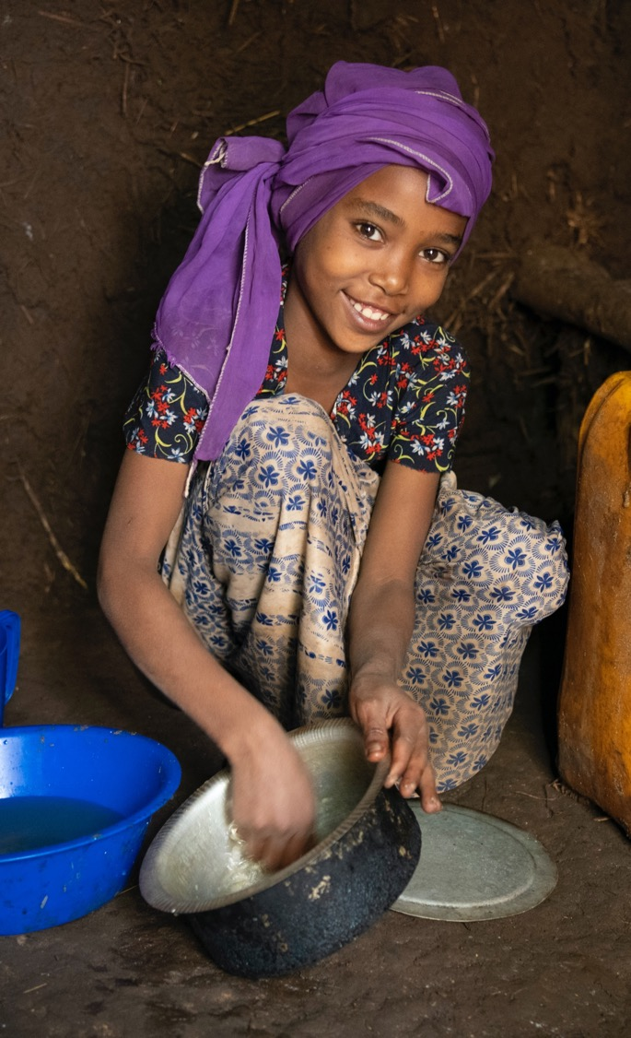

Session 3: Child, Early and Forced Marriage Basics
4 HOURS
Notes:
Show slide 18. Explain to the group that in this session we will be learning and defining what child, early and forced marriage is together.

Slide 19

LEARNING OBJECTIVES FOR SESSION 3
Child, Early and Forced Marriage
Understand the definition of CEFM
Understand why it is important to put adolescent girls at the centre of CEFM programmes
Understand the root causes of CEFM and how humanitarian situations exacerbate CEFM
Understand the negative impacts of CEFM and positive consequences of delaying marriage for girls, their families, and their communities
Analyse CEFM in the local context
Notes:
Show slide 19 and go through the learning objectives for the session.

Slide 20

TOPIC 3.1
WHAT IS CHILD, EARLY AND FORCED MARRIAGE?
60 minutes
Notes:
Show slide 20. Divide the participants into three groups by counting off. Ask group 1 to start at the flipchart with the heading “CEFM”, group 2 at the flipchart with the heading “early marriage” and group 3 at the flipchart with the heading “forced marriage”. Ask each group to brainstorm for 10 minutes at their flipchart what they think the definition and key characteristics are of each terms onto the flip. After five minutes, the groups should rotate and add to the work of the previous group. This time give them only 2 minutes. After 2 minutes, the groups will rotate again and have another 2 minutes to finalize the presentations.

Slide 21
CHILD MARRIAGE
A formal or informal union before the age of 18. It is considered a form of forced marriage as one of both persons have not given their full, free and informed consent due to lack of physical and psychological maturity to make informed adult decisions.
UNFPA, 2020, Child marriage - Frequently Asked Questions
Notes:
Show slides 21 - 23 and explain the definitions as well as the below key points:
There is a lot of overlap between the 3 terms.
The definition also includes informal unions, or marriages that are not legally registered.
All three are considered human rights violations and are violations of the UN Convention on the Rights of the Child.
CEFM disproportionately affects women and girls globally.
CEFM happens across cultures and religions.
Divide participants into groups of 4 and distribute the Convention on the Rights of the Child and give each group a flipchart paper. Ask the groups to identify which rights CEFM violates and list the right and the reason on the flipchart. Give them 15 minutes to complete the exercise

Slide 22
EARLY MARRIAGE
Is largely the same as child marriage, but can also sometimes refer to marriages or unions in which one or both spouses are 18 or older but have a compromised ability to grant consent. For example, the marriage of a 19-year-old who is not mature (physically or emotionally), and/or who does not have sufficient information about her choices.
UNFPA, 2020, Child marriage - Frequently Asked Questions

Slide 23
FORCED MARRIAGE
Forced marriages are marriages in which one and/or both parties have not personally expressed their full and free consent to the union, regardless of age
Forced marriage can also refer to a union in which one or both spouses are unable to end or leave the marriage
UNFPA, 2020, Child marriage - Frequently Asked Questions
Notes:
Divide participants into groups of 4 and refer to the Convention on the Rights of the Child (annex 4) and give each group a flipchart paper. Ask the groups to identify which rights CEFM violates and list the right and the reason on the flipchart. Give them 15 minutes to complete the exercise.
Bring the participants back together and ask each group to give one example until all of the rights that CEFM violates have been elaborated. Then refer participants to annex 5: How CEFM violates child rights.

Slide 24
TOPIC 3.2
WHY FOCUS ON ADOLESCENT GIRLS?
30 minutes
Notes:
Show slide 24 and introduce the next topic, “Why focus on adolescent girls”

Slide 25

The girl effect: the clock is ticking
Notes:
Show the video “The girl effect: the clock is ticking” on why it is important to invest in girls’ potential early on: https://www.youtube.com/watch?v=1e8xgF0JtVg
Ask the participants why they think this programme on child, early and forced marriage focuses on adolescent girls? Probe with follow up questions:
How is the situation of girls different from boys, men or women?
What are some of the issues that girls face, that most boys, men and women do not face?

Slide 26



Why focus on adolescent girls?
GIRL TURNS 12
DROP OUT OF SCHOOL
PHYSICAL HEALTH CONCERNS
ADOLESCENT PREGNANCY
SAFETY AND PROTECTION CONCERNS
POOR SOCIAL AND EMOTIONAL WELLBEING
BIRTH
Notes:
Show slide 26 and ask participants to visualize a 12 year old girl on the edge of a cliff. If not supported, she is at risk of CEFM, dropping out of school, pregnancy, and health and protection issues.

Slide 27


Assets that reduce risk, increase opportunities
GIRL TURNS 12
REPRODUCTIVE HEALTH
EDUCATION
PROTECTION & SUPPORT
ECONOMICS ASSETS
INSPIRATION
DROP OUT OF SCHOOL
PHYSICAL HEALTH CONCERNS
ADOLESCENT PREGNANCY
SAFETY AND PROTECTION CONCERNS
POOR SOCIAL AND EMOTIONAL WELLBEING
BIRTH
Notes:
Show slide 27 and explain to participants that a girl who is supported by her family and community through life skills education, staying in school, reproductive health information and services, will support girls to build their own assets and mitigate these vulnerabilities.
Ask participants why focusing on adolescent girls in humanitarian settings specifically is especially important. Write answers on flip chart, then show participants the prepared flip chart with the following points:
Girls are at heightened risk of GBV, unwanted pregnancy, HIV infection, maternal death, CEFM, trafficking in humanitarian settings.
They are often overlooked and excluded from humanitarian responses.
More than ever, they may have to take on adult responsibilities, and they may lose their access to education and services.
Their support networks may also be impacted, with caregivers losing their livelihoods, etc.

Slide 28
TOPIC 3.3
ROOT CAUSES OF CEFM AND CEFM IN HUMANITARIAN SETTINGS
60 minutes
Notes:
Show slide 28 and explain to participants that we are now going to discuss the root causes of CEFM.

Slide 29

GROUP WORK
Root causes of CEFM & contributing factors in humanitarian contexts
Notes:
Show slide 29 explaining the group work activity. Divide the participants into four groups and give them blue and green post-it notes and markers. Ask them to brainstorm together what they think are the root causes of CEFM and write one root cause on one post-it note colour (suggested colour: green). Ask them to write on a different colour (suggested colour: blue) reasons that think humanitarian settings exacerbate or increase CEFM. Give the group 15 minutes.

Slide 30
GENDER INEQUALITY
Girls are not valued as much as boys and are often seen as an extra burden on their family
Patriarchal values
Control over female sexuality
Notes:
Show slide 30 and explain the following key points about gender inequality:
In many communities where CEFM is practised, girls are not valued as much
as boys and are often seen as an extra burden on their family. Marrying off a daughter
at a young age can be seen as a way to reduce worries of families with little income, by
transferring this “burden” to her husband’s family.
CEFM is also very closely linked to male values (called patriarchal values or
beliefs) that dominate many societies, and control over female sexuality. For example,
this includes control over how a girl should behave, how she should dress, who she
should be allowed to see, and who she marries – usually by her father, or males in the
family or community.

Slide 31
CULTURE AND TRADITION
Considered to be a part of tradition or culture, or sometimes religion
Ready for marriage at menstruation
Rite of passage to womanhood, linked to other traditional practices such as FGM
Tradition and culture can change and can be changed, over time
Notes:
In many communities CEFM is a tradition, considered to be a part of tradition or culture, or sometimes religion, and one that has continued for generations.
In some communities for instance, when a girl starts to menstruate she becomes a woman in the eyes of the community. Marriage is seen as the next step towards giving her status as a wife and mother, regardless of her age.
Other traditional practices are often linked, particularly harmful practices against girls, such as female genital mutilation or cutting (FGM/C). This is considered a rite of passage to womanhood and to ensure the girl is seen as “clean”.
Although the practice of CEFM is rooted in tradition and culture, these are man-made practices that can be changed and updated. So, there is hope for ensuring change and putting an end to these harmful, damaging practices on girls.

Slide 32
POVERTY*
Allows parents to decrease family expenses as they have one less person to feed, clothe and educate
Where there is dowry or “bride price”, can be a source of income for poor families
Notes:
In communities with high levels of poverty, families (at times even the girls themselves) believe that marrying early will be a solution to secure their future. It allows parents to decrease family expenses as they have one less person to feed, clothe and educate.
In communities where a dowry or “bride price” is paid, it is often a welcome source of income for poor families. In those where the bride’s family pay the groom a dowry, they often have to pay less money if the bride is young and uneducated, so families to do this to keep down the costs.
Economics has a strong impact on attitudes to practices of CEFM because girls are seen as economic dependents, not income generators. But CEFM continues the poverty cycle, as girls who marry young will not be properly educated or take part in the workforce.
When faced with acute and extreme poverty exacerbated by conflict, many families are placed under immense pressure to decide on the best allocation of resources to ensure their family’s survival. Faced with economic uncertainty, and often with additional relatives to care for, some families see CEFM as their only option to generate income (e.g. through the payment of a dowry or bride price) or to reduce the financial burden on the family.

Slide 33
INSECURITY AND VIOLENCE*
Where there is war and conflict, girls are at high risk of harassment and physical or sexual assault; parents see this as a way to protect their girls
The reality is that child brides face much higher risks of violence, and have less power to exercise their rights, particularly with their partners
Notes:
In countries suffering from war and conflict, girls are at high risk of harassment and physical or sexual assault. In unsafe regions, parents often genuinely believe that marrying their daughters early is in their best interest to protect them from danger. In some countries, CEFM is used as a strategy in war to humiliate the enemy, weaken families and break down communities.
The reality is that child brides face much higher risks of violence, and have less power to exercise their rights, particularly with their partners.

Slide 34
WEAK GOVERNMENT SYSTEMS
Laws are subject to different or unequal interpretations and exceptions
In many countries the minimum age for marriage is lower under customary or religious law, which contradicts national laws and international conventions.
Many countries lack legislation, or the means to enforce laws
Notes:
CEFM is illegal in many countries around the world. But the law can be altered in many ways and contexts, for example if it includes exceptions, such as through parental consent as legal guardians. Laws are subject to different or unequal interpretations.
In many countries the minimum age for marriage is lower under customary or religious law, which contradicts national laws and international conventions. Many countries also lack legislation, or the means to enforce laws, and have weak governance structures – so laws are important but are not enough by themselves.

Slide 35
LIMITED EDUCATION AND ECONOMIC OPPORTUNITIES*
Educating girls is less of a priority than educating boys
When a woman’s most important role is considered to be that of a wife, mother and homemaker, schooling girls and preparing them for working life is not considered important
Lack access to nearby quality schools and money to cover the costs
For most families, conflicts and disasters severely restrict their social, economic, and educational opportunities
Notes:
Attending school and having higher levels of education helps protect girls from the possibility of CEFM and empower them about their rights. In many countries, educating girls is less of a priority than educating boys.
When a woman’s most important role is considered to be that of a wife, mother and homemaker, schooling girls and preparing them for working life is not considered important. Even families who want to send their daughters to school often lack access to nearby quality schools and money to cover the costs. It is often seen to be safer and economically more rewarding to spend limited resources on educating boys, over girls.
For most families, conflicts and disasters severely restrict their social, economic, and educational opportunities. Some girls and families may see marriage as an opportunity to improve their situation.

Slide 36
LACK OF AWARENESS
Child marriage also is a result of lack of awareness among parents, communities and the children themselves on national laws and on the rights of children and women
Many do not know about international human rights or conventions – or how to make sure their rights are protected
Notes:
CEFM also is a result of lack of awareness among parents, communities and the children themselves on national laws and on the rights of children and women. Many do not know about international human rights or conventions – or how to make sure their rights are protected.

Slide 37
TOPIC 3.4
CONSEQUENCES OF CEFM
45 minutes
Notes:
Show slide 37 and explain to participants we will now discuss the consequences of CEFM.

Slide 38
EXERCISE
TWO PATHS
Divide into four groups and draw a picture of a girl who got married at age 14, and a picture of a woman who married at age 23
Write down on post-it notes all of the positive and negative consequences for the girl and the woman in the 2 drawings, considering her education, health, economic situation, mental wellbeing, social networks, etc
For any negative consequence use a yellow post-it and for any positive consequence or outcome use a pink post-it note
Notes:
Divide participants into four small groups, and show slide 38. Ask each group to do the following:
draw a picture of a girl who got married at age 14, and a picture of a woman who married at age 23.
write down on post-it notes all of the positive and negative consequences for the girl and the woman in the 2 drawings, considering her education, health, economic situation, mental wellbeing, social networks, etc.
For any negative consequence use a yellow post-it and for any positive consequence or outcome use a pink post-it note.
After 20 minutes, bring the groups back together and ask each group to share the key differences between the two drawings and show the prepared flip chart with Benefits of Delaying Marriage until after 18:
Economic benefits: Less dowry, cost of treatment, girl can economically contribute if educated and earning income
Physical health: No harm from early pregnancies and potential reduced risk of physical abuse
Emotional wellbeing: Feels mentally prepared for both marriage and motherhood, better connections with support networks. Happiness contributes to good health, less disease and less expenditure
Aspirations fulfilment: Greater chance of finishing school and achieving personal goals
Managerial and leadership capacities developed: Increased opportunity to develop important life skills
Contribution to family and society: Ability to contribute to the wellbeing of the family and society
Explain that CEFM has serious and harmful effects on girls, their families, and their communities. CEFM also violates girls’ rights. Ask participants to arrange the yellow negative consequences post-it notes on the branches of the tree from before, representing fruit. Give participants additional yellow post-it notes and ask them to also write down what some of the consequences of CEFM for families and communities are.
If not already mentioned, list the following consequences and refer participants to Annex 6: Information Sheet: Consequences of CEFM:
Education
Safety and protection
Economic wellbeing
Life
Health
Social and emotional well being
Close the session by reminding participants of the positive benefits of delaying marriage (rather than focusing only on the negative consequences). Explain that through our work with communities, we have opportunity to make significant positive change, so rather than just focusing on negative outcomes, always look for opportunities to improve adolescent girls lives.

Slide 39
TOPIC 3.5
CEFM IN MY CONTEXT
30 minutes
Notes:
Show slide 39 and explain to participants that in this session we are going to analyse CEFM in our own context. This will help us identify some of the key issues that influence CEFM as well as how we can adapt our programme to better address CEFM.
Ask participants if they are familiar with any national laws that protect girls from CEFM. Share any relevant policies and explain that we will look more closely at laws and regulations now as we complete the CEFM and Gender Analysis Worksheet.

Slide 40
EXERCISE
CONTEXT ANALYSIS
Laws, policies and regulations
Cultural practices and beliefs
Gender roles and responsibilities
Access to and control over resources
Patterns of power and decision making
Notes:
Show slide 40 and read through the 5 headings of the analysis tool:
1. Laws, policies and regulations
2. Cultural practices and beliefs
3. Gender roles and responsibilities
4. Access to and control over resources
5. Patterns of power and decision making
Divide everyone into small groups and refer group members to their workbook: CEFM and Gender Analysis Worksheet. Give them 20 minutes to go through and answer all of the questions under each of the 5 headings.
Bring the participants back to the large group and ask each group to present their answers for one of the headings, facilitating a ten minute discussion about what they know about CEFM in their community.
Ask the participants if there are questions that they did not know the answers to? Who could they ask or where could they go to find this information? Ask them to finish filling out the analysis as homework.

Slide 41
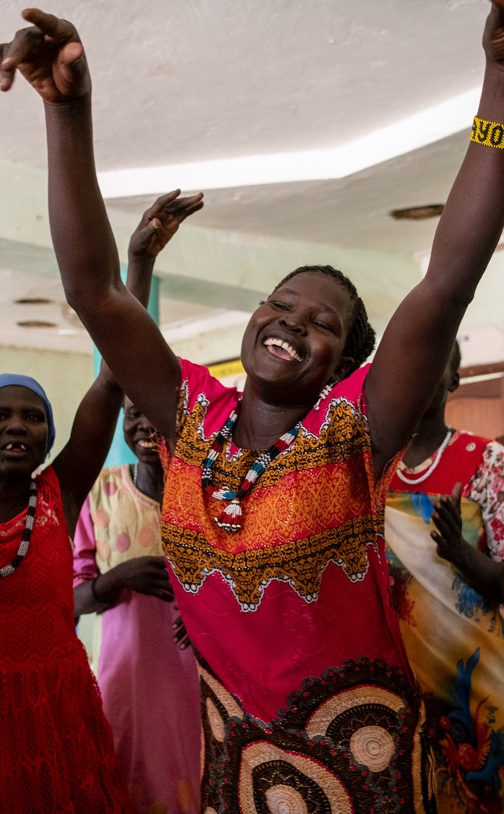


Session 4: Adolescent Sexual and Reproductive Health
2 HOURS
Notes:
Show slide 41 and explain to the group that this session is about the sexual and reproductive health and rights of adolescent girls.

Slide 42


LEARNING OBJECTIVES FOR SESSION 4
ASRH Basics
Understand the importance of providing girls with ASRH information
Examine our own beliefs, values, and attitudes related to ASRH and reflect if judgements are made that affect our work in communities
Notes:
Show slide 42 and explain the learning objectives for the session.
Ask the group if they know the difference between sexual health and rights and reproductive health and rights? Give each table post-it notes and ask individuals to write the first thing that they think of when they think of sexual rights and reproductive rights. After 5 minutes, ask the participants to stick their post-it notes on the corresponding flipchart paper hung at the front of the room. Ask for two volunteers to go through the answers and group them together and read them aloud to the participants.

Slide 43

TOPIC 4.1
ADOLESCENT SEXUAL AND REPRODUCTIVE HEALTH
90 minutes
Notes:
Show slide 37 and explain to participants we will now discuss the consequences of CEFM.

Slide 44


What is Adolescent Sexual and Reproductive Health (ASRH)?
Sexual and reproductive rights sometimes overlap
The principle of consent is central to sexual and reproductive rights. Access to information and services is also critical. Many of these rights are acknowledged in international agreements
Adolescent girls have the right to develop a positive sense of their own bodies and sexuality. They have the right to be free of abuse and inappropriate touching. As girls grow and develop their capacities, their rights and responsibilities continue to evolve
Young people have the right to obtain information to protect their health, including their sexual and reproductive health
Sexual Rights
Reproductive Rights
individuals’ control over their sexual activity and sexual health
Individuals’ control of decisions related to fertility and reproduction
Notes:
Show slide 44 and explain the key points related to ASRH.

Slide 45
Group 1
Sara is 12 years old, and she is very happy. Each day she goes to school. She loves learning math and helps her younger siblings. She has many friends at school and admires her teachers. When Sara grows up she wants to be a doctor. She has a very good relationship with her mother, they are very close and discuss everything. She adores her father and if she ever needs anything he always tries his best to make her happy.
Notes:
Ask participants to divide into four groups and given them each a scenario from Annex 8. Explain that the scenario they have been given is the story of a girl named Sara, who is living in a humanitarian setting. The story is in sequential order. Ask the groups to read the scenario they have been given and illustrate the story through drawing on flipchart paper. Give them 15 minutes to complete this activity.
Ask each group to present their drawings in sequential order (i.e. group 1, group 2 etc.). After all, four presentations are over, show slide 45 and ask the group the following questions:
What do you think is important in Sara’s life?
What makes Sara happy?
Explain to the participants that adolescence is a critical time in the life of a girl or a boy, where they transition from childhood to adulthood. Adolescent development is supported by the positive influence from adult role models, social norms, and community structures including peers, religion and culture.

Slide 46
Group 2
Sara’s family has told her that they must leave their home because there is danger coming and they must leave before it gets worse. Sara had no time to prepare, pack, or say goodbye to her friends. Sara was worried about what would happen next. She was uncertain of the future. After some time, Sara settled into her new routine. She was living in a camp, but she was not allowed to go to school because it was not considered to be safe. She was bored at home all day everyday with no friends and no education. She was also very tired, as she was now expected to do all of the chores in the house. The relationship with her family became tense. She no longer had long talks with her mother because her mother was always worried about the situation. She no longer saw her father as he was so busy trying to bring in money.
Notes:
Show slide 46 and based on what group 2 presented ask:
What is Sara experiencing?
How do you think she is feeling
Explain that in humanitarian settings, family and community structures are often disrupted and this can lead to challenges for adolescent development. Adolescents may become separated from their families, they may have their access to education disrupted, they may not be with their friends or communities. They may be bored or idle if school is disrupted or they may find themselves in risky situations or have to take on adult responsibilities due to the situation, without any positive adult support. Families may lose their livelihoods and the environment may be insecure or they may be exposed to violence.

Slide 47
Group 3
After some time, Sara gets her period. She does not know what this is. No one ever discussed this with her before. She was very scared. She did not know what was happening to her. She didn’t feel she was able to share this with anyone. Before, she could have told her mother, but nowadays her mother is distracted by many problems. But eventually, she does tell her mother. Her mother tells her that this means she is now a woman and soon she will get married, as this will help to protect her and also reduce the financial burden on the family.
Notes:
Show slide 47 and based on what group 3 presented ask:
What could have made this situation easier for Sara?
Is there information she could have received that would help her feel more prepared?
Is there information she could have received to help her negotiate with her family to delay marriage?
Explain to the participants that in crisis situations, adolescent girls (and sometimes boys) will often get married younger, will be sexually active younger than in non-crisis settings. Displacement, conflict, and natural disaster increases girls’ and women’s vulnerability to gender-based violence due to insecurity.

Slide 48
Group 4
Sara is married to a man some years older than her. Sara is now sexually active. She did not know anything about sex the first time it happened and this was a scary experience for her. She also got pregnant soon after she was married. Sara now has the responsibilities of managing a household and looking after a small baby. She did not receive any information about pregnancy or child birth. She was not sure how to look after her small baby.
Notes:
Show slide 47 and based on what group 4 presented ask:
What could have better prepared Sara to handle this situation?
What information could have been useful for her to have?
Where could she have received this information?
Explain that the disruption of family and community structures, and education and health services during emergencies may leave adolescents without access to sexual and reproductive services and information during a time when they are at heightened risk, making them vulnerable to unwanted pregnancy, unsafe abortion, STIs and HIV infection.
Ask participants, why is it important for girls to receive ASRH information, including girls who are not married or young adolescents? Let several people respond.
Explain that if girls do not have sexual and reproductive health information before they become sexually active, they will not know what to expect and this can be a traumatic experience. If they do not have information on pregnancy, family planning, STIs, etc. they will not be able to deal with these issues. Information after girls are married is too late. Information before they marry can be life-saving and it is important to give this information whenever possible. Adolescent girls have the right to receive this information and it is the facilitator’s role to help them secure their rights.

Slide 49
TOPIC 4.2
ASRH BELIEFS AND ATTITUDES
30 minutes
Notes:
Show slide 49 and explain to participants that we are now going to examine our own beliefs and attitudes related to ASRH, just like they did before with CEFM and gender equality.
Explain that our values form a fundamental part of our lives and, as such, they influence how we behave both personally and professionally. Explain that it is important to be aware of our values related to health and sexual and reproductive health matters and to avoid making value judgments that affect our professional work.

Slide 50
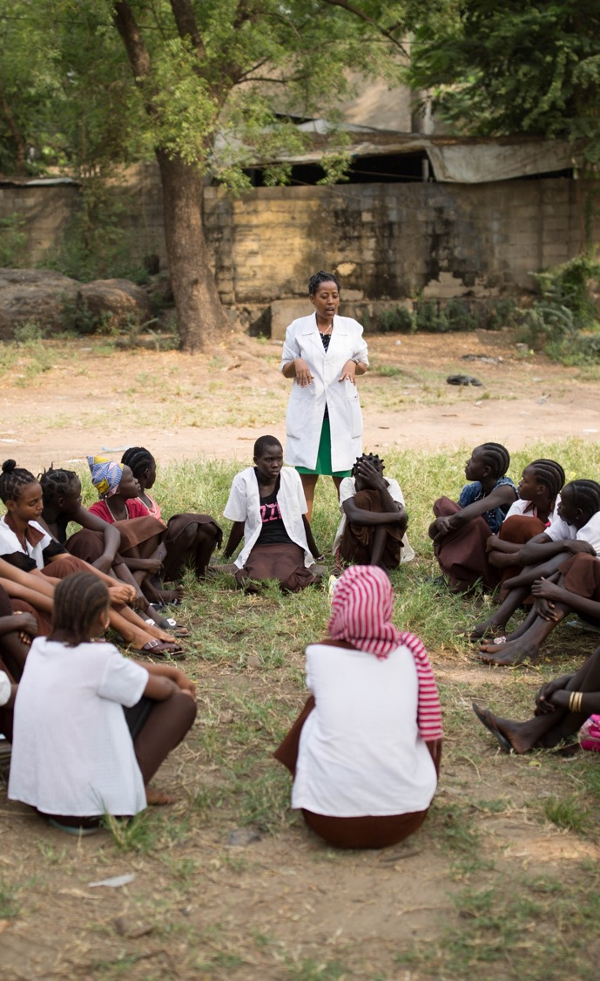

Session 5: Social and Legal Norms
2 HOURS
Notes:
Show slide 50 and introduce the session on Social and Legal Norms.

Slide 51

LEARNING OBJECTIVES FOR SESSION 5
Social and Legal Norms
Understand the different types of norms
Be able to analyse how to diagnose social norms related to CEFM
Understand how reference groups relate to social norms
Be able to explain how social norms can be changed
Notes:
Show slide 51 and introduce the learning objectives for the session.

Slide 52

TOPIC 5.1
SOCIAL NORMS KEY CONCEPTS AND DEFINITIONS
30 minutes
Notes:
Show slide 52. Ask participants to name some of the rules we live by in the community.

Slide 53


TYPES OF NORMS
LEGAL NORMS
MORAL NORMS
SOCIAL NORMS
Notes:
Show slide 53 and explain that there are different kinds of rules, often called norms. Legal norms, moral norms, social norms and religious norms are different sets of rules that say how we should behave in groups. When legal, moral and social norms are in harmony, they have the strongest influence on people’s behaviour.
Explain that legal norms are put in place by a formal authority and are written. Ask the participants if they know of any legal norms related to CEFM in their context?
Explain that moral norms are personal rules that guide how we behave, based on inner beliefs about what is right and wrong. What other people think does not affect a person’s moral beliefs.
Explain that social norms are informal unwritten rules that guide how we behave in groups. We will discuss this further later in the session
Explain that the difference between religious norms and the other types is that religious norms come from a divine authority, but religious norms can also work like legal, moral or social norms.

Slide 54

SILENT BRAINSTORM
Write one idea per post-it note:
WHY DO PEOPLE FOLLOW RULES?
Notes:
Show 54 and ask participants to silently brainstorm reasons why people follow these rules and write one idea per post-it note. After 5 minutes, ask participants to come up to the front of the room and stick them on the wall, working together to group similar answers together in one space.

Slide 55
Why do people follow rules?
Because society expects them to
In order to make progress, learn, solve problems, achieve goals to become better people (increasing the value in oneself)
Self fulfillment; fun; peace (but everyone isn’t the same in where they find these)
To defy and challenge social norms
To fulfill their responsibilities
As a spontaneous act
Because everyone does what they see with their own eyes
Because it interests them; or they have an interest
Because they believe in what they’re doing
Because they were raised that way
To survive!
Because they are scared of the police
Notes:
Show slide 55 with some common responses of why people follow rules.

Slide 56
Basic concept of social norms
When people are deciding how to act, what other people think and do matters!
So why do people do what they do?
It depends on:
- What we believe others WILL DO: EMPIRICAL EXPECTATIONS
- What we believe others EXPECT US TO DO: NORMATIVE EXPECTATIONS
SOCIAL NORMS are the collective rules that people follow because they believe others follow it (empirical expectation) and that others think it should be followed (normative expectation).
If the practice is only conditional on empirical expectations, this is called a DESCRIPTIVE NORM.
Notes:
Show slide 56 and explain that a big part of the reason people do what they do is because what others think and do matters very much to us. Individuals prefer to conform to social norms, or unwritten rules on the condition that they believe two things: 1) Most people in their peer group conform to it (they see it) 2) Most people that they think matters to their choices (family, friends, social networks) believe they should conform to it . An example of this is shoes. In some communities, there is an unwritten rule that people must take their shoes off before walking into someone’s house. This is a social norm because: 1) individuals believe that most people do this when they go into a house and see the pile of shoes at the door 2) individuals believe that people think they should do this (so the floor is not dirtied).

Slide 57
Social norms related to child marriage
Families may want their daughter to get married young because there is an expectation by others that girls should be virgins when they marry. Families may fear that as their daughter gets older, she may willingly seek out relationships with men, or that she may experience rape or sexual assault, compromising her virginity and bringing shame on the family.
In families cannot afford to educate all their children, there may be an expectation that they will prioritise their sons’ education. Prioritising their daughter’s education may not seem worthwhile if there is an expectation that women will stay at home to raise their children instead of entering the workforce.

Slide 58
Social norms related to child marriage
The expectation that families will receive or demand a bride price/dowry for their daughter’s marriage is a powerful driver of CEFM, especially when the expected amount in higher when the bride is younger.
Girls may claim that they want to get married young, because if women are not married by a certain age they may be stigmatised as being ugly or undesirable.
Girls may agree to get married to the person of their family’s choosing, even if they do not want to, because there is an expectation that girls will always obey their parents and not participate in decision-making.

Slide 59
Descriptive Norm vs Social Norm
 | DEFINITION | EXAMPLE 1 | EXAMPLE 2
DESCRIPTIVE NORM | A rule that people follow because they believe that others follow it (empirical expectation) | Fathers marry off their daughters young because they believe other fathers also marry off their daughters young. | All my neighbors marry their daughters as soon as they reach puberty.
SOCIAL NORM | A rule that people follow because they believe others follow it (empirical expectation) and that others think it should be followed (normative expectation) | Fathers marry off their daughters young because they believe other fathers also marry off their daughters young, and moreover, they believe other fathers think that girls should marry young (because girls should be pure and chaste). | I will marry my daughter as soon as she reaches puberty because all my neighbors do this and they think that one should do this.

Slide 60
Group Work
Identify shared beliefs or expectations in the community where you work that support child marriage. (for example, girls need to be pure and chaste)
Think about the individual who is making a decision to marry a girl under 18 (for example a father).
Do people follow this belief regardless of what others think/do (independent) or does what others think matter in their decision?
Discuss whether the practice of child marriage is an empirical expectation only or a social norm (both empirical and normative expectation).
Notes:
Show slide 60 and ask the participants to get into five groups. Give the groups 15 minutes to answer the questions. Ask each group to present back their answers.

Slide 61
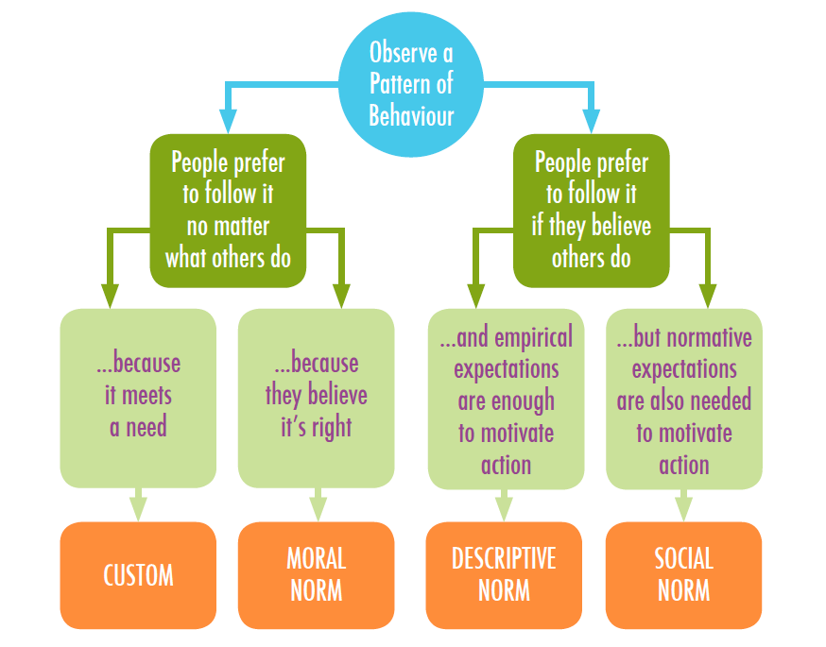
Notes:
Show slide 61, which is a diagram containing a flow chart on how to tell whether something is a social norm or not.
Adapted from Bicchieri, et. al (2014), ‘A Social Norms Perspective on Child Marriage: The General Framework,’ https://repository.upenn.edu/cgi/viewcontent.cgi?article=1012&context=pennsong, p. 12.

Slide 62
Is it a social norm?
Fathers who marry their daughters young because they are a financial burden.
Fathers marry their daughters because they are a financial burden and they believe sons have more value
Fathers who marry their daughters off because it has always been done that way.
Fathers believe that girls should get married at puberty.
RATIONAL RESPONSE: A rule that people follow because reason that it satisfies their preferences
MORAL NORM: A rule that people follow because they believe that it should be followed.
CUSTOM: A rule that people follow blindly but would abandon if it were in their own self-interest
MORAL NORM: A rule that people follow because they believe that it should be followed.
Notes:
Show slide 62 and ask the participants to explain whether each statement is a social norm and why or why not. Reveal the answers and definitions for each.

Slide 63
TOPIC 5.2
HOW ARE SOCIAL NORMS MAINTAINED AND HOW DO THEY CHANGE?
60 minutes
Notes:
Show slide 63 and introduce the topic, “How are social norms maintained and how do they change?
Explain to participants that any kind of rule is not useful unless it is enforced. Unlike legal norms, which are enforced through punishments such as a fine or prison, social norms are enforced through social punishments, known sanctions, and by social rewards (a concept that is not relevant to legal norms). These social rewards and sanctions are immensely powerful and ensure that people comply with and/or do not transgress (going against) social norms.
Tell participants that examples of a social reward include being included in a certain social group or being praised by someone important in the community, such as a religious leader. Social sanctions occur when someone experiences the disapproval of others. Examples include being the subject of others ‘gossip’, receiving threats or experiencing violence. Remind the group that sometimes social sanctions may not actually occur, however merely the fear of them occurring is enough to ensure that people comply with social norms.

Slide 64
Reference groups and opinion leaders
Not everyone’s behavior or opinion influences us when we make decisions. People in our REFERENCE GROUP, the group of people whose actions and opinions matter most to me when I make an interdependent decision, will have the most influence.
OPINION LEADERS are highly influential members of a reference group.
They may have formal roles in the community such as religious leaders or village chiefs but they can also be informal, such as gossips or admired community members.
Reference groups, including opinion leaders, are important because they play a role in maintaining norms and if their beliefs are changed, can also play a role in changing social norms.
Notes:
Show slide 64 and explain that social norms are also maintained by something called reference groups and opinion leaders. Explain the concepts.

Slide 65


GROUP ACTIVITY
30 minutes
Who are the key decision makers (in the family/extended family/community) in the process of negotiating a marriage of a girl under 18?
  Think about who is involved in the three steps of marriage negotiation:
What types of relationships are most influential on these key decision makers? Whose opinion of these relationships matters most?
Who are the opinion leaders on marriage in the community?
Use this information to draw a network between the different stakeholders.
INITIATION
NEGOTIATION
FINAL DECISION-MAKING
Notes:
Show slide 65 and explain the instructions for the group activity. Divide participants into 4 groups and give them 30 minutes to prepare the answers to the question and a map of different influential stakeholders who take part in CEFM decision making.
Ask the participants to come back to the larger group and give each group 3 minutes to present their mapping.

Slide 66






COMMUNITY LEADERS
GOVERNMENT OFFICIALS
COMMUNITY
gossip
influence
pressure
(not) enforce law
arrange
arrange
PARENTS
FAMILY/FRIENDS
bride price
dowry
PARENTS
obey
arrange
force
obey
force
GIRL
consent
GROOM
Notes:
Show slide 66 with the example of a mapping related to CEFM.
Explain that reference groups are also important in the process of changing social norms. The process of social norms change may be gradual over time, but sometimes especially in humanitarian settings, it can happen rapidly due to the fast changes that sometimes occur in the ways that families and communities reorganise themselves in humanitarian settings.

Slide 67
Social norms change
Find out if people disagree or agree with a norm.
If MOST PEOPLE PRIVATELY DISAGREE WITH A NORM, it’s easier to change it. Helping people talk openly and share their opinion can show others that many people also disagree with the norm and encourage them to do something about it together.
If MOST PEOPLE AGREE WITH A NORM, we need to get them to change their minds through providing information about the harmful effects and encouraging discussion, debate and dialogue about how things could be different, and about the benefits of change.
Notes:
Show slide 67
Explain that it is important to understand through baseline research if people privately disagree with a norm, then it is easier to change the norm by making them aware of the truth. If most people agree with a norm, it will be a more difficult process.

Slide 68

Social norms change
For behaviour of individuals in a reference group to change, it is necessary that:
Individual attitudes change
There are enough people ready to change
Those who are ready to change know that enough other people are ready to change
They change together
Notes:
Show slide 68 and explain that social norms change starts with changing individual attitudes within a reference group. At least some people must be ready to change and think that other people will also change, otherwise they will be afraid of sanctions.
Building consensus within the reference group through critical reflection and dialogue will be important to change.
Sometimes, it can be enough to change a smaller group of influential individuals such as opinion leaders who will act as role models and agents of change, spreading their influence on the wider population.
Our interventions will not reach everyone in the community, that is why it is important to select the participants carefully so that they can spread the change through their social networks.
Sometimes it is difficult for people to abandon norms, and it might be easier to replace them with a new, more positive norm.
Explain that in the session on Theory of Change, we will discuss in more detail how the programme components will lead to social norms change.

Slide 69

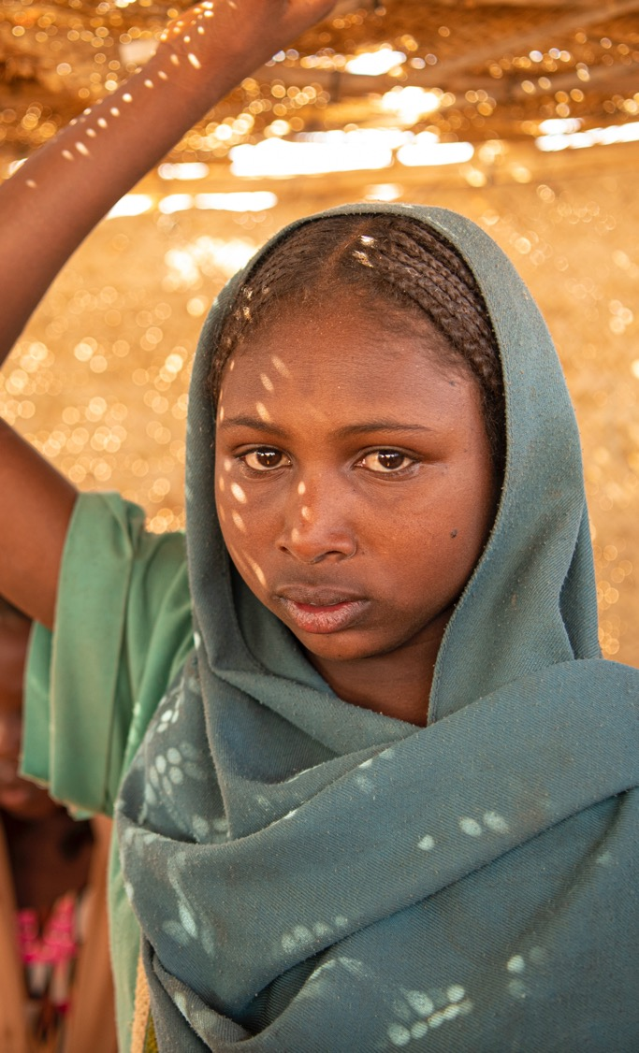
Session 6: ENGAGE Theory of Change
2 HOURS
Notes:
Show slide 69 and introduce the session on Theory of Change.

Slide 70

LEARNING OBJECTIVES FOR SESSION 6
ENGAGE Theory of Change
Understand the role of programme theory in the monitoring and evaluation process
Identify the key components and terminology in a Theory of Change
Review and validate the logic and assumptions underpinning the ENGAGE programme and and understand the relationship between the root cause, activities, outputs, outcomes and impact
Notes:
Show slide 70 and explain to participants that the objective of this session is to understand the role of programme theory in the monitoring and evaluation process, including identifying the key components and terminology in a Theory of Change (ToC) diagram. We will also look at how the activities that we conduct in the field will meet short term objectives, long term objectives and the overall desired impact.

Slide 71

TOPIC 6.1
WHAT IS THEORY OF CHANGE?
60 minutes
Notes:
Show slide 71 and explain that we will look at what is a Theory of Change.
Tell participants that in simple terms, a ToC is an explanation of how and why a given set of interventions will lead to a desired change.
Inform participants that a ToC is commonly expressed as a visual diagram but may also include some additional narrative (text) for explanatory purposes.
Explain to participants that the process of developing theories of how things work has been around for centuries (use the example of a scientist developing a hypothesis for a proposed experiment) but has only gained popularity in the aid and development sector in the past decade.
Tell participants that a ToC is a useful and practical tool to support programme monitoring and evaluation, especially where experimental methods (e.g. randomly controlled trials) are not practical.
Explain to participants that a ToC can be developed at many different levels, for example, for an activity, a project, a programme, a policy, an organisation or a ‘problem’ more broadly. They may be ‘high-level’ (broad with little detail) or detailed and specific.
Tell participants that most ToCs include the following three core components:
A brief analysis of the problem and its root causes and key drivers (problem analysis).
A causal pathway that describes the relationship between activities, outputs, outcomes and impact using an ‘if…then’ logic. It is common to see outcomes sequenced into 2-3 levels (e.g. short, medium and long-term outcomes).
A series of assumptions that have been made in developing the ToC, which must be true if the causal pathway is to function as described. Assumptions are often implicit (unspoken) and therefore unaddressed.
Tell participants that some ToCs include other information, including a description of the implementation context and how it may affect the outcomes. Remind the group that there is no right or wrong way of developing a ToC. What is most important is that it provides a useful and practical foundation for programme implementation, monitoring and evaluation.

Slide 72


Terminology commonly used in a ToC
CONTEXT
Things occurring externally to the project that may influence the outcomes
PROBLEM ANALYSIS
  A description of the problem and its context, including root causes and key drivers/influencing factors.
ACTIVITIES
  The specific activities to be implemented, which represent a logical response/solution to the stated problem.
OUTPUTS
  The tangible ‘products’ of the activities and the extent to which participants engaged with them (also referred to as ‘reach and reaction’).
OUTCOMES
  The endogenous changes resulting from the activities. Often sequenced into different levels (e.g. short, medium and long-term).
IMPACT
  The desire change that the programme seeks to contribute to (but can not achieve alone)
ASSUMPTIONS:
The implicit conditions that underpin the programme logic at different points (they must be true if the change is to occur as predicted). Assumptions are tested a validated through the process of implementation.
Notes:
Show participants slide 72, which defines some of the key terminology commonly used in a ToC:
Activities are the specific interventions that will be implemented to respond to the problem at hand (note: some ToCs do not include specific activities). They are 100% in control of the implementing organisation/team.
Outputs are the ‘product’ of the activities (i.e. a workshop, brochure etc.). Some people also like to include the extent to which participants engage with the outputs, including participation and reaction (satisfaction). Outputs are somewhat within the control of the implementing organisation/team and somewhat within the control of the participants.
Outcomes are the endogenous (internal) changes that occur within participants as a result of the activities/outputs. They can be sequenced into multiple levels (e.g. short term, medium term, long-term). Outcomes are almost entirely within the control of the participants (i.e. they depend on how they choose to make use of the new knowledge, skills, resources provided through the activity).
Impact describes the ultimate desired change that the programme team or implementing organisation seeks to achieve, in collaboration with others. The impact is something that the programme will contribute to but could not achieve alone. The impact is within the control of the participants acting within an enabling external environment.
Assumptions are the implicit conditions that underpin the programme logic at different points (i.e. they must be true if the change is to occur as predicted). Assumptions are tested and validated through the process of implementation.
Context describes the things happening in the external environment, which are beyond the control of the programme team but which may influence the outcomes.
Tell the group that the ToC (especially the outputs and outcomes) should follow the general principles of ‘SMART’ (specific, measurable, achievable, realistic and time-sequenced (i.e. they occur in a chronological order).

Slide 73
TOPIC 6.2
THEORY OF CHANGE FOR THE ENGAGE PROGRAMME
60 minutes
Notes:
Explain to participants that the objective of this session is to review and validate the logic and assumptions underpinning the NCA CEFM programme Theory of Change as they relate to the specific context in which the programme activities will be implemented.

Slide 74


GROUP ACTIVITY
20 minutes
CATEGORIES FOR ENGAGE TOC:
A problem analysis, consisting of root cause, key drivers and a problem statement
Three broad strategies and nine activities
Ten intermediate outcomes
Six long-term outcomes; and
Five impact statements
A
B
C
D
E

Slide 75
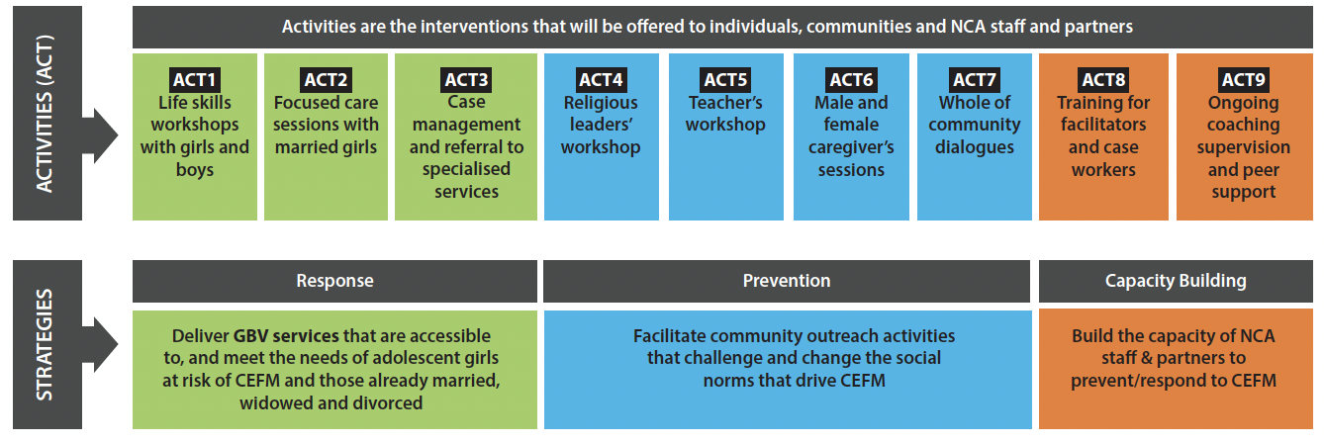
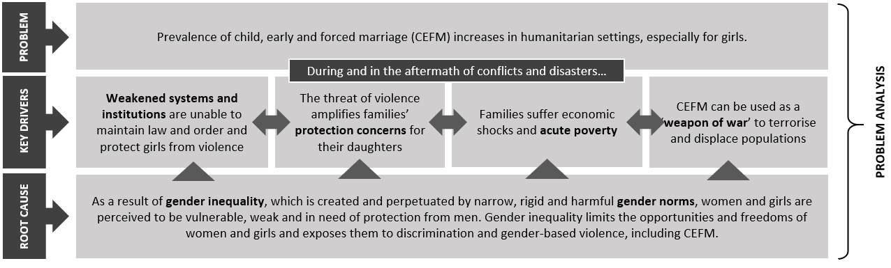
Theory of Change for the ENGAGE Programme
NOTE:
The ToC should be read from the bottom to the top!
Notes:
Show participants slide 75 which shows the problem analysis underpinning the programme, and the strategies and activities of the programme.
FACILITATOR SCRIPT
Explain that the programme’s Theory of Change explains the ‘logic’ behind the toolkit activities. In other words, how and why the activities will contribute to the desired change. The Theory of Change is generic, in other words, it is intended to be applicable across the different contexts. It is also an evolving document that may change as the programme learns more about which strategies are most effective in achieving the desired outcomes.
Explain that the Theory of Change begins with a problem analysis that summarises the intervention’s understanding of the problem at hand, its key drivers and root causes – shown in grey. The problem analysis is based on the findings from the literature review and consultations with key stakeholders.
Explain that underpinning the problem analysis is the understanding that gender inequality and harmful gender and social norms are the root cause of CEFM. In humanitarian settings (including during and in the aftermath of conflict and disasters) key drivers work to exacerbate gender inequality and harmful gender norms and increase the risk of CEFM, especially for girls.
Some of the key drivers included in the problem analysis may not be relevant in the community you are working in. For example, CEFM is used as a weapon of war in some conflicts, but this driver is not relevant in post-disaster humanitarian settings. There may also be other key drivers that are unique to your context that are not included in the problem analysis. It is important to note that the problem that the toolkit seeks to address (the increase of prevalence of CEFM in humanitarian settings) and its root causes (gender inequality and harmful gender norms) are fixed and therefore should not be changed.
The next two rows of the Theory of Change describe the strategies (broad approach) and activities (specific actions) chosen to address the problem. These are the activities included in the toolkit.
These strategies and activities have been chosen based on the available evidence, they represent a logical solution to the problem at hand. At the community-level, a dual strategy of prevention and response to CEFM will be adopted. This recognises that activities that seek to prevent gender-based violence (including CEFM) in the long-term may increase the needs for service provision in the short-term as awareness about CEFM increases and community acceptance decreases. A third, internal strategy of capacity building will ensure that programme staff and partners have the necessary knowledge, skills and support to implement an effective and sustainable programme.
The specific activities included under each strategy will be discussed in more detail throughout the training.
Explain to participants that the theory underpinning the dual strategy of prevention and response is evidence-based and should not be changed under normal circumstances, however the activities may be changed. For example, there may have been changes to problem analysis which have made the activities unnecessary, or the country office/implementing partner intends on omitting activities (for example, if there are insufficient resources or if another organisation is already implementing similar activities).

Slide 76
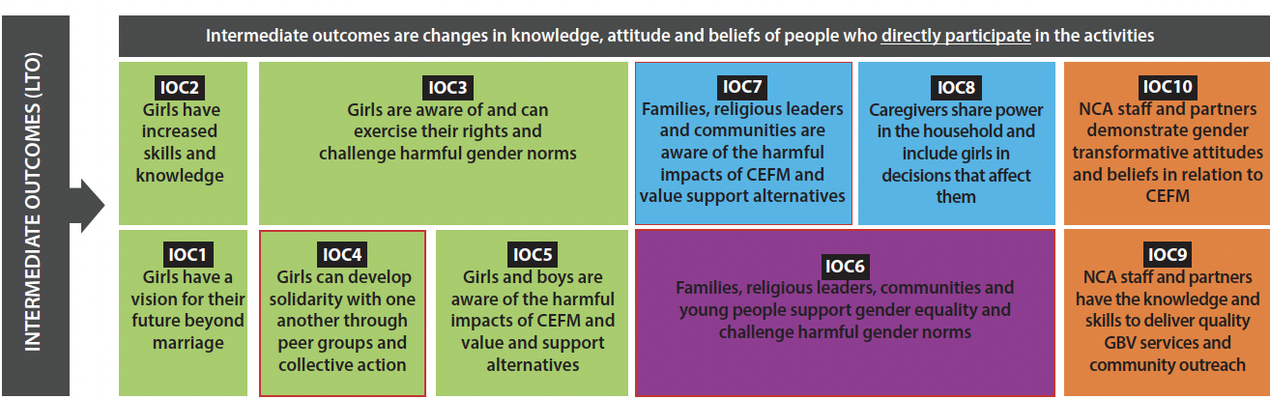
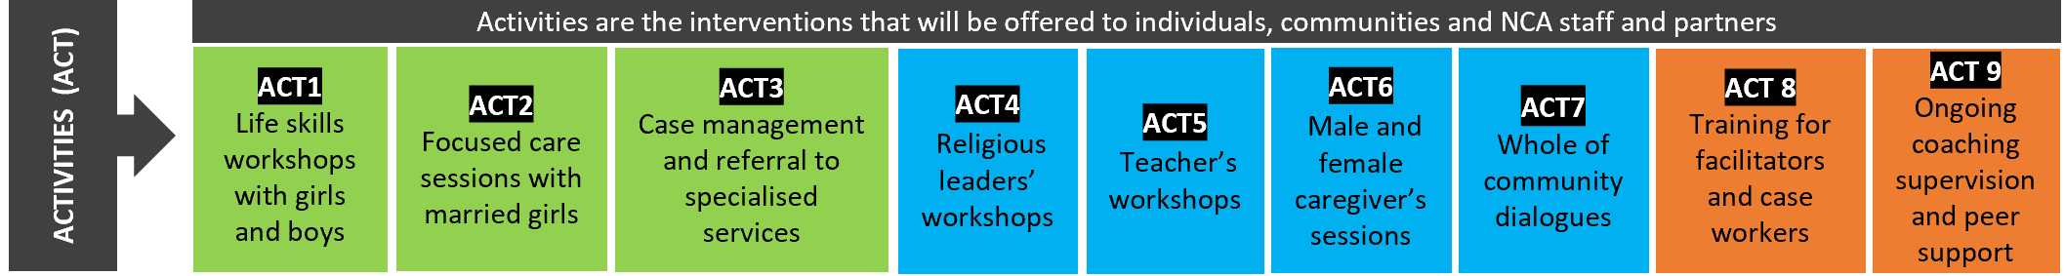
Theory of Change for the ENGAGE Programme
ACTIVITY>INTERMEDIATE OUTCOME ASSUMPTIONS:
Activities are delivered with fidelity (as intended)
COVID-19 does not present insurmountable challenges to the delivery of activities
People actively participate in activities
Activities are delivered in ‘safe spaces’ according to girls, their husbands and families
Activities meet the needs and contexts of adolescent girls and their families
Activities are appropriately adapted for the local context
Activities are delivered in ‘safe spaces’ according to girls, their husbands and families
Notes:
FACILITATOR SCRIPT
This slide shows the expected outcomes of the activities (activity row is repeated for reference)
Outcomes are defined as the changes that occur within individuals and institutions because of an intervention. They are distinct from the ‘products’ that result from an activity (e.g. a workshop or dialogue) and the extent to which participants engage with them (these are sometimes referred to as outputs).
Different colours (blue, green, orange) are used to indicate which outcomes are related to which strategy/activities (outcomes that are dependent on more than one strategy are shown in purple).
The outcomes follow an if = then logic — in other words, if the specified activity is delivered then it will result in the intermediate outcome. Subsequently, if the intermediate outcome is evident, then it will trigger the long-term outcomes.
The outcomes in the diagram are sequenced. In other words, the intermediate outcomes represent the necessary conditions required for the long-term outcomes to be achieved. The intermediate outcomes are expected to occur first. In this Theory of Change, the intermediate outcomes describe changes in behaviour and relationships of individuals and groups who participate directly in the activities (as opposed to the broader community).
The outcomes outlined in red are aligned with relevant results in the Girls Not Brides Theory of Change, demonstrating a shared vision for ending CEFM.
The expected intermediate outcomes of service delivery activities (green) are that girls will be more aware of their human rights and have increased life skills and knowledge. It is also expected that activity participants will increase their social networks with other adolescent girls (for those activities delivered in small groups), which is an important foundation for improved psychosocial wellbeing. Finally, it is expected that, as a result of the activities, girls will come to realise that there are options for their future beyond marriage.
The expected intermediate outcomes of community outreach activities (blue) describe the foundations for social norm change. This includes being more aware of the harmful impacts of CEFM and the alternative options for girls, and an increased willingness to challenge unequal gender norms. Additionally, it is expected that activities targeted at caregivers will result in them sharing power and decision-making with their daughters.
It is theorised that these intermediate outcomes will not be achieved unless the people delivering the activities (programme staff and partners) have the necessary knowledge, skills and attitudes to deliver interventions that transform harmful gender roles (orange).

Slide 77
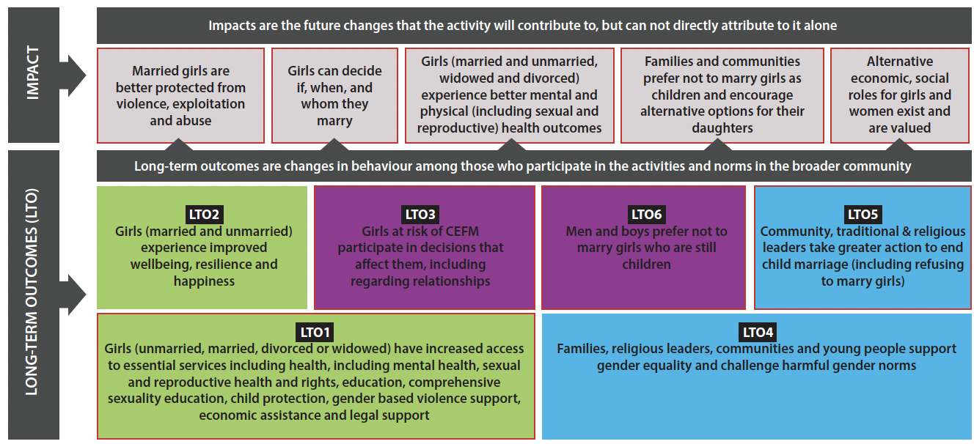
Theory of Change for the ENGAGE Programme
INTERMEDIATE>LONG-TERM OUTCOME ASSUMPTIONS:
Activities are informed by religious leaders, leverage religious concepts/scripts and ensure religious leaders do not lose status
Families are able to meet their basic economic needs
Service providers refer girls to health education and economic support services
Alternatives to CEFM are available to girls (e.g. education, employment)
Notes:
FACILITATOR SCRIPT
The long-term outcomes are expected to occur as a result of sustained implementation of the activities, but only if the intermediate outcomes are first achieved.
In this Theory of Change, the long-term outcomes describe the changes in behaviour of people who directly participate in the activities, as well as changes in norms (collective beliefs and attitudes) in the wider community that may occur through ‘diffusion’ (direct participants sharing ideas and information with the broader community).
The expected long-term outcomes of service delivery activities (green) are that girls will have increased access to support services, which in turn will result in improved wellbeing, resilience, and happiness. It is also expected that adolescent girls will participate more in decisions that affect them, which will occur as a result of activities delivered under both strategies (purple).
The expected long-term outcomes of community outreach activities (blue) are that there will be changes evident in the community’s perception of harmful social norms that drive CEFM. Additionally, it is expected that changes in awareness will compel leaders to take greater action to end CEFM. Eventually, it is hoped that changes in social norms occur to the extent that marrying girls is viewed as undesirable by men and boys.
In a Theory of Change, the impact statements describe the future changes that the combined toolkit activities will contribute to, alongside other interventions and external forces. Impact statements are important because they provide a shared goal and vision and keep stakeholders on-track and motivated to ensure high quality implementation over time.
Determining the extent to which changes at the impact level can be attributed to a particular activity or programme is difficult and requires rigorous techniques, therefore it is generally beyond the scope of programme-level monitoring and evaluation. Because measuring impact is generally beyond the scope of programme-level monitoring and evaluation, it is only necessary to change the impact statements if the omission of certain strategies and activities has made them irrelevant.

Slide 78


Session 7: How to Contextualise the Programme
2.5 HOURS
Notes:
Show slide 69 and introduce the session on Theory of Change.

Slide 79


LEARNING OBJECTIVES FOR SESSION 7
How to Contextualise the Programme
Understand the impact of crisis situations and the impact this may have on program participants
Understand the impact and behaviour characteristics of children at different chronological and developmental stages
Provide dynamic and concrete recommendations to adapt sessions based on cultural and context considerations

Slide 80

TOPIC 7.1
INTRODUCTION TO ADAPTATION
60 minutes
Notes:
Show slide 80 and inform participants that adaptation describes all the changes, inclusions, and omissions that facilitators make to the toolkit activities during the process of implementation.
Ask participants to think of a time when they had to facilitate an activity from a toolkit or instructions that had been developed by someone else but had to make changes at the last minute to make it work. What were the outcomes of the adaptation? Did it make it better or worse? Write answers on the flip chart headed ADAPTATION and discuss a selection of responses among the group.
Suggest the following examples of other things that a facilitator may change about an activity (if not already raised in the above discussion:
Extending or shortening the length of the activity (including the number of sessions and timing of each session)
Including, omitting, or changing certain key messages or activities
Using examples different to those provided (e.g. that are more contextually relevant)
Changes to the participants, including way participants are grouped
Changes to the time/date/location of the activity
Changing the way that words and phrases are translated
Ask participants if they can now suggest some reasons as to why a facilitator may need to change something about an activity. Write answers on the flip chart headed REASONS and suggest the following if not already mentioned:
The facilitator did not understand the instructions
The facilitator was unprepared
There was insufficient/too much time for the activity
The activity content might have offended the participants (i.e. it was inappropriate)
The activity did not interest participants (i.e. was too boring)
The resources required to facilitate the activity were not available
Some external event beyond the control of the facilitator interpreted the event (e.g. bad weather, political unrest etc.)
Ask participants if they have any other examples of why a facilitator may need to change something about an activity?
Ask participants whether they think adaptation a good thing or a bad thing? Why?
Explain to participants that when it comes to activity implementation, it is important to strike a balance between adaptation (reasonable changes made to the activity to make it fit in the local context) which is seen as a positive process and drift which is a misapplication of the programme model, often involving either technical error, abandonment of necessary or core components, or the introduction of counterproductive elements, which often results in poorer outcomes.
Inform participants that ‘drift’ occurs easily in field implementations, especially among organisations and practitioners that have not yet achieved full competency or integration of a new model and are not in consultation with model experts.

Slide 81


CORE COMPONENTS VS. ADAPTABLE ELEMENTS
CORE COMPONENTS
Phased implementation (community outreach)
Implementation in cycles (service delivery)
Stepped care approach (service delivery)
Disaggregation of participant groups
Number of sessions, except for those marked as optional
Sequencing (order) of sessions, unless options are provided
Main/key messages of the activity/session
Confidentiality/consent
ADAPTABLE ELEMENTS
Examples/case studies used to demonstrate key points/messages
Adaptations for age-appropriateness and contextual relevance
Notes:
Show participants slide 81. Tell participants that when considering adapting the programme activities, they should think about which parts of the activity are ‘core components’ vs. ‘adaptable elements’.
Explain to participants that the core components are the essential and indispensable elements of the activity that are required for it to be effective and the adaptable elements are the things that can be changed to make the activity more relevant and engaging without detracting from the intended outcomes.
Tell participants that the core components and adaptable elements often become evident through trial and error over time as the intervention is implemented and adapted for a variety of contexts. However, as a rule, this programme has some core components that should not be changed.
Inform participants that the elements of the programme that should not be adapted (the core components) are:
The number and timing of sessions (unless a session is marked optional)
The main/key messages of the activity/session
The gender and age segregated nature of the groups (where stipulated)
The phasing and sequencing of sessions (e.g. the implementation phases in the community outreach component and the ‘stepped care’ approach of the service delivery component
Tell participants that when adapting activities, they should also consider the programme Theory of Change and whether the adaptation is likely to affect the likelihood that the activity will achieve its intended outcomes. For example, if one of the outcomes of an activity is that girl’s will increase their social networks, and the facilitator decides to reduce the number of people in the group activity or the opportunity for dialogue among participants, then it might have a negative effect on the achievement of outcomes.
Remind the facilitators that the most important thing they can do is take note of the changes they make the toolkit activities and reflect on whether they are adaptations or ‘drift’. Tell participants that later in the training they will be learning how to do this using the implementation monitoring tools provided in the toolkit.

Slide 82
TOPIC 7.2
IMPACT OF CRISIS SITUATIONS
45 minutes

Slide 83





Impact of crisis situations
PHYSICAL
  Fatigue
  Aches and pains
  Excessive appetite or no appetite
  Excessive alertness
BEHAVIOURAL
  Socially withdrawn
  Avoiding places and disengaging in activities
  Loss of interest in activities
  Inactive or hyperactive
  EMOTIONAL
  Anger and anxiety
  Fear, detachment and sadness
  Guild or regret, overwhelmed
SOCIAL
  Change in friendship circles
  Financial and social pressures resulting in CEFM
  Increased safety and security risks

Slide 84
TOPIC 7.3
DEVELOPMENTAL CONSIDERATIONS
45 minutes
Notes:
Show slide 84 and introduce the topic.
Explain to participants that there are several factors to consider when facilitating sessions for caregivers and children. These include a child’s socio-emotional development and also the impact of external stressors on a child. Explain that children develop at different rates and their cognitive and socio-emotional development might not be the same as their chronological age. Various social constructs influence a child’s development.
Tell participants that each child is unique so even though they are the same age as their peers, they might have different socio-emotional and cognitive skills.

Slide 85
Adapting the content
Create 2, two-minute roles plays
One for adolescent girls 12-14 and one for girls 15-19
You can create your own activity, but MUST use the same topic below
Adapt the activity for the different age groups, considering their different developmental ages
The topic is:
"Introduction to the first session and welcoming the girls"

Slide 86
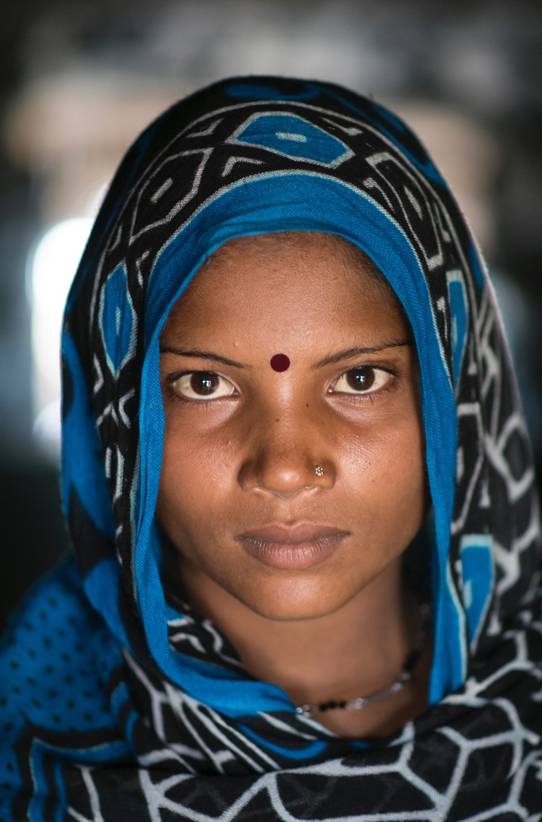

Session 8: Implementation Monitoring and Evaluation
60 MINUTES
Notes:
Show slide 69 and introduce the session on Theory of Change.

Slide 87

LEARNING OBJECTIVES FOR SESSION 8
Implementation Monitoring and Evaluation
Familiarise facilitators with the implementation monitoring tools included in the toolkit and how to administer them in their context
Notes:
Show slide 87 and explain the objective of this session is to understand and practice how to use the implementation monitoring tools included in the toolkit.

Slide 88

TOPIC 8.1
ADMINISTERING THE M&E TOOLS
60 minutes

Slide 89
PROGRAMME OUTCOMES | IMPLEMENTATION OUTCOMES
describes the changes evident in programme beneficiaries | describes how the activity was delivered
occur as a result of the activity (of the implementation) | how participants responded to the activity
sequenced in various stages, for example, short, medium and long-term outcomes, end of project outcomes, intermediate outcomes etc | largely in control of the facilitator and project team
external factors will also affect if these are achieved | will affect program outcomes
Notes:
Show slide 89 and ask whether anyone in the group can describe the difference between implementation outcomes and programme outcomes? After participants have suggested some ideas, show the points on the slide highlighting the differences and explain the following:
Explain to the group that programme outcomes, describe the changes evident in programme beneficiaries (including individuals, groups and institutions) that occur as a result of the activity, but do not describe the activity itself. These are often sequenced in various stages, for example, short, medium and long-term outcomes, end of project outcomes, intermediate outcomes etc.
Explain to the group that there are many things that affect whether programme outcomes are achieved. Many of these things are beyond the control of the facilitator and project team. For example, factors in the external social, political and economic context and the unique ways in which individuals interpret and use the things they have learned in the activity.
Inform the group that one thing that has a big impact on whether programme outcomes are achieved, and which is largely in control of the facilitator and project team, are implementation outcomes, which describe a) how the activity was delivered, and b) how participants responded to the activity.
Tell the group that the objective of monitoring implementation outcomes is to identify flaws in the implementation of activities and take action to correct them, with the ultimate goal of increasing the likelihood that programme outcomes will be achieved. This is quite different from the objective of monitoring programme outcomes, which is often to prove that the activity has been effective, which in this case is to change harmful social norms.

Slide 90











Berkel et. al.’s Integrated Model of Programme Implementation
FACILITATORS BEHAVIORS
PARTICIPANT BEHAVIORS
FIDELITY
QUALITY
RESPONSIBILITY
PROGRAM OUTCOMES
Interactive teaching methods
Clinical process skills
Attendance
Practice
Participation
Satisfaction
ADAPTATION
Notes:
Show slide 90 and explain to the group that today we will be talking about two distinct but related categories of implementation outcomes, those which describe facilitator behaviours and those that refer to participant behaviours.
Tell the group that the three main implementation outcomes relating to facilitator behaviour which influence the achievement of programme outcomes are:
a. Fidelity: The extent to which the activity was facilitated as intended by the people who designed it. This includes the extent to which all the key messages and activities were facilitated, and in the order or sequence shown.
b. Quality: The skill with which the activity was facilitated. It includes the facilitator’s knowledge of the subject matter (referred to as ‘clinical process skills’ in Berkel’s model) and presentation style (referred to as ‘interactive teaching methods’ in Berkel’s model).
c. Adaptation: Adaptation describes changes that are made to activity to ‘fit’ with the context you are working in (refer to Activity 5.1 on adaptation)
Tell the group that implementation outcomes relating to participant behaviour describe the responsiveness of participants to the activity – another useful way of remembering this is the ‘reach and reaction’ of the activity. When it comes to responsiveness, there are four main outcomes of interest:
a. Attendance: The level of participation in the activity by different segments of the community and the extent to which those who attended the activity were representative of all people who were eligible to or expected to attend (also called ‘reach’).
b. Active Participation: The extent to which participants were actively involved in the activity. For example, did they sit and listen quietly or ask/respond to questions and discuss the topic amongst each other?
c. Home Practice: The extent to which participants are likely to ‘practice’ what they have learned in the activity at home and in their lives in general. When monitoring implementation this information is usually gathered by asking participants if they tend to use the information they have learned in their lives, including sharing key messages with family and friends.
d. Satisfaction: Describes what participants thought of the activity, including the content and the facilitator.
Explain to the group that the toolkit includes five tools that can be used to monitor implementation of toolkit activities. These tools can be adapted for use in all activity (community outreach and service delivery), however when adapting the tools, they should always align the questions to the implementation outcomes described above.

Slide 91
1
facilitator/caseworker logbook: facilitators can provide feedback on the implementation of the activities to the project team, including informing them of which activities work well (or don’t). Used after each session and completed by facilitator
participant/client feedback form: participants can provide feedback on their level of satisfaction with the activity, which can help facilitators improve future implementation. Used after each session and completed by participants (with support from facilitator as required)
participant/client discussion guide: as above. Used through out program cycle to develop more in depth feedback. Ideally completed by MEAL colleagues
participant/client feedback 1-1 interview guide: gather more in-depth feedback from individual participants/clients in the weeks and months following the activity (including on the outcome of Home Practice, which cannot easily be measured immediately following the activity)
activity/session observation: enable an experienced independent observer (such as a senior member of the project team or a MEAL specialist)
2
3
4
5
Notes:
.Show slide 78 and refer participants to the implementation monitoring tools in their workbook. Explain that we will look over and practice each tool now including:
facilitator/caseworker logbook: facilitators can provide feedback on the implementation of the activities to the project team, including informing them of which activities work well (or don’t). Used after each session and completed by facilitator.
participant/client feedback form: participants can provide feedback on their level of satisfaction with the activity, which can help facilitators improve future implementation. Used after each session and completed by particpants (with support from facilitator as required)
participant/client discussion guide: as above. Used through out program cycle to develop more indepth feedback. Ideally completed by MEAL colleagues.
participant/client feedback 1-1 interview guide: gather more in-depth feedback from individual participants/clients in the weeks and months following the activity (including on the outcome of Home Practice, which cannot easily be measured immediately following the activity).
activity/session observation: enable an experienced independent observer (such as a senior member of the project team or a MEAL specialist).
Facilitators Note: The activity/session observation tool can also be used as a tool for coaching and supervision.
Ask participants to get into pairs and spend 15 minutes on each of the 5 tools, taking in turns to fill out the form. Remind participants to make note of any adaptations that are required to ensure the forms are suitable for their context and program. this needs to be revised

Slide 92
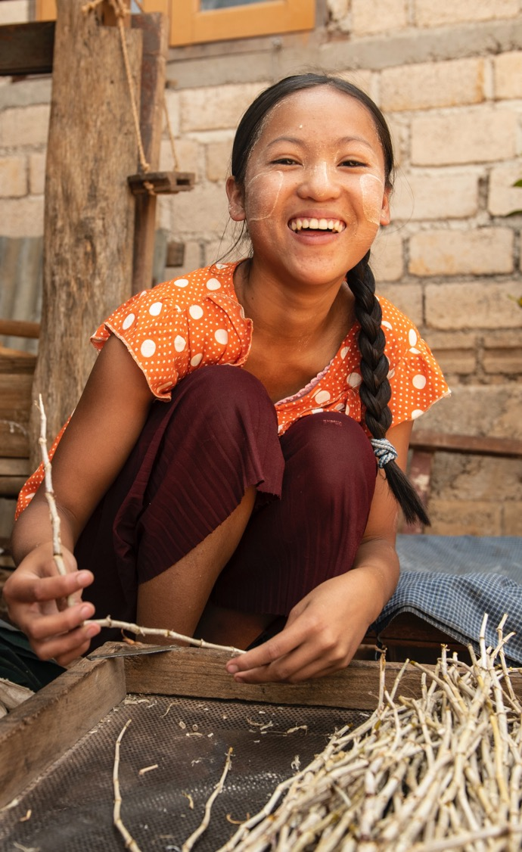

Session 9: Social Norms Monitoring
5 HOURS AND 15 MINUTES

Slide 93

LEARNING OBJECTIVES FOR SESSION 9
Social Norms Monitoring
Familiarise facilitators with the social norm’s measurement tools included in the toolkit and how to administer them in their context

Slide 94

TOPIC 9.1
INTRODUCING THE SOCIAL NORMS MONITORING TOOLS
15 minutes

Slide 95

TWO TOOLS TO MEASURE SOCIAL NORMS
The toolkit contains two tools that have been designed to measure changes in perceptions of social norms that may result from the community outreach activities:
A
Story-based group discussions (qualitative measure)
B
Rapid social norms survey (quantitative measure).
Notes:
About the tools
The toolkit contains two tools that have been designed to measure changes in perceptions of social norms that may result from the community outreach activities: story-based group discussions (qualitative measure) and a rapid social norms survey (quantitative measure).
This implementation guide provides advice on administering these tools and using the results to improve your programming.
The tools have been developed using the Social Norms Analysis Plot (SNAP), designed by CARE International,
You can use one or both these tools, depending on the resources that you have available. If you use both tools, you can compare the results to strengthen your claim that change has occurred.

Slide 96
TIMEFRAME
The timeframe for collecting data will differ depending on whether you are using the tools at the participant or community-level
When using the tools at the participant-level, baseline data should be collected after participants have been identified, but before the activity has started
End line data should be collected approximately 6-12 months after the entire activity has concluded (not immediately after the activity has concluded)
Notes:
Show slide 96 and say that we will now look at the suggested timeframe for facilitating both the social norms measurement tools.
Explain that the timeframe for collecting data will differ depending on whether you are using the tools at the participant or community-level. When using the tools at the participant-level, baseline data should be collected after participants have been identified, but before the activity has started. For example, you may like to collect baseline data as part of the first activity session.
When using the tools at the participant-level, end line data should be collected approximately 6-12 months after the entire activity has concluded (not immediately after the activity has concluded). This is because participants may need some time to internalise what they have learned before changes in perceptions of social norms become evident. When planning end line data collection, it is important to keep in mind that in humanitarian settings, people may be highly mobile, and it may be difficult to locate them after a long period of time.

Slide 97
Audience
Both tools can be used to measure changes in perceptions of social norms among two groups:
 | DIRECT PARTICIPANTS (PRIORITY): At a minimum, you should use these tools to measure changes in perceptions of social norms among the people who directly participate in your activities (e.g. people who attend sessions or workshops). Changes in perceptions of social norms are likely to occur among direct participants first, as they are the ones who are directly exposed to the activity.
 | BROADER COMMUNITY (OPTIONAL): You can also use these tools to measure changes in perceptions of social norms among a sample of the entire community. Measuring changes at the community level may help understand whether ‘norm diffusion’ is occurring from participants to the broader community. This approach is more time consuming and is only recommended as an option if the resources are available.
Notes:
Show slide 97 and explain that both tools can be used to measure changes in perceptions of social norms among two groups. Read the key points on the slide and ask if there are any questions.

Slide 98
TOPIC 9.2
ADMINISTERING THE STORY-BASED GROUP DISCUSSION TOOL
2.5 hours
Notes:
Show slide 98 and explain that the objective of this session is to understand how to implement and adapt the social norms measurement tools included in the toolkit. This session relates to the first tool, the story-based group discussions.
Explain that stories (sometimes called vignettes or scenarios) are a popular way of measuring changes in social norms for two main reasons:
Because social norms can be sensitive, asking people to consider a realistic but fictional story can elicit a more honest response than asking them questions about their own and others’ lives.
Because social norms are complex and nuanced, the discussion questions elicit qualitative data that is required to fully understand them in different contexts.

Slide 99
TOOL 1
STORY-BASED GROUP DISCUSSIONS
An open-ended story (sometimes called a vignette) is a qualitative evaluation tool that can be used to measure changes in perceptions of social norms over time
Researchers have found that when participants are asked to comment on a realistic but fictional scenario, rather than their own reality, they are more open and honest about their thoughts
The story-based discussion tool consists of five different stories, each told from the perspective of a different character
Each story has been designed to measure changes in a specific social norm that enables CEFM in most contexts
Notes:
Show slides 99 and 100 and read key points (You can ask participants to read the points if they feel comfortable and language skills allow)
An open-ended story (sometimes called a vignette) is a qualitative evaluation tool that can be used to measure changes in perceptions of social norms over time. Researchers have found that when participants are asked to comment on a realistic but fictional scenario, rather than their own reality, they are more open and honest about their thoughts.
The story-based discussion tool consists of five different stories, each told from the perspective of a different character. Each story has been designed to measure changes in a specific social norm that enables CEFM in most contexts:
The stories are followed by a series of group discussion questions, that explore what participants think about the stories. The discussion questions are structured according to the five components of a social norm outlined in the SNAP. Participant’s responses to the discussion questions provide the qualitative data that will be analysed as part of this tool.

Slide 100
TOOL 1
STORY-BASED GROUP DISCUSSIONS
The stories are followed by a series of group discussion questions, that explore what participants think about the stories
The discussion questions are structured according to the five components of a social norm
Participant’s responses to the discussion questions provide the qualitative data that will be analysed as part of this tool
Notes:
Show slide 100 and read points

Slide 101

5 Stories featuring a Social Norm Related to CEFM
Ahmed and Hanan’s story relates to the social norm that families will seek to protect their ‘HONOUR’, even if it places their daughter at risk of harm
Abdul’s story relates to the social norm that when faced with limited resources, families WILL PRIORITISE THEIR SONS’ EDUCATION over their daughters’
Imani’s story relates to the social norm that DAUGHTERS WILL AGREE WITH THEIR PARENT’S DECISIONS about marriage for the good of the family
Jameal’s story relates to the social norm that MEN PREFER TO MARRY A GIRL under the age of 18
Shaik Mohamed’s story relates to the norm that RELIGIOUS LEADERS will always agree to officiate the marriage of girls under the age of 18
1
2
3
4
5
Notes:
Show slide 101 and explain that these are the 5 stories which are used for the story base discussion tool.
Inform the group of the following characteristics of an effective story/vignette for the purposes of measuring social norm change.
Normative: The discussion questions should be structured in a way that explores social norms, not moral beliefs and attitudes.
Specific: Each story must be designed to explore one specific social norm relating to CEFM in the context you are working it (stories should not attempt to measure multiple social norms or changes in CEFM in general). The tools presented here are designed to test common social norms that drive CEFM across contexts, however further formative research may be required to determine the extent to which they are relevant to your context.
Realistic: The situation presented in the story must be relevant and recognisable in the context that you are working in, for example, the characters should be similar to people in programme communities so participants can relate to them.
Fictional: The story and characters should never be real or be able to be mistaken for real people in the community you are working in. The facilitator should inform participants at the beginning of the story that the characters are not real people.
Visual: If possible, stories should be accompanied by pictures to help the audience use their imagination. You may consider engaging a local artist to produce some pictures to accompany the stories in this toolkit.

Slide 102
7 STEPS- STORY-BASED GROUP DISCUSSIONS TOOL
STEP 1: Select and customise stories (if required)
STEP 2: Identify respondents
STEP 3: Convene discussion groups
STEP 4: Gain participant’s consent
STEP 5: Read and discuss the story
STEP 6: Take notes using the template
STEP 7: Analyse results
Notes:
Show slide 102 and explain the 7 steps that participants will follow to effectively implement the tool. Tell the group that the story-based group discussions can be used both with direct participants of the programme and the broader community. The approach used will be determined by the project team (in consultation with Technical Advisors), who will inform facilitators.
Facilitator’s Script
Step 1: Select and customise stories (if required)
This tool includes five separate stories, each designed to test a specific social norm relating to CEFM in most contexts. You can use all the stories to collect data, or only a few, depending on the resources you have available. If you do not have the resources to use all five stories, you should prioritise measuring the social norms that you think are most likely to change because of your activities. Remember, each story will take approximately 45-60 minutes to read and discuss, therefore it is only practical for each group to discuss one story with each group.
For community-level data collection this is not so problematic because you can form more groups, but for participant level data collection you are limited to the groups you have available, however I cannot see how you can use more than one story with the same group, because it will take too long and the quality of data is likely to be poor.
Step 2: Identify respondents
The story-based group discussions tool is administered to small groups of no more than 6-8 people. Discussion groups should be segregated by gender, age and any other relevant factors that may influence how social norms are perceived (e.g. religion, ethnicity). This will allow people to participate safely and share their opinions.
Step 3: Convene discussion groups
It is important to convene the group at a time and place that is convenient and safe for participants. Ideally, this will be a place they are familiar with and is not far from their home. The following gender considerations are important when convening discussion groups:
Is the location and the route to get there safe, especially for women and children?
Are women able to bring their young children, or have arrangements been made for childcare?
Is the group convened at a convenient time that takes into account women’s unpaid care work burdens?
Each discussion group should be facilitated by at least two people: one storyteller and one notetaker. Ideally, the gender of the facilitators should match the gender of the participants. Each discussion group will take approximately 45-60 minutes. If the session lasts less than 45 minutes, it may mean that the discussion was not in-depth enough and the resulting data will be less meaningful.
Step 4: Gain participant’s consent
Like any data collection that occurs for the purposes of research and evaluation, it is essential that you gain the informed consent of respondents before administering the tool. This includes explaining to the participants how the research will be conducted, presented and reported. Participants must be fully aware of any risks or potential discomfort that may arise during the research. It should also be made known that participation is voluntary and that the participants can withdraw from the discussion group at any time. Gaining informed consent for children generally requires more stringent standards of consent, therefore it is not recommended to include respondents under the age of 18. A basic script for gaining consent from participants (which can be adapted to your local context) is provided
Step 5: Read and discuss the story
Reading the story:
The role of the storyteller is to read the story in a way that is accurate and engages the audience. Each story is divided in two parts. The first part of the story introduces a relevant, hypothetical situation by describing the setting and the main characters. It goes on to describe an event which leads the main character in the story to a decision point about how to act.
Step 6: Take notes
The role of the notetaker is to make detailed summary notes of the discussion group, which can be used for analysis. The responses of the audience to the discussion questions will form the data that will be used to determine whether changes in social norms have occurred, therefore it is essential that the notetaker make clear (legible), detailed and confidential notes of what is being said in the discussion. If possible and with the consent of the participants, the discussions can also be recorded on an audio device to assist with note taking
Step 7: Analyse results
Transcripts or summary notes from the story-based discussions should be analysed to identify key themes. This can be done manually by underlining themes using different colour pens or highlighting passages of text using word processing software

Slide 103
TOPIC 9.3
ADMINISTERING THE RAPID SOCIAL NORMS SURVEY TOOL
2.5 hours
Notes:
Show slide 103 and explain that the objective of this topic is to understand how to implement and adapt the rapid social norms survey included in the toolkit.
Explain to the group that like the stories/vignettes they learned about earlier, surveys can also be a useful way of measuring changes in social norms. This is because surveys allow us to collect smaller amounts of data from a larger number of people.

Slide 104
TOOL 2
RAPID SOCIAL NORMS SURVEY
A survey is a quantitative evaluation tool that can be used to measure changes in perceptions of social norms over time
Surveys enable project teams to collect data from a larger number of people, although the depth of information collected is much less than qualitative tools
The rapid social norms survey includes 32 questions that are designed to measure empirical expectations and normative expectations

Slide 105
Characteristics of an effective survey for the purposes of measuring social norm change:
NORMATIVE: The survey questions should be structured in a way that explores social norms, not moral beliefs and attitudes. The questions included in this survey have been carefully constructed to explore empirical expectations and normative expectations relating to specific social norms that drive CEFM in most contexts.
RAPID: a good survey should be kept as short as possible.
CLEAR: Survey questions should be easy to translate and understand (it is a good idea to test survey questions with your community before the survey begins).
OPTIONAL: Respondents should have the opportunity to refuse to answer the question (or the entire survey) if they choose.
Notes:
Show slide 105 and Inform the group of the following characteristics of an effective survey for the purposes of measuring social norm change.
Normative: The survey questions should be structured in a way that explores social norms, not moral beliefs and attitudes. The questions included in this survey have been carefully constructed to explore empirical expectations and normative expectations relating to specific social norms that drive CEFM in most contexts.
Rapid: Most people are busy and do not want to spend a lot of time answering survey questions, so a good survey should be kept as short as possible.
Clear: Survey questions should be easy to translate and understand (it is a good idea to test survey questions with your community before the survey begins)
Optional: Respondents should have the opportunity to refuse to answer the question (or the entire survey) if they choose

Slide 106
THE SURVEY IS DIVIDED INTO THREE PARTS:
1
Demographic questions that collect basic information about the respondent and their circumstances
Questions relating to empirical expectations relating to CEFM (things that the respondent thinks other people in the community actually do)
Questions relating to normative expectations (things that the respondent thinks other people in the community expect them to do)
2
3
Notes:
The survey is divided into three parts:
Demographic questions that collect basic information about the respondent and their circumstances. The remaining survey results can be analysed according to this demographic information to identify trends in different segments of the community.
Questions relating to empirical expectations relating to CEFM (things that the respondent thinks other people in the community actually do). These questions ask the respondent to nominate what proportion of people within their reference group they think behave in a certain way.
Questions relating to normative expectations (things that the respondent thinks other people in the community expect them to do). These questions ask the respondent to nominate what proportion of people within their reference group would disapprove of someone behaving in a certain way.

