Slide 1

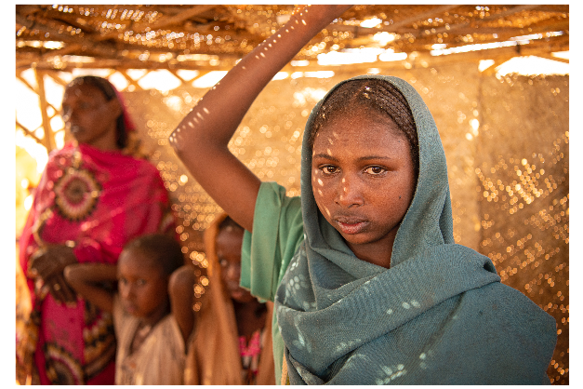

ENGAGE
MODULE 2: FACILITATION SKILLS AND CONSIDERATIONS

Slide 2
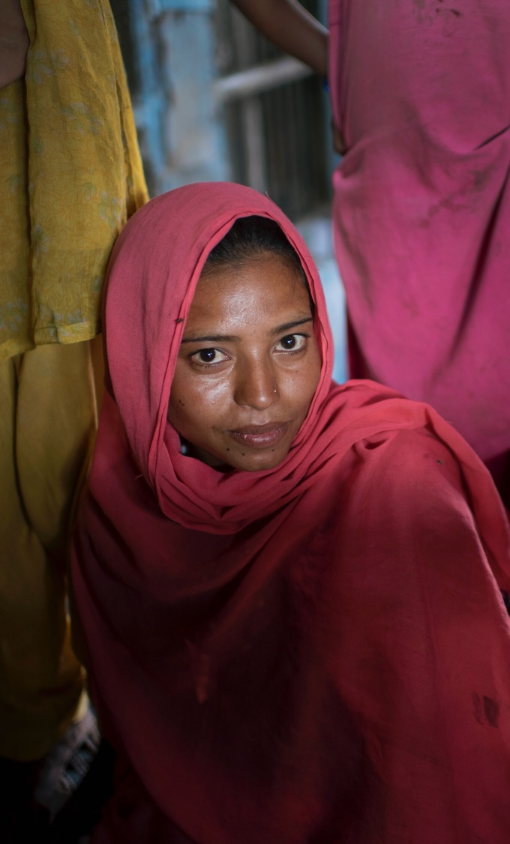

Session 1: Do No Harm
2 HOURS

Slide 3



LEARNING OBJECTIVES FOR SESSION 1
Do No Harm
Understand the concept of Do No Harm and how it relates to your role as a facilitator
Notes:
Read slide 3 to go over the session objectives.
Ask participants to turn and talk to their neighbour about what “do no harm” means? Say “has anyone heard this phrase before?” After 5 minutes, bring participants back to a plenary.

Slide 4



TOPIC 1.1
Do No Harm
2 HOURS
Notes:
Show slide 4.
Say: The principle of Do No Harm requires all humanitarians to place the wellbeing of the people they are trying to assist, at the centre of their work.

Slide 5
DEFINITION OF
DO NO HARM
“The principle of Do No Harm requires all humanitarians to place the wellbeing of the people they are trying to assist, at the centre of their work”*
"Do no harm" is to avoid exposing people to additional risks through our action
"Do no harm" means taking a step back from an intervention to look at the broader context and mitigate potential negative effects on the social fabric, the economy and the environment.
*The Alliance for Child Protection in Humanitarian Action (2019). Minimum Standards for Child Protection in Humanitarian Action, 2019 Edition.
Notes:
"Do no harm" is to avoid exposing people to additional risks through our action. "Do no harm" means taking a step back from an intervention to look at the broader context and mitigate potential negative effects on the social fabric, the economy and the environment.
As practitioners, we need to recognise the potential negative effects of interventions and the need to take these into consideration.
The third point here explicitly states that mitigation not only targets beneficiaries but also the wider environment.
By placing an emphasis on taking a step back, the DNH principle encourages actors to think before they act. The aim is to strengthen project design and management methodologies in a way that allows for a better understanding of the negative effects of future projects or programmes.
The desire for quality relationships with beneficiaries is integral to the most common view of DNH.
benefits of more effectively taking DNH into consideration include:
improved accountability towards beneficiaries,
improved relations with beneficiaries,
understanding the contexts and community dynamics in which projects take place, and acceptance in an intervention area.
Organisations wishing to develop a definition of DNH should include the following four points:
recognition of the potential negative effects of interventions;
taking into consideration not only beneficiaries but also the wider environment;
taking a step back from and even questioning interventions;
the quality of relationships with beneficiaries. Main point is that beneficiaries and their environment must be central to any definition of the DNH principle

Slide 6

Notes:
Show slide 6 and Play the YouTube video. After the short animated video, explain that effective gender-based violence and child protection programme requires an understanding of the risks in any context through:
Ongoing, participatory risk analysis;
Monitoring and reporting systems that address risk and vulnerabilities; and
Knowledge of the expected behaviours and social norms for children.
Say that in our work, it is important to consider the location, timing, transport and other arrangements to ensure accessibility and inclusivity to those who want to attend the programme. Poor programme design and planning can lead to unintended and negative risks. Assistance needs to be provided in an environment that does not further expose people to physical hazards, violence or abuse. As facilitators, it is important to:
Understand and build on existing child protection and gender-based violence programmes and other related systems;
Guarantee confidentiality for and informed consent/assent of children for any sensitive issues;
Ensure compliance with data protection standards on collecting and sharing personal information about individual children;
Conduct systematic monitoring of the programme to ensure that children are not exposed to additional risks or harm.

Slide 7
MINIMIZING HARM FOR ADOLESCENT GIRLS
It is especially important to consider the needs of adolescent girls
Girls face the highest protection risks of sexual violence, early marriage and social and psychological problems
Persons working with adolescent girls must place the girls’ best interests, safety and wellbeing at the centre of all decisions about their safety and access to services
It is the responsibility of the implementing organisation to ensure that the experience of participants is free from any form of abuse or exploitation
Notes:
Show slide 7 and say that while it is important to consider the protection risks for all groups to minimize harm, it is especially important to consider the needs of adolescent girls. In humanitarian contexts, girls face the highest protection risks of sexual violence, early marriage and social and psychological problems. Persons working with adolescent girls must place the girls’ best interests, safety and wellbeing at the centre of all decisions about their safety and access to services.
Explain that it is the responsibility of the implementing organisation to ensure that the experience of participants is free from any form of abuse or exploitation. This is outlined in the Child Safeguarding Policy.
GBV AoR (2019). The Interagency Minimum Standards for Gender-Based Violence in Emergencies Programming.

Slide 8
CODE OF CONDUCT KEY WORDS
RACE!
Match the key words from the ACT Alliance Code of Conduct with their definitions
First team to get all 12 answers correct wins!
Notes:
Show slide 8 and tell participants that we will now play a game related to the Code of Conduct (CoC) Remind participants that the CoC is important to reduce the risk of harm and ensure all staff keep program participants safe. Break participants into small groups and handout the cut out key definitions (Annex 1). Give participants 10 minutes to race to match all key words with their definitions. Make sure you have a copy of the Act Alliance Code of Conduct accessible to cross check the answers https://actalliance.org/wp-content/uploads/2019/08/ACT-Code-of-Conduct-Policy-2016-E.doc.pdf
Do you think that is ok? I dont want to add another 2 pages of Annex

Slide 9
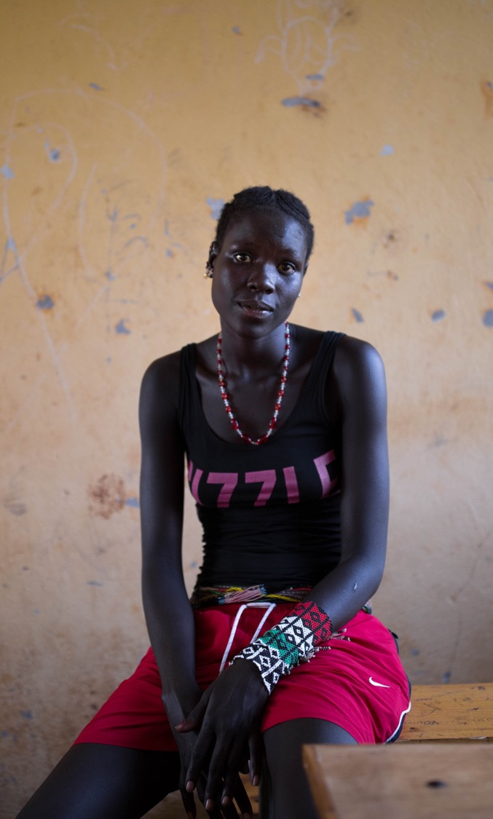


Session 2: Staff And Self-care
90 MINUTES
Notes:
Show slide 9 to introduce the session.

Slide 10


LEARNING OBJECTIVES FOR SESSION 2
Staff and Self-care
Understand the types of traumatic stress and their impact
Gain awareness of the signs of burnout and vicarious trauma
Notes:
Read slide 10 to go over the session objectives.
Ask participants why we are talking about stress? Say that as facilitators you can be faced with high pressure and high stress situations. In order to deliver good sessions, it is good to take care of our own well-being. This requires awareness of the stressors in our daily lives, how they affect us and how we can cope to mitigate the stress.

Slide 11

TOPIC 2.1
OUR OWN PHYSICAL AND PSYCHOSOCIAL WELLBEING
90 minutes

Slide 12


WHAT IS STRESS?
Stress is a state of psychological and physical arousal that comes about as a result of a threat, challenge, or change in one’s environment (Mitchell and Bray, 1990).
DAY-TO-DAY STRESS
Common to all people
Part of every day decision making and problem solving
Motivates people to be more productive
Managed routinely
NEGATIVE STRESS
CUMULATIVE STRESS
• Result of prolonged, accumulated, unrelieved exposure to stressors
• This is very common amongst people working in emergencies, can lead to burnout
CRITICAL INCIDENT STRESS
Caused by extraordinary events which provoke high level of stress in almost everyone involved
VICARIOUS TRAUMA
Result of witnessing or learning about others’ traumatic experiences that causes a reaction that mirrors that of the survivor
Notes:
Say that stress is a part of our daily lives. It is a state of psychological arousal that comes about because of a threat, challenge or change in one’s environment. Show slide 12 and read points.

Slide 13

Signs of Stress & Trauma
• There are many different signs of stress, and they manifest in many different ways depending on the characteristic of the person and the stressor
• May be physical, cognitive, emotional, behavioral, or spiritual/philosophical
• May be immediate or may be delayed
Behavioral
Cognitive
Spiritual/philosophical
STRESS
Physical
Emotional
Notes:
Show slide 13 and say that the signs of stress may manifest in different areas of our lives. The signs of stress may also appear immediately or may be delayed. For each person, the way stress manifests may be very different.

Slide 14




1
GROUP DISCUSSION
What you can do to care for yourself?
What your team can do together for mutual care and are and support?
What your organization/supervisor can do to support your well-being?
2
3
Notes:
Show slide 14 and ask in small groups of three, discuss:
what you can do to care for yourself,
what your team can do together for mutual care and support, and
what your organization/supervisor can do to support your well-being.
After 5 minutes we will come back as a group to discuss.

Slide 15


ABC Framework
To help prevent and reduce the impact of stress, vicarious trauma, and burnout
Be aware of our own needs, limits, emotions, and resources
Check in with ourselves;
Create balance in our lives between work and our personal lives;
Maintaining positive, supportive relationships with those around us.
ABC
AWARENESS
CONNECTION
BALANCE
Notes:
Say that one framework you can use for thinking about self-care that may help prevent and reduce the impact of stress, vicarious trauma, and burnout. It is the ABC’s – to be aware of our own needs, limits, emotions, and resources – really checking in with ourselves; to create balance in our lives between work and our personal lives; and maintaining positive, supportive relationships with those around us. Following the ABC’s is one way to help us ensure we are caring for ourselves so that we are equipped to care for others.
A – Awareness – Be attuned to your needs, limits, emotions and resources. Practice self-acceptance. Look for early signs of secondary stress and trauma so you can focus on self-care to prevent further problems. Develop the habit of “checking yourself.”
B – Balance – Maintain a healthy balance among your activities. Balance work, family life, rest and leisure. Remind yourself that you deserve to have a meaningful and enjoyable life outside of work.
C – Connection – Maintain supportive relationships. Establish positive relationships with co-workers, friends and family to elicit support and avoid isolation. Communication with others breaks the silence of unacknowledged pain. Connections can also increase feelings of hope.
To put this into the context of our own lives, you will complete a self-care inventory.

Slide 16
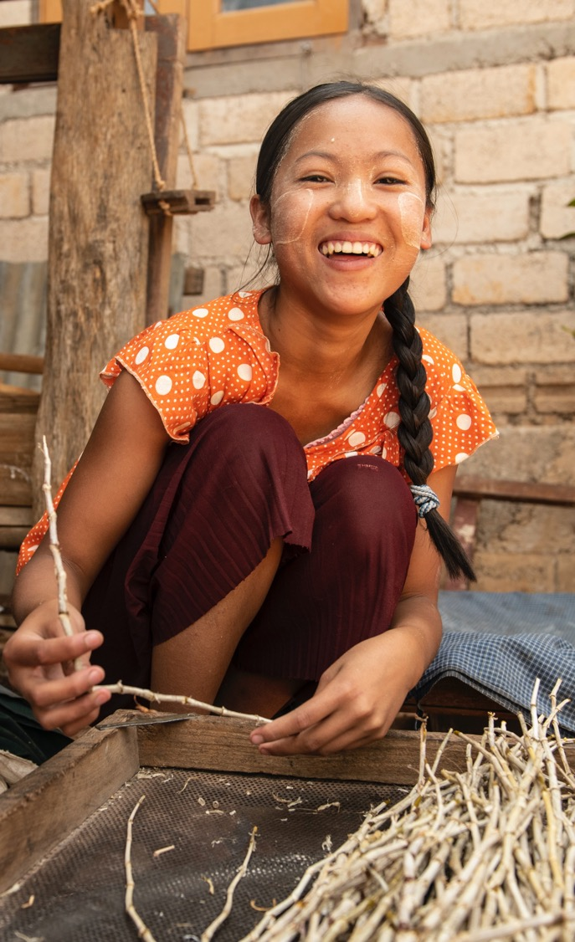

Session 3: Facilitation Skills and Considerations
15 HOURS
Notes:
Show slide 16 and tell the group that we are going to spend the next several sessions discussing facilitation skills.

Slide 17

LEARNING OBJECTIVES FOR SESSION 3
Facilitation Skills
Discuss participatory processes and learn how to apply them when leading group discussions
Learn the four stages in the adult learning cycle
Learn the four stages of group development
Consider how power relations can affect group participation and dynamics
Identify possible barriers and solutions to participation in groups
Understand different types of communication skills and how to effectively use them when facilitating
Know the purpose of and process for establishing a group agreement
Identify strategies for managing conflict in group discussions
Learn to effectively apply confidentiality considerations when facilitating.
Identify strategies and techniques to manage common group facilitation problems and challenges
Understand how to identify potential safety and protection issues that might arise during or as a result of group discussions and be ready to respond to them
Be able to refer participants appropriately
Understand the roles and boundaries as a facilitator
Notes:
Show slide 17 ‘Learning objectives’ and explain the learning objectives for the session on facilitation skills

Slide 18

TOPIC 3.1
WORKING WITH GROUPS OF ADULTS
30 minutes
Notes:
Show slide 18 and tell the group that we are going to spend the next session discussing how to work specifically with groups of adults. Explain that adults learn differently from children.
Ask the group to discuss with their neighbour for 2 minutes why they think that is and give 2-3 people the chance to share their response.

Slide 19
SIX PRINCIPLES OF ADULT LEARNING
Adults are internally motivated and self-directed
Adults bring life experiences and knowledge to learning experiences
Adults are goal oriented
Adults are relevancy oriented
Adults are practical
Adult learners like to be respected
Notes:
Show slide 19 ‘Six principles of adult learning’.
Explain to the participants that learning in groups is a partnership between the learners and the facilitator.
Ask the group to think of a learning experience that they have had as an adult. Now ask them to share with the group what they did to get the most out of the learning experience. Did they take notes? Did they verbally repeat what they learned to someone else? Did they practice a new skill or behaviour? Make sure the groups understand that you are asking what the learners did, not what the teacher did.
Write down the key points on a flipchart paper titled “Ways we maximize learning”.
Ask the participants to now think of things that adults do that minimize learning, giving examples first such as looking at their phone or getting to sleep after lunch. Ask the participants to be honest.
Write their answers on the flipchart paper titled ‘Ways we minimize learning’. Now, ask them to think of techniques that they can use to get participants to pay attention and come back to the present.
Ask the group to look at the two lists, and ask them to think about how they can use these strategies as facilitators of groups?

Slide 20
TELL ME, AND I WILL FORGET.
SHOW ME, AND I MAY REMEMBER.
INVOLVE ME, AND I WILL UNDERSTAND.
Notes:
Show slide 20. Ask the group how they think this Confucian saying applies to adult learning.
Tell the group that:
Adults learn through experience.
They build up knowledge and skills through their life experiences and they bring them, along with a wide range of backgrounds, learning styles, needs and interests, to group discussions.
Every group will have a wealth of information, knowledge and skills. The richness of the discussions and learning by group members will depend on how well the discussion process draws on their experiences.

Slide 21


EXPERIENCE
ACTION
REFLECTION
MAKING MEANING
Notes:
Show the group the diagram on slide 21. Ask them what they think the diagram means and ask a few volunteers to share their thoughts.
Explain that the diagram shows how adults learn. It shows that people make meaning by reflecting on their direct and personal experiences. This process of reflecting and analysing leads to discovery and understanding, which are then translated into action. Called ‘experiential learning’, the process begins with experience, which participants then reflect on, discuss, analyse and evaluate.
Ask the group to give examples of experiential learning. The list should include role plays, case studies, simulations, brainstorming, discussion, debate, etc.
Tell the participants that the programme consists of different components where groups of adults such as male and female caregivers, community and religious leaders, will meet together, discuss and reflect on their beliefs, and are encouraged to share and analyse their own experiences. This reflection and new information combined together should stimulate the groups of adults that we will work with to have new ideas and reinterpret their existing knowledge and beliefs. This process of dialogue and reflection is what will lead to change within the group, as well as change within the social norms of the wider community.

Slide 22
TOPIC 3.2
FACILITATING PARTICIPATORY PROCESSES
75 minutes
Notes:
Show slide 22 and explain that in the next topic we will focus on participatory processes.

Slide 23

Scenario 1
Scenario 2
XXXX
Notes:
Show slide 23. Ask participants to look at the two pictures of group discussions on the slide and ask them the following questions:
Which picture shows the way people normally communicate and work in the community?
What is happening in scenario 1? in scenario 2?
How would you describe the relationships among people in scenarios 1 and 2?
What feelings do you think people have in scenarios 1 and 2?
What word or phrase would you use to describe what is happening in scenarios 1 and 2?
Ask participants what method of group discussion they prefer and why.
Explain that in this programme, we will use the approach shown in scenario 2 because everyone is valued equally and the learning process is an exchange between the participants and the facilitator. The facilitator is not more important than the participants in this approach.

Slide 24
PARTICIPATORY APPROACHES
Change is more likely if people most affected own the process
Change is more likely if the process is empowering and horizontal (versus top-down) and gives a voice to unheard members of the community
Communities should be the agents of their own change
Change is more likely if the process is based in discussion and dialogue rather than on persuasion and telling people what to do
Notes:
Show slide 17 and explain the points:
Change is more likely if people most affected own the process.
Change is more likely if the process is empowering and horizontal (versus top-down) and gives a voice to unheard members of the community.
Communities should be the agents of their own change.
Change is more likely if the process is based in discussion and dialogue rather than on persuasion and telling people what to do.

Slide 25
PRINCIPLES FOR PARTICIPATORY PROCESSES
Communities and discussion leaders are the experts;
Local experiences are at the centre of the process;
Discussion and dialogue are more effective than top-down intervention;
Participation by different groups in the community is important, especially participation of women and girls;
Mutual learning occurs (between facilitators and the community, one community with another, and among community members).
Notes:
Show slide 25. These principles help guide our work:
communities and discussion leaders are the experts (not facilitators);
local experiences are at the centre of the process;
discussion and dialogue are more effective than top-down intervention;
participation by different groups in the community is important, especially participation of women and girls;
mutual learning occurs (between discussion leaders and the community, one community with another, and among community members).

Slide 26
TOPIC 3.3
UNDERSTANDING GROUP PROCESSES
60 minutes
Notes:
Show slide 26 and tell the group in this topic we will learn about the importance of group process.
Explain that there are two considerations for you to be aware of within the group discussions with caregivers, adolescents, and religious and community leaders. One part is delivering the content of what will be discussed, including the introduction of new knowledge. The second part is the group process, or how the group members interact with each other in order to achieve the goal of the group.

Slide 27

DISCUSS:
Is group content or process more important?
How does content affect process, and vice versa?
Are facilitators responsible for the content or process in the discussions?
Notes:
Show slide 27. Ask the participants to discuss the following questions with the person next to them:
What is more important the content, or the group process?
How does the content affect the group process? How does the group process affect the content
Are facilitators responsible for the content or process in the discussions?
Ask a few pairs to share their discussion with the larger group. Make sure it is clear that facilitators are responsible for both delivering content, but also ensuring that the group process is facilitating the goal of the programme. Managing the group process and dynamic is a key facilitator skill.
Tell participants that when people come together in groups they often go through specific stages of group development. These stages can affect group dynamics. Ask participants to remember a time that they either participated in or facilitated a group. Did they ever notice that people act differently at the beginning of a group then at the end? Why do they think that is?

Slide 28


FORMING
Happens when people first come together.
Group members are finding out about each other.
They are usually a bit anxious and uncertain.
NEEDS
Group members need to be comfortable and safe within the group, to know and share information about each other and the purpose of the discussions.
BEHAVIOUR
People are polite, nervous, shy and tend to assess others at this stage. Members try to understand the group ‘rules’, to determine the group task.
Notes:
Show slides 28-33, explaining each stage and the key actions and tips for facilitators in each stage.
Explain that the role of the facilitator is to support the process of the group members to move through the four stages. The successful delivery of the content of the programme is linked to the group dynamic.

Slide 29
STRATEGIES
Make all participants feel welcome
Introduce people to each other
Help participants become familiar with each other and with the purpose of the group
Help quieter members feel included and comfortable enough to talk
Provide information.

Slide 30

STORMING
Happens when group members feel more comfortable with each other and with the purpose of the group
They begin to explore different roles and assert themselves
The more dominant members of the group emerge, while others may stay quiet
NEEDS
Members need to belong and to be secure in the group, to review aims and absorb material.
BEHAVIOUR
Members may be non-cooperative, show resistance to group aims, challenge agreed-upon aims, sabotage group work or challenge the facilitator.

Slide 31
STRATEGIES
Be assertive about your role
Help draw out and resolve differences that might disrupt group cohesion
Clarify group goals and objectives
Answer questions
Review group norms providing clarification about the group’s purpose
Manage conflict

Slide 32
NORMING
A sense of ‘community’ and shared purpose and expectations emerge
NEEDS
Members need to be independent and recognized and to have self-esteem.
BEHAVIOUR
Group members are flexible and trust each other. They may positively challenge other members. They start to help one another more.

Slide 33



PERFORMING
The group can achieve its purpose
Members can engage in problem solving, experimentation and testing of possible solutions
NEEDS
Deeper relationships are established between members, and members need to celebrate achievements.
BEHAVIOUR
• Members get involved in group facilitating; people are able to challenge each other positively.
• We want to move to this stage as quickly as possible because this is where groups can discuss sensitive and challenging issues.

Slide 34
TOPIC 3.4
POWER AND PARTICIPATION IN GROUPS
75 minutes
Notes:
Show slide 29 and introduce the next topic on power dynamics and participation in groups.
Ask participants to form two rows facing each other, with equal numbers of participants. Tell participants on one side of the row to hold out their right hand and place it in front of (but not touching) the person’s face opposite of them. Explain to the participants who have their hand extended that they will be moving their hand as quickly or slowing as they want in any direction. The person opposite from them must follow the movements of the other persons’ hand no matter how difficult it is and keep the same distance between their hands. Give the group 3 minutes to do the exercise and then ask them to change roles so that the opposite person is leading and following, giving them another 3 minutes.
Ask the pairs to sit together and discuss the following questions;
How did the exercise make you feel?
How did you feel when you were leading?
How did you feel when you were following?
Ask a few pairs to share and write on a flipchart any key words that are frequently repeated that are related to power dynamics in relationships such as ‘control’ or ‘abuse’ or ‘exploitation’.
Explain that in this session, we are going to talk about power dynamics in groups and how these dynamics can affect participation.

Slide 35
GROUP EXERCISE
ANALYZING POWER RELATIONS
GROUP 1 & 2
Power relations between group facilitators and group members
GROUPS 3 & 4
Power relationships among different group members
Notes:
Divide the participants into four groups. Groups 1 & 2 will analyse power relations between group facilitators and group members, while Groups 3 & 4 will analyse power relationships among different group members. Give the groups flipchart paper so that they can summarize their presentation. Give the groups 15 minutes for discussion.
Ask the pairs to sit together and discuss the following questions;
How did the exercise make you feel?
How did you feel when you were leading?
How did you feel when you were following?

Slide 36
KEY POINTS ABOUT POWER AND PARTICIPATION IN GROUPS
To make people feel safe to participate in group discussions, we need to address power relations
We must recognize the power and authority we hold as facilitators
Facilitators can use their power to empower others; good facilitation helps break down power relationships in groups
Power dynamics in groups are often a reflection of power relations in wider society
Sometimes power dynamics are difficult to detect, but we can often see them in the way people participate
Notes:
Show slide 36 and explain the following key points to wrap up the session:
To make people feel safe to participate in group discussions, we need to address power relations. Otherwise, those with less power may not speak out.
We must recognize the power and authority we hold as facilitators; we need to be aware of how our attitudes and behaviours might disempower some group members.
Facilitators can use their power to empower others; good facilitation helps break down power relationships in groups.
Power dynamics in groups are often a reflection of power relations in wider society; e.g., between men and women, old and young, rich and poor.
Sometimes power dynamics are difficult to detect, but we can often see them in the way people participate; e.g., by not listening to what others have to say.

Slide 37
TOPIC 3.5
FOSTERING PARTICIPATION IN GROUPS
60 minutes
Notes:
Show slide 37 and introduce the topic on fostering participation in groups.
Explain to participants that participation is a key principle of the programme and will determine the success and outcome of the activities. If participants do not actively and meaningfully participate in the group discussions, it is much less likely that the knowledge will increase or beliefs, attitudes and social norms will change.
Ask participants to divide into four groups. Ask each group to spend 15 minutes brainstorming a list of barriers that prevent people from participating in group discussions. After they have made the list, they should choose one factor and make a role play on how as a facilitator they would address or manage this barrier to participation.

Slide 38
PARTICIPATION CHECKLIST
How much talking is done by the group facilitator? By participants?
Are questions addressed to the whole group or to individuals?
Do most group members appear interested or bored?
Are subgroups forming or side conversations taking place?
Are quiet members being encouraged to contribute and speak?
Is one person doing most of the talking?
Notes:
Show slide 38 and explain the participation checklist.

Slide 39
KEY POINTS ABOUT FOSTERING PARTICIPATION IN GROUPS
Participation can be affected by many factors related to the individual, group and environment
Participation levels need to be constantly monitored; a co-facilitator is helpful for this purpose
Levels of participation vary by person. Some group members are active, talkative participants; others are more withdrawn, shy and passive
Notes:
Show slide 39 and 40 and explain the following key points to summarize the session:
Participation can be affected by many factors related to the individual, group and environment.
Participation levels need to be constantly monitored; a co-facilitator is helpful for this purpose.
Levels of participation vary by person. Some group members are active, talkative participants; others are more withdrawn, shy and passive.
Participation is about involvement, but people will be involved in different ways.
Using participatory techniques enhances participation; e.g., role-plays and other dramatic activities, games, sharing personal stories and other story-telling, discussion and reflection in pairs or small groups.

Slide 40
KEY POINTS ABOUT FOSTERING PARTICIPATION IN GROUPS CONT…
Participation is about involvement, but people will be involved in different ways
Using participatory techniques enhances participation; e.g., role-plays and other dramatic activities, games, sharing personal stories and other story-telling, discussion and reflection in pairs or small groups

Slide 41
TOPIC 3.3
COMMUNICATION SKILLS
60 minutes
Notes:
Show slide 41 and introduce the topic on communication skills.
Ask participants to give examples of different ways people communicate with each other? How do we exchange information? How do we exchange thoughts? How do we exchange feelings?

Slide 42

Four types of messages
VOICE MESSAGES
how we talk, the volume, tone and speed
VERBAL MESSAGES
what we say
BODY MESSAGES
messages we send with our face and other parts of our body, sometimes called ‘body language’.
BEHAVIOUR MESSAGES
what we do
Notes:
Show slide 42. Explain that when we communicate with another person, we are sending and receiving messages to and from each other. We send and receive four types of messages. Explain each, asking for and giving examples/ demonstrating each one:
voice messages: how we talk, the volume, tone and speed;
verbal messages: what we say;
body messages: the messages we send with our face and other parts of our body, sometimes called ‘body language’;
behaviour messages: what we do.

Slide 43


KEY POINTS ABOUT COMMUNICATION
Good verbal communication involves the use of clear and simple language and the opportunity to ask questions and check for understanding
When we are facilitating discussions, we need to:
use simple language and sentences;
check that group members have understood what we and others are saying;
ask lots of questions.

Slide 44
KEY POINTS ABOUT NON-VERBAL COMMUNICATION
Non-verbal communication tells us a huge amount about a person’s thought and feelings, often more than verbal communication
As facilitators we need to be very aware of our own non-verbal communication and that of group members
Common non-verbal cues include facial expression, posture, seating (close or far), eye contact, holding body rigid or relaxed, use of hands and nervous gestures

Slide 45
TOPIC 3.6.1
LISTENING SKILLS
45 minutes

Slide 46

QUALITIES AND BEHAVIOURS OF GOOD LISTENERS
They pay attention,
They show they are interested,
They may nod their head
They are non-judgmental, empathetic, calm or polite
They don't jump to give advice,
They never interrupt,
They ask follow-up questions,
They listen as much (or more than) they speak.
Notes:
Show slide 38 and explain the participation checklist.

Slide 47
KEY POINTS ABOUT LISTENING SKILLS
Active listening means listening and really trying to understand what another person is saying
It involves the need to suspend our own thought processes, be aware of our bodies and use verbal and non-verbal communication skills, including summarizing
Active listening is important for group facilitators, but it also helps group members, so we need to model active listening to the group

Slide 48
KEY POINTS ABOUT LISTENING SKILLS, CONTINUED
THE SIGNS OF ACTIVE LISTENING ARE:
Leaning towards the speaker
An interested facial expression
Good eye contact
Small affirming movements, such as nodding
Avoiding signs of impatience, such as looking at your watch
Using verbal cues to draw out the speaker; e.g., “How did you feel about that?”
Summarizing and restating

Slide 49
TOPIC 3.6.2
ASKING QUESTIONS
30 minutes
Notes:
Tell participants that asking questions is one of the most important skills for a facilitator and it’s essential to facilitate both the content and process.
Ask participants what the difference is between open-ended and closed questions.

Slide 50
Closed and Open Questions
CLOSED QUESTIONS
OPEN QUESTIONS
Require a yes, no or short answer.
Are useful for getting information such as a person’s age, who she lives with, etc.
Do not encourage discussion or expression.
Express themselves, their feeling and ideas.
Have no right or wrong answers.
Notes:
Acknowledge the correct answer if it is given or explain the difference yourself.
Ask for examples of each type of question. Continue getting examples until it is clear participants understand the difference.

Slide 51
ASKING QUESTIONS
Think of examples of questions that might:
• Draw out people’s knowledge and experiences
• Help people reflect on their experiences
• Help people analyse an issue

Slide 52
TOPIC 3.6.3
PRACTICING COMMUNICATION SKILLS
60 minutes

Slide 53
TOPIC 3.7
CREATING A SAFE AND RESPECTFUL SPACE
60 minutes
Notes:
Say that activities must be conducted in a way to ensure that participants feel comfortable when participating. It is particularly important to consider gender when creating a safe space for program participants.

Slide 54
SAFE SPACE CHECKLIST
The safe space checklist should include:
Accessibility to adolescents
Can items be left in the space when the programme is not in session?
Can facilitators keep supplies in a safe location if this is not an option?
Can the space be locked when not in use?
What procedures need to be put in place to ensure that the space remains safe and confidentiality is ensured?
Does the community understand the programme objectives and agree to allow the programme to take place?
Who needs to be involved to ensure that the space remains safe and accessible for the programme cycle?
Notes:
Show slide 42. Say that special considerations should be taken to ensure that no additional harm is done to participants when participating in the program. As facilitators, it is important that to consider: The safe space checklist should include:
**read list
Explain that in addition for the physical safety considerations, it is important to provide a welcoming environment. Tell participants that for participants to be able to share their beliefs and opinions, speak with honesty and openness and discuss sensitive issues, the discussions need to be treated as a container or safe space in which members can interact with trust and respect. They must be able to bring their ideas, concerns, and beliefs to the process so they can work together, in a peaceful manner, to transform relationships.

Slide 55

EXAMPLES THAT COULD BE INCLUDED IN GROUP AGREEMENTS
Respect everyone’s opinions;
Allow everyone an equal opportunity to speak;
Maintain the confidentiality of personal information;
Be honest;
Listen, even if you disagree;
Criticize the idea, not the person;
Pass if you’re not comfortable speaking;
Don’t interrupt;
Be brief;
Agree to disagree.

Slide 56




Key Points about Safe and Respectful Spaces
Facilitators role to make the group a safe and respectful environment.
The training environment is a safe space where:
A group agreement establishes how members are expected to behave.
It helps to create a safe environment in which participants can communicate openly, without fear of being criticized by others.
It must be developed and agreed on by all group members to be useful, especially if tension arises.
Group members have a chance to express their own ideas and feelings freely;
Everyone listens respectfully and openly to others;
Group members can safely reveal what they really think and feel;
No individual or group dominates;
Disagreements are based on ideas and opinions, not on personalities.
Notes:
Facilitators have to help make the group a safe and respectful environment.
The training environment is a safe space where:
Group members have a chance to express their own ideas and feelings freely, and a variety of viewpoints are put forward and discussed;
Everyone listens respectfully and openly to others’ ideas and feelings;
Group members can safely reveal what they really think and feel;
No individual or group dominates;
Disagreements are based on ideas and opinions, not on personalities.
A group agreement establishes how the group’s communication will occur and how group members are expected to behave.
It helps to create a safe environment in which participants can communicate openly, without fear of being criticized by others.
Ground rules need to be developed and agreed on by all group members to be useful, especially if tension arises.

Slide 57
TOPIC 3.8
MANAGING CONFLICT
60 minutes

Slide 58
SMALL GROUP WORK
Brainstorm about what kinds of ‘pushing’ or conflicts might arise in a group activity or discussion setting?
What are effective and ineffective ways of handling conflict and disagreement in a group setting?
What kinds of topics might lead to disagreement?
How can we encourage different perspectives and opinions in the group without leading to harmful conflict between group members?
Notes:
Divide the participants into four groups. Groups 1 & 2 will analyse power relations between group facilitators and group members, while Groups 3 & 4 will analyse power relationships among different group members. Give the groups flipchart paper so that they can summarize their presentation. Give the groups 15 minutes for discussion.
Ask the pairs to sit together and discuss the following questions;
How did the exercise make you feel?
How did you feel when you were leading?
How did you feel when you were following?

Slide 59
STRATEGIES FOR MINIMIZING CONFLICT
When making the group agreement, ask, “How will we handle disagreements between group members?”
Remind people to speak for themselves, not for others
Take the focus off individuals, and put it on the issue being discussed
Invite people to share the experiences that led to the formation of their opinions; e.g., say, “Can you tell us more about any experiences that affected your feelings and thoughts about this issue?”
Invite others into the conversation if conflict is escalating between two people by asking “Would someone else like to offer an opinion?”
If two people are disagreeing, ask them to identify any overlap between their two positions; ask others from the group to help them see common ground

Slide 60
STRATEGIES FOR HANDLING CONFLICT
Remind group members of group agreement/group norms if the conversation becomes heated.
Stop the conversation if it becomes personal or confrontational.
Take a short break.
Speak to individuals privately and ask them to follow the group agreement.

Slide 61
TOPIC 3.9
OVERCOMING CHALLENGES AND WORKING WITH SENSITIVE ISSUES
90 minutes

Slide 62
KEY POINTS ABOUT OVERCOMING CHALLENGES AND WORKING WITH SENSITIVE TOPICS
As facilitators, it is important that we do not ignore challenging situations; we must always be accountable and act as role models to speak up
If we let a group member get away with repeating a harmful belief, then they will not change their opinion. Other people in the group may also hold a similar opinion but may not have spoken it aloud
Changing someone’s opinion takes time and it may not happen in one session
It is better not to lecture participants about their views, but instead engage them in dialogue and reflection in a supportive safe environment
Notes:
Explain that it is important to make sure that as facilitators we do not ignore these challenging situations. As facilitators, we have to always be accountable and act as role models to speak up and use these moments as learning opportunities. If we let a group member get away with repeating a harmful belief, then they will not change their opinion. Remember, other people in the group may also hold a similar opinion but may not have spoken it aloud. Remember that changing someone’s opinion takes time and it may not happen in one session. It is better not to lecture participants about their views, but instead engage them in dialogue and reflection in a supportive safe environment.

Slide 63
TOPIC 3.10
CONFIDENTIALITY
60 minutes

Slide 64

CONFIDENTIALITY
Confidentiality means that anything that is told within the training or between the facilitator and participants is confidential. The information will not be shared without the permission of the participants
There are a few situations where confidentiality might be breached:
When a participant threatens to harm themselves or others;
In cases involving minors, survivors with disabilities and a non-offending caregiver must be involved;
Where mandatory reporting policies exist - this doesn’t always mean that the authorities will be involved but a supervisor will be contacted.
Notes:
Explain that confidentiality within the context of programme means that anything that is told within the training or between the facilitator and participants is confidential. Confidentiality is not hiding information or keeping a secret for the sake of secrecy but recognizing that information that is shared belongs to the person sharing the information so we have no right to use it or share with other. This includes information which is shared amongst participants. Say that the information will not be shared without the permission of the participants.
There are a few situations where confidentiality might be breached and in these instances you must consult with your supervisor:
This includes when a participant threatens to harm themselves or others;
In cases involving minors, survivors with disabilities and a non-offending caregiver must be involved;
Where mandatory reporting policies exist. Emphasize that this doesn’t always mean that the authorities will be involved but a supervisor will be contacted.
Say that it is important to consider the following questions when facilitating discussions. Ask each question below and brainstorm so potential responses and actions:
How identifying information gathered during the programme will be used and protected.
How information disclosed during the training, such as personal stories, examples, and general discussion among participants will be used, shared and protected.
On what grounds confidentiality may be breached (e.g. in the case on mandatory reporting when working with children and families/caregivers).
Can items be left in the space when the programme is not in session? Can facilitators keep supplies in a safe location if this is not an option?
Can the space be locked when not in use?
What procedures need to be put in place to ensure that the space remains safe and confidentiality is ensured?

Slide 65

How identifying information gathered during the programme will be used and protected
How information disclosed during the training, such as personal stories, examples, and general discussion among participants will be used, shared and protected
On what grounds confidentiality may be breached (e.g. in the case on mandatory reporting when working with children and families/caregivers)
Can items be left in the space when the programme is not in session? Can facilitators keep supplies in a safe location if this is not an option?
Can the space be locked when not in use?
What procedures need to be put in place to ensure that the space remains safe and confidentiality is ensured?
1
2
3
4
5
6
Notes:
Show slide 101 and explain that these are the 5 stories which are used for the story base discussion tool.
Inform the group of the following characteristics of an effective story/vignette for the purposes of measuring social norm change.
Normative: The discussion questions should be structured in a way that explores social norms, not moral beliefs and attitudes.
Specific: Each story must be designed to explore one specific social norm relating to CEFM in the context you are working it (stories should not attempt to measure multiple social norms or changes in CEFM in general). The tools presented here are designed to test common social norms that drive CEFM across contexts, however further formative research may be required to determine the extent to which they are relevant to your context.
Realistic: The situation presented in the story must be relevant and recognisable in the context that you are working in, for example, the characters should be similar to people in programme communities so participants can relate to them.
Fictional: The story and characters should never be real or be able to be mistaken for real people in the community you are working in. The facilitator should inform participants at the beginning of the story that the characters are not real people.
Visual: If possible, stories should be accompanied by pictures to help the audience use their imagination. You may consider engaging a local artist to produce some pictures to accompany the stories in this toolkit.

Slide 66
TOPIC 3.11
ROLES AND BOUNDARIES
45 minutes

Slide 67
TOPIC 3.12
PREPARATION AND LOGISTICS
30 minutes

Slide 68
TOPIC 3.13
MANAGING SAFETY AND PROTECTION ISSUES
60 minutes

Slide 69
INFORMED CONSENT VERSUS INFORMED ASSENT
INFORMED CONSENT is the voluntary agreement of an individual who has the legal capacity to give consent. To provide “informed consent” the individual must have the capacity and maturity to know about and understand the services being offered and be legally able to give their consent
INFORMED ASSENT is the expressed willingness to participate in services

Slide 70
A PARTICIPANT SHOULD BE REFERRED TO SPECIALIZED SERVICES WHEN:
Child who is married and is below 15 (with and without children)
Child who is married and exposed to an additional protection risk or concern (including disability, neglect and no outside support)
Child at risk for committing suicide because of forced marriage
Child who was raped and forced to marry perpetrator
Unaccompanied or separated child spouse
Child engaged to be married and marriage in imminent
Child is married to another child
You have difficulty maintaining real contact with the person.
A person hints or talks openly of suicide

Slide 71
A PARTICIPANT SHOULD BE REFERRED TO SPECIALIZED SERVICES WHEN:
A person hints or talks about harming others
A person presents imaginary or real ideas or details of persecution
You become aware of child abuse or any criminal activity
You see persistent physical symptoms developing
Common physical problem includes flashbacks, problems sleeping, headaches, extreme reactions to loud noises
You become aware of dependency on substances
You see the person engaging in risky behaviour (showing carelessness towards one self/others)
Emotions or behaviours suddenly change or become persistent

