Slide 1
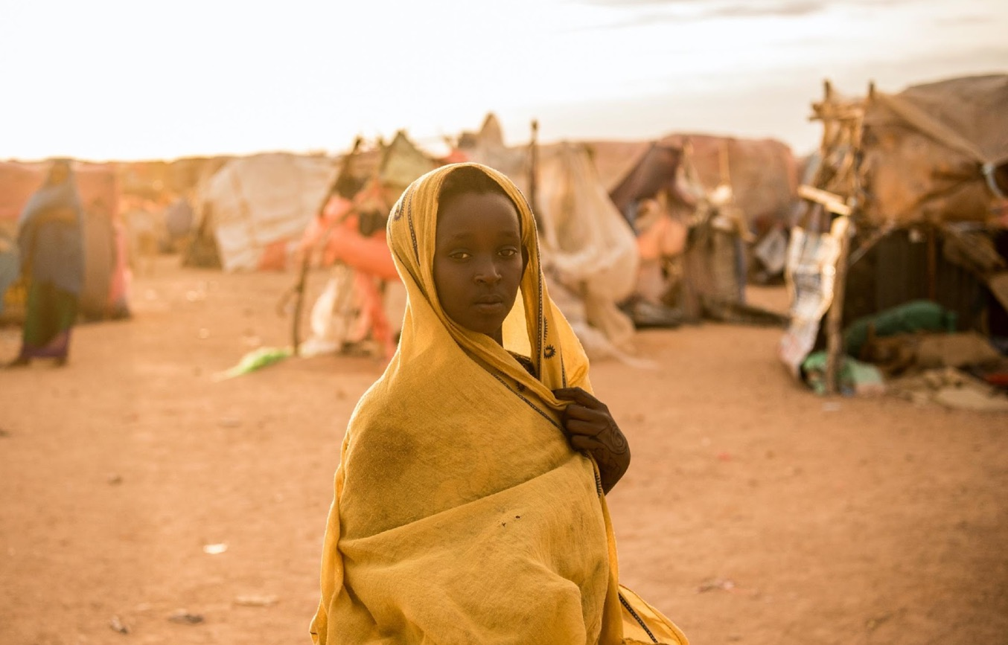
ENGAGE
MODULE 3: IMPLEMENTATION OF SERVICE DELIVERY COMPONENTS
Notes:
Show slide 1 and introduce Module 3. Explain that during this module we will focus on implementation of the service delivery components, including case management, life skills for adolescent girls and boys and focused care sessions

Slide 2
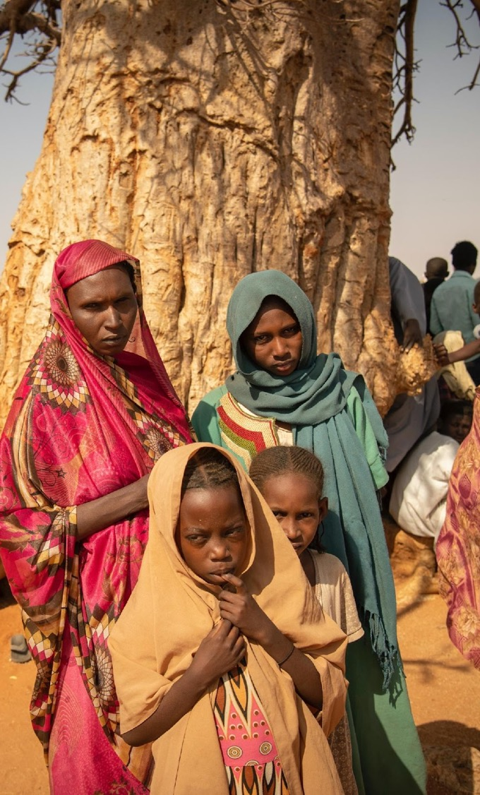
Session 1: Child, Early and Forced Marriage (CEFM) and GBV Case Management
5.5 HOURS
Notes:
Show slide 2 to introduce the session.

Slide 3
LEARNING OBJECTIVES FOR SESSION 1 Child, Early and Forced Marriage (CEFM) and GBV Case Management
Understand the various case management responses to early marriage
Determine how to provide levels of face to face and remote safety support for adolescent girls
Understand how to identify and refer participants appropriately
Understand the differences between standard case management process and adaptations for emergencies
Notes:
Read slide 3 to go over the session objectives.

Slide 4
TOPIC 1.1 CASE MANAGEMENT FOR AT RISK GIRLS AND GIRLS WHO ARE ALREADY MARRIED 3.5 HOURS
Notes:
Show slide 4 and introduce topic 1: Case management for at Risk Girls and Girls who are Already Married
Ask participants if they can list the principles of working with adolescent girls in case management.

Slide 5
PRINCIPLES OF WORKING WITH ADOLESCENT GIRLS
Respect the rights, wishes, opinions, and dignity of the girl survivor and jointly determine her best interest
Show empathy
Establish and maintain safety
Ensure and maintain confidentiality
Non-discrimination: Treat every girl with equal care and respect
Collaboration: Engage the girl survivor in decision-making
Empower girls and build resilience
Accountability and responsibility

Slide 6
IMPORTANT CONSIDERATIONS FOR WORKING WITH ADOLESCENT GIRLS
Alter your delivery based on the girl’s developmental level, situation, and maturity
Do not use professional jargon, terms, or phrases
Use simple, clear language – tailored to the age and understanding of the girl
Prioritize safety
Notes:
Say that working with adolescent girls can be a bit scary for those of us who have worked with adult women for most of our careers. At the core of GBV case management with adolescent girl survivors, the principles, theories and skills are all the same. We maintain survivor-centred attitudes and pull on our strong communication skills to effectively support, assess, and service/safety plan with survivors.
The only thing that will change when working with adolescent girls is your delivery, which you will need to alter based on the girls’ developmental level, individual situation, and maturity. As with all survivors (adults and children), you should not use professional jargon, terms and/or phrases but instead use simple, clear language and tailor the way you express ideas to the age of the girl. Additionally, as with adults, you will prioritize and attend to the survivor’s safety at all times.
Explain that when working with adolescent the most import principles and skills to remember are:
Alter your delivery based on the girl’s developmental level, situation, and maturity
Do not use professional jargon, terms, or phrases
Use simple, clear language – tailored to the age and understanding of the girl
Prioritize safety

Slide 7
CASE MANAGEMENT RESPONSES
FOLLOWS SAME TRAJECTORY AS CASE MANAGEMENT FOR OTHER FORMS OF GBV
Our assessment and therefore our actions will be different depending on type of case (two main categories):
The case is ‘imminent risk’ (i.e. girls who are going to be married or for which a marriage is being planned)
The girl is already married
Notes:
Show slide 7. Say that CEFM case management follows the same process and guiding principles as other GBV cases. Explain that there are two main categories of early marriage cases, which require different types of focus in your assessment and ultimately different actions based on the needs of the girl. This includes imminent risk and already married cases, which we will look at closer in this topic.
First and foremost, in any case management response is introducing yourself and getting consent to proceed with services. This is followed by a safe, well-paced, and thorough assessment. The assessment will look slightly different depending on the girl’s situation: whether she is at risk for an early marriage or if she is already married.

Slide 8
ROLE OF CASE WORKERS ​
Build a trusting relationship​
Facilitate a process of engagement, assessment and case action planning​
Provide information to the girl about early marriage​
Engage with trusted adults if and when relevant. Just like with any type of GBV, as the case worker, we do not intervene directly ​
Keep safety of the girl at the forefront of any action / intervention​
Notes:
Say remember that while this may be our instinct, it is not our role to go immediately to the family to try to stop a marriage from going ahead. Doing so is unsafe for the girl as well as ourselves and our colleagues. Our role is rather to work with the survivor to understand what she wants and how we can support that process. We want to:
Build a trusting relationship
Facilitate a process of engagement, assessment and case action planning
Provide information to the girl about early marriage
Engage with trusted adults if and when relevant. Just like with any type of GBV, as the case worker, we do not intervene directly
Keep safety of the girl at the forefront of any action / intervention

Slide 9
Consent
The consent process for working with adolescent girls will be different depending on the age of the girl with whom you are working.
AGES 6-11: you will obtain informed assent, an agreement from the girl that she wants to receive services. You will then have to get informed consent from the girl’s caregiver or trusted adult.
AGES 12- 14: The same process applies however, depending on the maturity of the girl, her consent for services can take due weight.
AGES 15-17, informed consent must be obtained from the girl and, if possible, from her caregiver.
Notes:
Say that the case management response always begins with Introduction and Engagement (including the informed consent process). If our organization has other programming for adolescent girls, it is possible that we may already be working with that girl. If you are already working with the girl, but not in the context of a case management service, you still need to re-confirm consent at this first stage. You will also need to re-confirm consent for each referral or for transition into remote modality.
Remember to be clear about confidentiality and its limits and mandatory reporting.
Explain the consent process for working with adolescent girls is will be different depending on the age of the girl with whom you are working.
If the girl is between the ages of 6-11, you will obtain informed assent, an agreement from the girl that she wants to receive services. You will then have to get informed consent from the girl’s caregiver. If the caregiver is not supportive or if reaching out to the caregiver is deemed to not be in the child’s best interest, another trusted adult or the girl’s casemanager can provide written consent for services.
The same process applies to girls aged 12-14; however, depending on the maturity of the girl, her consent for services can take due weight, meaning that consideration can be given to her views and opinions based on factors such as her age and maturity.
For girls ages 15-17, informed consent must be obtained from the girl and, if possible, from her caregiver

Slide 10
IMMINENT RISK CASES
IMMINENT RISK:
Girls who are not yet married but their parents are in the process of negotiating her marriage or are actively planning for it.
Notes:
Explain that imminent risk cases are girls who are not yet married but their parents are in the process of negotiating their marriage or are actively planning for it,

Slide 11
IMMINENT RISK CASES: ASSESSMENT
Understand how girl feels about the marriage
Provide information to the girl about early marriage
Help her identify a supportive family member or other trusted adult in her life
Determine if safe for her to speak to this person
Plan with the girl for when and how she will approach the person
Identify a time and place to follow-up with the girl about the conversation
Notes:
Explain that the recommended case management response for imminent risk cases is:
First understand the situation and how the girl feels about the marriage; we know that some girls are initially excited about the marriage because they get to dress up and have a party, but know little more of what the marriage will entail.
Provide information. Once you have gathered enough information, you will provide information to the girl client. You can start by asking the girl “how do you think getting married will impact your life?”; it is also helpful to use communication materials that your office may already have.
** Brainstorm as a group what information it might be useful to share with the girl. Flipchart responses**
Some of the information you want to provide includes:
Getting married at her age will likely restrict her freedom. Girls who get married young usually do not get to
see their friends as much and are not allowed to attend school anymore.
Many girls who get married will be expected to have sex before they want to, and because of power dynamics
within the relationship, sex will likely not be based on their own willingness or consent—and it may well be
physically forced. Given that most often the men to whom girls are married are older and sexually experienced,
this could put the girl at increased risk of HIV and other STIs, particularly when there is physical force.
Many girls give birth within the first year of marriage, when their bodies are not fully matured. There can be
serious health consequences from this.
Girls in early marriages are more likely to experience intimate partner violence.
Determine if there is a supportive family member or trusted adult in her life. This must be a thorough conversation to ensure that engaging an adult will not put the girl at risk. You and the girl will need to plan for when and how she will approach the supportive adult; role plays can be a helpful tool to use in these moments. Role play with the girl what she will say and how she will approach the adult. You will then need to identify a time and place to follow-up with her to check in about the conversation.
If the adult was indeed supportive and caring, and you assess it will be safe, you can engage the adult in a joint or one-on-one session.

Slide 12
IMMINENT RISK CASES: ASSESSMENT
ENGAGE THE SUPPORTIVE ADULT
If the adult responds to the girl in a supportive and caring manner, consider engaging them in a 1:1 or joint session
IF PARENT/FAMILY MEMBER
Non-judgmental
Understand the family and environment circumstances
Support the caregiver in thinking through the pros and cons of the early marriage
Provide information about consequences
IF SUPPORTIVE ADULT IS NOT PARENT OR FAMILY MEMBER:
Discuss the adult’s relationship with the family and decision makers -- do they have influence? Could they speak to the family / decision makers?
ALWAYS KEEP THE GIRL’S SAFETY THE TOP PRIORITY
Notes:
Show slide 12. Explain that when working with a parent or family member there
are special considerations:
If you are engaging with the girl’s parent or other family member with decision making power, be NON JUDGMENTAL in your conversation. Your goal is to understand the family and environmental circumstances that are contributing to the early marriage decision. You want to support the caregiver in thinking through the pros and cons of the early marriage and then provide information about the consequences of early marriage.
These consequences are similar to those you explained to the girl, but tailored to the adult perspective:
Early marriage restricts girls’ freedom, isolates them from peers and ends their
education prematurely.
Girls are often wed to men who are older and more sexually experienced; young
brides lack power and are more likely to experience intimate partner violence.
They risk exposure to HIV and other STIs. Eighty percent of unprotected sex among adolescent girls in the developing world occurs within marriage.
Because girls married young are likely to give birth within one year of marriage and their bodies may not be fully developed, they are more likely to experience complications in childbirth.
Provide information on the legal framework, where relevant. This should be provided in a non-threatening way so that the family is not encouraged to marry the girl in another location or clandestinely. It is intended to serve as an argument for waiting until the girl is older, when more protections will be afforded her and her family members.
Say that if the trusted adult is outside of the family, assess with the adult their degree of influence over decision making in the family and their ability to get involved. You can also explore with this adult if s/he thinks one of the girl’s caregivers would be willing to speak with you, the case worker.
Again, assessing the risks in this situation is important for the girl’s safety, the supportive adult’s safety and your safety. If you deem it to be safe to engage a caregiver, obtain consent from the girl to do so and give her the option to be present for the meeting with her caregiver.
Divide participants into groups of three. Ask participants to discuss how you would provide information to both girls and clients and caregivers. What topics do you expect to be difficult?
How do you aim to properly address some of the more difficult topics? Give participants 10-15 minutes in the small groups and then come back to the larger group to share highlights of their discussions. Write the groups responses on a flipchart paper.

Slide 13
IMMINENT RISK CASES: RISK REDUCTION
GIRLS WHOSE MARRIAGES ARE IN PROCESS OF MOVING FORWARD :
Assess with her:
Carry out safety planning
Provide information
Keep or get the girl involved in services
Help the girl identify a supportive person in her life
Advocate for the girl
Engage a supportive caregiver
What are her feelings about the marriage ?
What are her questions/concerns?
What are the potential risks for her?
Notes:
Show slide 13. Say that if, following your engagement of the girl and a parent or other trusted adult, it remains likely that the marriage is going to move forward, your goal must be to prepare the girl to navigate her new relationship and environment in a way that minimizes her risk of violence and health complications. We call this risk reduction.
You will want to:
Assess with her
What are her feelings now about the marriage?
What are her questions/concerns?
What are the potential risks for her, particularly related to safety and health? This should include questions about the person she will be marrying, and whether she recognizes any signs that he may be abusive.
Safety plan. Utilize your assessment to carry out a safety plan with her and if you identify together that there are current or potential safety risks from either her future husband, family members or community members. Explain that we will look more at Safety Planning in the next topic
Provide information and make potential referrals to reproductive health. It is incredibly important that you discuss and help the girl understand her sexual and reproductive health. If you feel that you do not have the appropriate skills or knowledge to do this, be sure to identify a reproductive health expert who can provide this information and get the girl’s consent to have this person speak to her. It will be important that she understands pregnancy and contraception methods. You also want to make sure that she understands that sex, even within a marriage, should be consensual. You or the reproductive health expert can practice with her how she will communicate with her new husband about having sex. The girl can be referred to life skills to learn more about reproductive health if this is appropriate or the programme/implementing partner could arrange for a reproductive health expert to come to your centre to provide an information session to groups of girls, on a regular basis.
Legal information/support. Depending on the context, you may also want to provide her with legal information or make a referral to an organization that can. She should be provided with accurate legal information about her rights and protections under national and customary law, including if she wants to stop the marriage from happening, or if once she is married she wants to escape the marriage or get an official divorce.
Keep or get the girl involved in supportive services so that you can maintain a relationship with her and provide opportunities for her to be around other girls, make friends and build a social support system.
Help the girl identify a supportive person in her life. It is best if this is someone that she can see on a regular basis and who she can talk to about her worries, fears and problems.
Help her identify positive coping strategies. Ask the girl what she is currently doing to help herself when she feels sad or upset. Help her connect to those existing practices and help her identify new ones that build on her sources of support in her life, activities that bring her joy or calm and that build on her strengths. Refer the girl to focused care activities.
Advocate for the girl. If it is safe to do so, speak with the parent, caregiver or supportive adult about ways to take into account the girl’s best interests within the marriage negotiation such that her right to access education and health care is preserved.
Continue to engage a supportive adult. If the marriage is going forward, it is even more important that the girl have a supportive adult in her life. If it is safe to do so, you can discuss with a parent, caregiver, or other trusted adult to ensure that she/he knows the consequences of early marriage, some of the safety risks, and how to support the girl moving forward.

Slide 14
GIRLS WHO ARE ALREADY MARRIED
FOR GIRLS WHO ARE ALREADY MARRIED, CARRY OUT CASE MANAGEMENT PROCESS:
Key assessment points:
Sexual relationship – forced sex? Pain due to sexual intercourse?
Girl’s understanding of reproductive health and her own body
Pregnancy
Is there intimate partner violence?
Is there violence from other family members?
Access to money – who is earning? Who is controlling?
Is she still attending school?
Does she have a social support system?
How does she feel about the marriage in general?
Notes:
Show slide 14 and explain that girls who are already married and not currently seeking your services as survivors of violence also require our support. If the programme is already working with adolescent girls or is planning to, create the opportunity and space for married girls to become engaged in your group services, which may eventually allow for individual engagement with them such that you can provide support regarding their situation as a young wives and mothers.
Once a girl consents to individual services, individual responses should be focused on understanding and responding to the girl’s current needs and supporting her to minimize her risk of violence and health complications. With these cases, you can use a standard survivor-centred approach to case management, focusing the assessment on safety, health, psychosocial status, and economic well-being. Some key assessment points to which you want to be particularly attuned are:
Sexual relationship: Is there forced sex within the marriage? Is she in any pain because of sexual intercourse? Is their risk for HIV?
The girl’s understanding of reproductive health and her own body.
Pregnancy: Is the girl pregnant? If so, what does she want to do? Has she had appropriate medical care? Does she have anyone helping her through the pregnancy? Does the girl have other children and/or know how to provide care to a new born?
Is there intimate partner violence?
Is there violence from other family members?
Access to money: Who is earning it? Who is controlling it?
Is she attending school?
Does she have a social support system?
How does she feel about the marriage in general?

Slide 15
GIRLS WHO ARE ALREADY MARRIED
ACTION PLAN SHOULD INCLUDE:
Provide information to the girl about:
Health, safety, and psychosocial consequences of early marriage
Health and reproductive health services, including family planning, safety and security services, psychosocial services and any other relevant support
Legal counseling services
Safety planning
Identify & engage a supportive adult
Identify positive coping strategies
Referrals as necessary
Notes:
Remind participants that your assessment will inform the development of an action plan with a range of responses. You should also provide information to the girl about:
The health, safety and psychosocial consequences of early marriage.
Health and reproductive health services, safety and protection and psychosocial services and any other relevant support available.
Legal counselling or services so that she can understand her rights within the marriage and options should she want to leave.
Carry out safety planning.
Help the girl identify a supportive person in her life. It is best if this is someone she can see on a regular basis and who she can talk to about her worries, fears and problems.
Help the girl identify positive coping strategies. This can be as simple as asking her what she likes to do, what brings a smile to her face, or what helps calm or soothe her. Discuss with her if she is doing these things now and if/how they are working. Discuss with her how she may be able to use these strategies when she is feeling down or upset.
You can still try to work with a supportive adult to ensure that the girl has a positive and caring adult in her life and that you have some contact with this person.

Slide 16
WHAT IF THERE ARE NO SUPPORTIVE ADULTS?
Case worker may be the only person she trusts
Focus on preserving the girl’s access to you and your program’s services
DO NOT try to engage an unsupportive caregiver:
If caregiver does not respond well to you discussing the early marriage they may prevent their daughter from receiving services
Notes:
What happens if you’re working with a girl and together you cannot identify a supportive adult in her life?
In these cases, you as the casemanager, may be the only adult she trusts. What can you do to help her while maintaining appropriate boundaries?
You can focus on preserving the girl’s access to you and your program’s services; keep a line of communication open with her to ensure you can aid her in crisis response.
You do NOT want to engage a caregiver prematurely or out of desperation to find a supportive adult because it can result in them seeing you as the “enemy” and not allowing their daughter to receive services.

Slide 17
TOPIC 1.2 SAFETY PLANNING 30 MINUTES
Notes:
Listen and assess for:
The person’s sense of safety in their home and in the community.
Identify with whom and where the survivor does not feel safe and why. You can do this by asking the person or by mapping it with them visually, i.e. conducting a mapping of places in the community where the person does not feel safe.
Break participants into groups of 3 to map out the survivor’s needs. Each group will be given a case study that includes information from an assessment and a “needs map”. For each of the needs the group identifies from the case study, determine which area the need fits in on the needs map.

Slide 18
SAFETY PLANNING
A process within case management which includes the identification and formation of goals and strategies that the survivor can use to bring positive change to her situation
Helps her to minimize the harm done by the perpetrator by identifying resources
Empowers the survivor to have some control over of the situation
If there is an immediate safety threat, the girl should be connect with services which can provide short-term protection which might lead to a longer-term option
(IRC, Case Action Planning: Safety Planning – GBV Responders, 2018)
Notes:
Show slide 18 and say that safety planning is a contingency mechanism that helps survivors to minimize the harm done by the perpetrator by identifying resources, ways to escape, means to avoid harm, and places she can run to for safety. Safety planning empowers the survivor to have some control over of a situation that is usually quite victimizing and demeaning5.
Say that the safety plan can be documented as part of the case action plan or can be documented separately.
You will determine the level of the survivor’s safety by understanding her sense of safety in the home, in the community and her identified safety and support systems if available. The safety of a girl is a priority and as such, if there is an immediate safety threat, the girl should be connect with services which can provide short-term protection which might lead to a longer-term option.

Slide 19
SAFETY NEEDS – HOW TO ASSESS
Listen for situations, circumstances, and people that are harming the survivor
If it will be understood in your context, use a scale (1-5) to gauge the survivor’s sense of safety in different situations
Identify who the survivor does not feel safe with and why
Identify what places they do not feel in and why
In cases of Intimate Partner Violence, assess perpetrator-specific safety and risks
Safety assessment Safety plan
Notes:
You can begin to assess safety when the survivor is telling their story, by listening carefully for situations, circumstances, and people that are harming the survivor. You can then engage with them by asking questions to help gage their sense of safety.
You can have the survivor use a scale from 1-5, with 1 being in danger and 5 being completely safe, to rate their sense of safety in different situations and contexts.
You will need to identify who they do not feel safe with and why, which places they do not feel safe in and why and, in cases of intimate partner violence, perpetrator-specific safety and risks.
In cases of Intimate Partner Violence, assess perpetrator-specific safety and risks
The safety assessment will then inform the safety plan
Listen and assess for:
The person’s sense of safety in their home and in the community
Identify with whom and where the survivor does not feel safe and why. You can do this by asking the person or by mapping it with them visually, i.e. conducting a mapping of places in the community where the person does not feel safe.

Slide 20
EXISTING SAFETY AND SUPPORT SYSTEMS AND STRATEGIES
Identify what the survivor has been doing since the incident to keep themselves safe
If there are particular places that are unsafe, discuss whether there are strategies for avoiding those places or for mitigating the associated risks
Notes:
Identify what the survivor has been doing since the incident to keep themselves safe from the perpetrator/husband or others who might harm them. Discuss if what they have been doing is something they can continue to do and identify what resources or support they might need to continue using these strategies.
If there are particular places that are unsafe, discuss whether there are strategies for avoiding those places or for mitigating the associated risks (such as having a friend supportive person in their life and if none are available, work on preserving the girl’s access to case management series and programmes.

Slide 21
TOPIC 1.3 SECURE REFERRALS TO SPECIALIZED SERVICES 60 MINUTES
Notes:
Ask participants to think about when and where they should refer a participant. Say that participants should be referred according to the refer pathways available in their area.
Say that participants should be referred directly for some services, but there are instances where the facilitator must refer the individual for specialized services. Informed assent/consent should always be obtained from the individual. Explain that informed consent refers to the giving of approval after careful consideration. In order to give informed consent, the individual concerned must have all adequate relevant facts at the time consent is given and must be able to evaluate and understand the consequences of an action.

Slide 22
COMMON SERVICES THAT SURVIVORS HAVE THE RIGHT TO RECEIVE
Medical treatment and health care
Psychosocial care and support
Options for safety and protection
Legal and law enforcement services
Education and livelihood opportunities
Other protection services
Notes:
Show slide 22 and explain GBV survivors, including girls who have been married often need various type of care and support to help them recover and heal and to be safe from further violence. Some of the most common services that survivors have the right to receive are:
Medical treatment and health care to address the immediate and long-term physical and mental health effects of GBV
Psychosocial care and support to assist with healing and recovery from emotional, psychological and social effects.
Options for safety and protection for survivors and their families who are at risk of further violence and who wish to be protected. Legal and law enforcement services that can promote or help survivors to claim their legal rights and protections.
Education and livelihood opportunities to support survivors and their families to live independently and in safety and dignity.
Other protection services, including durable solutions for displaced populations. In displacement situations, lack of documentation and detention can expose survivors to considerable further risk.
In many humanitarian contexts, some or all of these services may not exist or be functioning properly, and/or some affected persons may not have adequate access. Before setting up case management services, you will need to know what services exist in the community, the extent to which they are functioning, and who has access to them. Where there are gaps, you will need to work with other organizations and community leaders and members to address them.

Slide 23
REFERRAL TO SPECIALIZED SERVICES
Child who is married and is below 15 (with and without children)
Child who is married and exposed to an additional protection risk or concern (including disability, neglect and no outside support)
Child at risk for committing suicide because of forced marriage
Child who was raped and forced to marry perpetrator
Unaccompanied or separated child spouse
Child engaged to be married and marriage in imminent
Child is married to another child
When you have difficulty maintaining real contact with the person.
When a person hints or talks openly of suicide.
Notes:
Show slide 23 and 24, explaining that these cases may need referral for specialised services .

Slide 24
When a person hints or talks openly about harming others.
When a person presents imaginary or real ideas or details of persecution.
When you become aware of child abuse or any criminal activity.
When you see persistent physical symptoms developing.
Common physical problem includes flashbacks, problems sleeping, headaches, extreme reactions to loud noises.
When you become aware of dependency on substances
When you see the person engaging in risky behaviour (showing carelessness towards one self/others).
When emotions or behaviours suddenly change or become persistent.
Notes:
After reading the slide, ask participants how children express their emotions compared to adults? What are the unique experiences of girls and boys which could lead them to feel distressed? Explain that it is important to observe a child’s emotional state when they are participating in the sessions.
As a group, brainstorm how you can tell if a child is distressed and not feeling well during a session? Some examples might include that she is out of character and not ‘feeling like normal’. This might include being withdrawn, changes in behaviour, anxious or anger.
Say that here may be situations that occur during the sessions that are of a sensitive nature. These need to be handled with care, and facilitators must ensure that they do not cause further harm to participants. Facilitators may be faced with children displaying harmful coping mechanisms, rejecting information due to its sensitive nature (especially during ASRH sessions) and disclosing personal cases of GBV.
Recognize and manage girls’ discomfort.
Avoid lecturing or preaching.
Share accurate information.
Do not give personal opinions.
Ask for support if help is needed to respond to particular issues.
Talk to the group about the importance of privacy.
Make sure to set group agreements from the start of the curriculum and ask girls to remind themselves of these at the beginning of each session.

Slide 25
HANDLING SENSITIVE BEHAVIOURS
Recognize and manage girls’ discomfort.
Avoid lecturing or preaching.
Share accurate information.
Do not give personal opinions.
Ask for support if help is needed to respond to particular issues.
Talk to the group about the importance of privacy.
Make sure to set group agreements from the start of the curriculum and ask girls to remind themselves of these at the beginning of each session.
Notes:
There may be situations that occur during the sessions that are of a sensitive nature. These need to be handled with care, and facilitators must ensure that they do not cause further harm to participants. Facilitators may be faced with children displaying harmful coping mechanisms, rejecting information due to its sensitive nature (especially during ASRH sessions) and disclosing personal cases of GBV.
Recognize and manage girls’ discomfort.
Avoid lecturing or preaching.
Share accurate information.
Do not give personal opinions.
Ask for support if help is needed to respond to particular issues.
Talk to the group about the importance of privacy.
Make sure to set group agreements from the start of the curriculum and ask girls to remind themselves of these at the beginning of each session.

Slide 26
TOPIC 1.4 REMOTE SERVICE DELIVERY 30 MINUTES
Notes:
Explain that remote GBV service delivery provides GBV services (predominately emotional support and case management) over a technology platform (i.e. hotline, chat, or SMS) rather than in person.

Slide 27
REMOTE GBV SERVICES
As a separate stand-alone intervention in places where the population cannot access services in person or an organization cannot set up in-person services due to insecurity
Implemented in tandem with static programming to expand the geographic reach of services, in which case they are often accessible on a regional or national level; and/or
Implemented as part of a mobile service delivery approach to enhance continuity of GBV services when the mobile team is not on-site
Notes:
Show slide 27 and explain remote GBV services can be provided as follows: 1) as a separate stand-alone intervention in places where the population cannot access services in person or an organization cannot set up in-person services due to insecurity; 2) implemented in tandem with static programming to expand the geographic reach of services, in which case they are often accessible on a regional or national level; and/or 3) implemented as part of a mobile service delivery approach to enhance continuity of GBV services when the mobile team is not on-site, in which case they may have a more limited geographic scope, accessible only to the population at the mobile sites

Slide 28
BENEFITS OF REMOTE PROGRAMMING
Allows survivors to immediately access help when they experience a crisis.
Expands access to crisis support and case management in areas that are inaccessible or unserved
Offers greater confidentiality for all survivors
Potentially increases service access for adolescent survivors, who are more likely to use such technologies
Functions of a hotline when used as part of a mobile intervention include:
Allows GBV casemanagers to speak directly with survivors
Allows GBV casemanagers to speak with community volunteers who support mobile programming
Notes:
Show slide 28 and Say that remote service delivery provides immediate, confidential assistance for girls who are at imminent risk of CEFM or for girls who are already married in need of individual case management services or focused group support. Remote service delivery also provides crisis support for girls who are in unserved or isolated areas.
Benefits of Remote Programming includes:
Allows survivors to immediately access help when they experience a crisis.
Expands access to crisis support and case management in areas that are inaccessible or unserved as well as to
populations who cannot reach in-person services due to restricted mobility.
Offers greater confidentiality for all survivors, but may be particularly useful in reaching survivors who face additional stigma related to help-seeking, such as male or LGBTI survivors.
Potentially increases service access for adolescent survivors, who are more likely to use such technologies and are at high risk of sexual violence, abuse, and exploitation in humanitarian settings.
when used with mobile responses, hotlines can provide continuity in GBV service delivery when a mobile team is not on-site. The functions of a hotline when used as part of a mobile intervention include:
» Allows GBV casemanagers to speak directly with survivors and offer crisis intervention, safety planning, information resources and referrals;
» Allows GBV casemanagers to speak with community volunteers who support mobile programming (referred to as community focal points in this resource) and other service providers to support their work with survivors.
. The life skills workshops should not be conducted remotely.

Slide 29
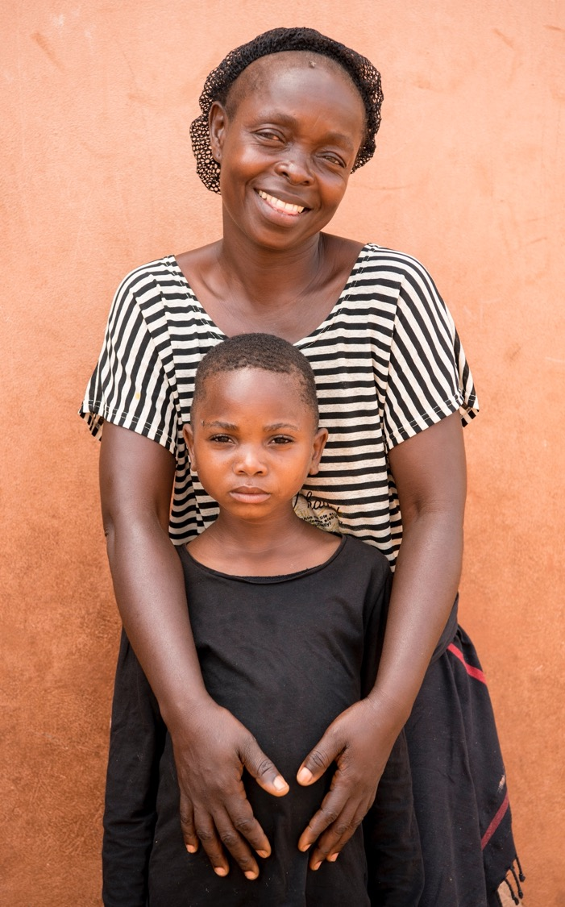
Session 2: Overview of Service Provision Activities and Teach Back Process
90 MINS

Slide 30
LEARNING OBJECTIVES FOR SESSION 2 Overview of Service Delivery Activities and Teach Back Process
Gain a broad understanding of the purpose and content of the service delivery activities
Learn how to practice facilitation of service delivery activities
Understand how to give and receive feedback
Notes:
Show slide 30 and explain that each session of the training has specific learning objectives, which we will read together before each session begins.
Read the learning objectives of the session to the participants.

Slide 31
TOPIC 2.1 SERVICE DELIVERY ACTIVITIES 15 MINUTES

Slide 32
SERVICE DELIVERY ACTIVITIES
PHASE | ACTIVITY | TIME REQUIRED | WHO IS RESPONSIBLE
PREPARATION PHASE (WEEKS 1-5) | Train community outreach workers and caseworkers in how to implement the community outreach and service delivery activities | 4 weeks | Programme managers, supervisors
 | Conduct baseline rapid social norms assessment (community outreach activities) and opinion leader identification tool (caregivers’ sessions only) | 1 week | Programme managers, supervisors and/or M&E team
 | Conduct pre assessment with adolescent girls (service delivery activities) | 1 hour per individual | Facilitators and/or caseworkers
IMPLEMENTATION- PHASE 1 (WEEKS 6-27) | Life skills workshops for adolescent girls and adolescent boys | 14-15 weeks | Facilitators
 | Focused adolescent girl groups | 7 weeks | Facilitators
 | Male and female caregivers’ sessions | 17-22 weeks | Community outreach workers
 | Religious leaders’ workshops (optional) | 7 weeks (spread over 14 weeks) | Community outreach workers
 | Teacher’s workshop | Anytime during phase 1
 | Weekly and monthly supervision meetings, monitoring activities | Every week | Supervisors and frontline workers
IMPLEMENTATION- PHASE 2 (WEEKS 28- 42 AND AFTER) | Community dialogues | 16 weeks | Community outreach workers
 | Implementation of community-led social norms change | TBC | Community dialogue members, supervised by community outreach workers
MONITORING AND EVALUATION | Conduct endline rapid social norms assessment (community outreach activities) | 6-12 months after intervention ends | Programme managers, supervisors and/or M&E team
 | Conduct post assessment with adolescent girls (service delivery activities) | 1 hour per individual | Facilitators and/or caseworkers
Notes:
Show slide 32, the table giving an overview of the entire intervention and explain service delivery activities fit into the overall programme.

Slide 33
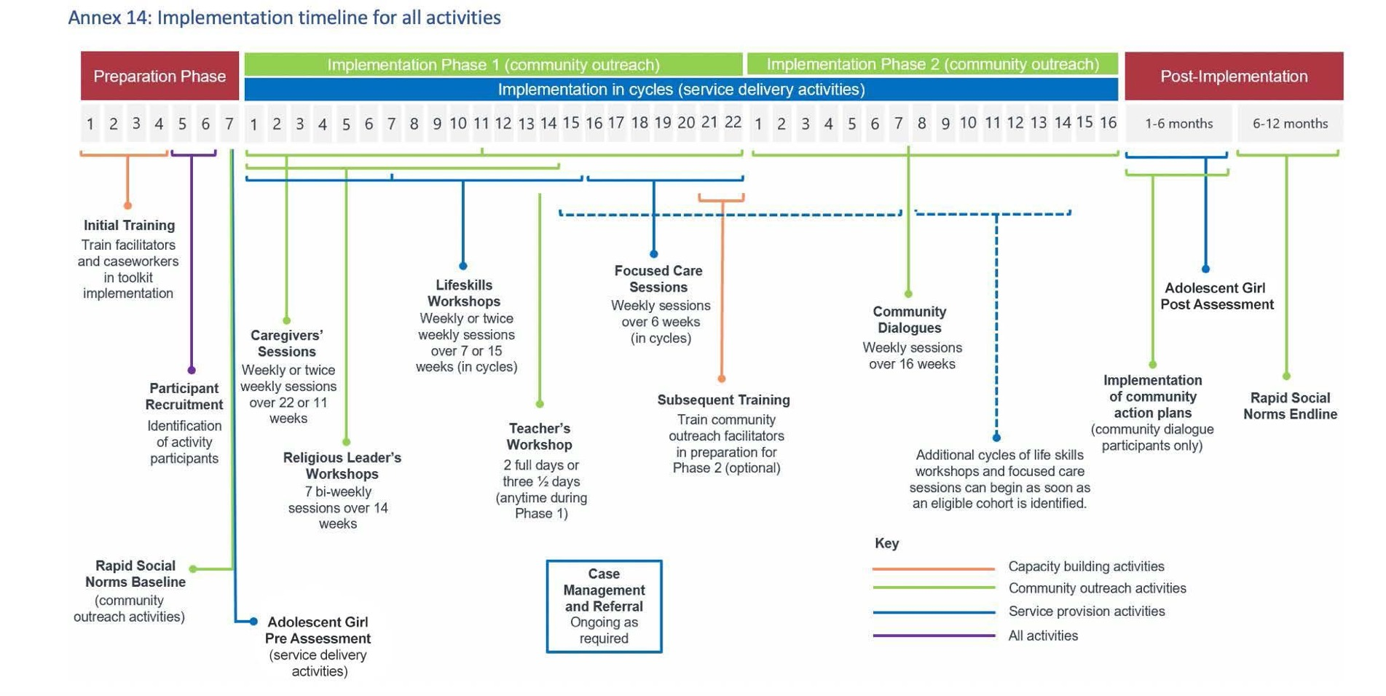
Notes:
Show slide 33 and explain that this is the timeline of the overall program. Again explain how the service delivery activities fit into the overall program, highlighting that they occur simultaneously with the community outreach component.

Slide 34
TOPIC 2.2 INTRODUCTION TO THE TEACH BACK PROCESS 15 MINUTES
Notes:
Explain to participants that for each component of the community outreach toolkit we are going to practice amongst ourselves. This is called teach back. The teach back is both an opportunity to practice facilitating activities in the curriculum, and the opportunity of practicing how to provide feedback, how to receive feedback, how to frame comments and observations in a way that are constructive and encouraging.
Explain that it can be unnerving to present back to peers - especially as this may be the first time for many of them. That’s ok! Remind them that we are here to support each other, and we are expecting all of us to make mistakes and use these as learning opportunities.

Slide 35
WHY IS THE TEACH BACK PROCESS IMPORTANT?
To practice facilitating conversations around CEFM, life skills and psychosocial support, identifying and challenging common resistance reactions and using the facilitation skills we learnt.
To practice giving and receiving feedback.
To continue experiencing the activities of the curricula as participants, so that we can experience the toolkit from the participants’ perspective.
To engage and interact with all parts of the curricula. It is important to be familiar with the curricula, the flow, and some key points in the facilitation.
Notes:
Tell participants that there are four main reasons we are dedicating this time to the teach back process:
As mentioned, the first is to practice facilitating conversations around CEFM, life skills and psychosocial support, identifying and challenging common resistance reactions and using the facilitation skills we learnt.
2. The second is to practice giving and receiving feedback.
3. The third is to continue experiencing the activities of the curricula as participants, so that we can learn more about what it is like to experience the toolkit from the participants’ perspective.
4. The final one is to engage and interact with all parts of the curricula. It is important to be familiar with the curricula, the flow, and some key points in the facilitation.
Explain that the goal is to improve, and you do not need not be perfect the first time.

Slide 36
TOPIC 2.3 GIVING AND RECEIVING FEEDBACK 60 MINUTES
Notes:
Explain to participants that before we start the teach back, we are going to think about feedback, how we give it, how we receive it.
Explain that we all react differently to different events, and feedback is no different. This can also be culturally specific. This is why we need to reflect on ourselves to make sure we are aware of how we communicate, and how we receive information.
Tell participants we are now going to play a game.

Slide 37
HOW TO GIVE GOOD FEEDBACK
HOW YOU SAY IT
Always give feedback in a genuine, gentle, and caring way. What you say is one thing, but how you say it is just as important. Be direct but also supportive in the way you feedback so that it can be easily absorbed by the receiver.
FOCUS ON BEHAVIOUR
Feedback is helpful (and best absorbed) when it is specific. By contrast, feedback consisting of general statements about a person’s personality or beliefs is much less useful. This puts the recipient on the defensive.
FOCUS ON CHANGE
Effective feedback looks at behavior that is relatively easy to change. Giving feedback on behaviors that are difficult to change is not helpful, creates defensiveness, anxiety and self-consciousness about the behavior without changing it.
Notes:
Explain that everyone has a different style of giving and receiving feedback. Some people are very open about providing feedback. Others are shy about it. Likewise, people are different in how they receive feedback from others. But despite these differences in style, there are some common elements to good feedback. Go over common elements to good feedback:

Slide 38
HOW TO GIVE GOOD FEEDBACK, CONTINUED
BE SPECIFIC
Focusing feedback on specific behaviors or statements helps people understand what needs to be improved.
BE CONSTRUCTIVE
People often don’t want feedback because they expect it to be negative criticism. Good feedback is often critical, but in a constructive way that helps people to improve. Constructive criticism identifies what needs to be improved in the context of what was done well.
TAKE PERSONAL RESPONSIBILITY
Feedback is one person’s view of another’s performance. When giving feedback, it is important that you “own” it by beginning your statements with “I think that…” or “I felt that…”

Slide 39
HOW TO GIVE GOOD FEEDBACK, CONTINUED
ALLOW FREEDOM TO CHANGE
OR NOT TO CHANGE
Feedback is intended to help people improve their work. However, it remains their choice whether they wish to act on such feedback. Good feedback skills will help people to choose their future actions based on the information that is being given.
KEY SENTENCES TO BEGIN WITH
Share with participants some key approaches so that the tone set is positive and constructive. Some examples could be:
Thank you for all you have done….
I heard you say X and would like to share my thoughts on that because ..
I thought that was great, and thought that perhaps we could we rework this so that …
I learnt a lot and felt like sharing that….

Slide 40
HOW TO RECEIVE FEEDBACK WELL
Listen only. Do not react- take the time to focus on what is being said, and sitting with it.
Do not justify your behavior
Ask only for clarification
Acknowledge the feedback
Notes:
It is also useful to understand how to receive feedback in a way that best helps you. Good practice for receiving feedback includes:
Listen only. Do not react - take the time to focus on what is being said and sitting with it.
Do not justify your behaviour
Ask only for clarification
Acknowledge the feedback
Close this session by asking participants to remember this exercise and the tips as they watch their peers facilitating sessions and use these during the time allocated to feedback.

Slide 41
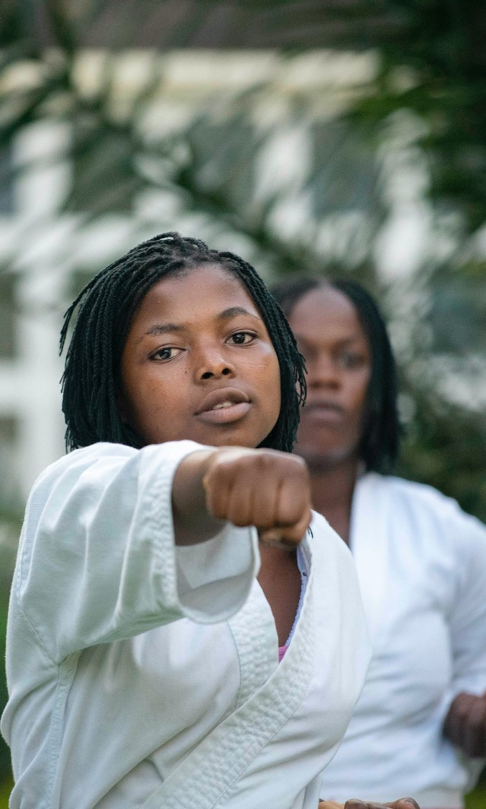
Session 3: Life Skills and Focused Care Sessions
17.5 HOURS
Notes:
Show slide 41 and explain to the group that this session is focused on the service delivery activities: life skills and focused care sessions.

Slide 42
LEARNING OBJECTIVES FOR SESSION 3 Life Skills and Focused Care Sessions
Understand how to plan the implementation of the tools
Become familiar with the tools
Practice facilitating and receiving feedback
Notes:
Show slide 42 and explain the learning objectives for the session.
Ask the group if they know the difference between sexual health and rights and reproductive health and rights? Give each table post-it notes and ask individuals to write the first thing that they think of when they think of sexual rights and reproductive rights. After 5 minutes, ask the participants to stick their post-it notes on the corresponding flipchart paper hung at the front of the room. Ask for two volunteers to go through the answers and group them together and read them aloud to the participants.

Slide 43
TOPIC 3.1 OVERVIEW OF THE LIFE SKILLS AND FOCUSED CARE TOOLS
60 MINUTES

Slide 44
PROGRAMME THEORY OF CHANGE
Notes:
Show slide 44-46 to the participants and explain how this tool contributes to the long-term outcomes in the Theory of Change (slide 46). Briefly explain that the life skills workshops and focused session activities contribute to the intermediate and long-term programme outcomes.

Slide 45
PROGRAMME THEORY OF CHANGE (CONT.)

Slide 46
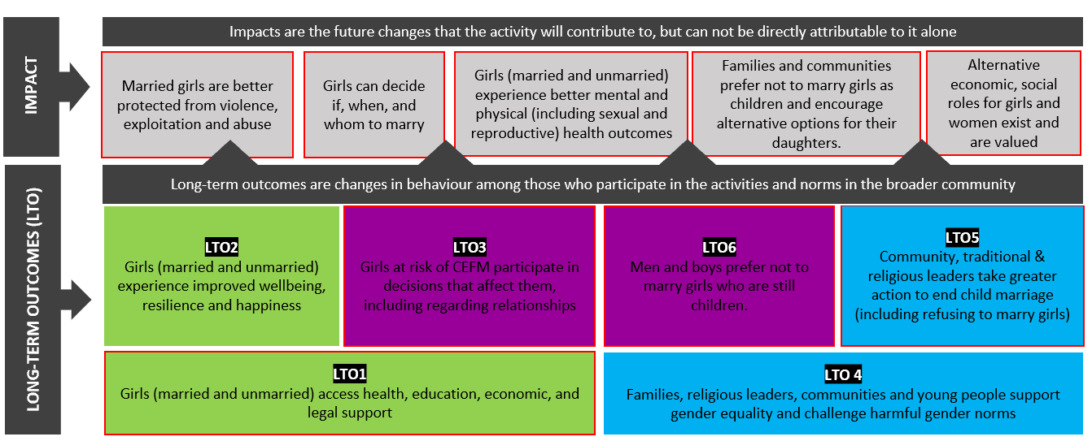
PROGRAMME THEORY OF CHANGE (CONT.)
Notes:
The long-term outcomes are:
1. Girls (married and unmarried) experience improved wellbeing, resilience and happiness
2. Girls at risk of CEFM participate in decisions that affect them, including regarding relationships
3. Girls (unmarried, married, divorced or widowed) have increased access to essential services including health, including mental health, sexual and reproductive health and rights, education, comprehensive sexuality education, child protection, gender based violence support, economic assistance and legal support

Slide 47
SCHEDULING SESSIONS AND PARTICIPANT RECRUITMENT – LIFE SKILLS
9-12 participants participants per group per cycle
Scheduled once weekly for a period of 7-14 weeks
PARTICIPANTS:
YOUNG GIRLS (AGED 10-14) who are currently unmarried and at risk of CEFM
OLDER GIRLS (AGED 15-19) who are currently unmarried and at risk of CEFM
YOUNG GIRLS (AGED 10-14) who are at imminent risk, already married, widowed or divorced
OLDER GIRLS (AGED 15-19) who are at imminent risk, already married, widowed or divorced
YOUNG BOYS AGED 10-14
OLDER BOYS AGED 15-19
Notes:
Show slide 47. Explain that participants for life skills should be recruited based on a set of criteria:
Explain that eligible girls can participate in the focused care sessions as a stand-alone or complementary intervention to life skills workshops.
Say that adolescents should be recruited based on age and marital status. Explain that the service delivery activities (excluding case management) are delivered in cycles. The recommended group size and participation is 9-12 participants per group/cycle. For example, the first group of 9-12 participants begin the programme and complete all sessions together (Cycle 1). When enough eligible adolescents have been identified and recruited, a new group of 9-12 participants begin the programme and complete all sessions together (Cycle 2) and so on.
At no point should new participants be invited to join the group mid-way through the cycle. This is to maintain rapport and trust among the participants and minimise disruption to the group (e.g. having to re explain concepts previously discussed).
explain that sessions should be planned once a week, according to the availability of the participants. Explain that invited life skills participants are grouped by age, needs, sex and marital status and are recruited through the community while focused care activities are designed to build the assets and develop positive coping mechanisms for challenging situations and participants should only be referred to participate through case managements services. Adolescent girls who are at imminent risk, already married girls, widowed and divorced are eligible to attend.

Slide 48
SCHEDULING SESSIONS AND PARTICIPANT RECRUITMENT – FOCUSED CARE
9-12 participants participants per group per cycle
Scheduled once weekly for a period of 7 weeks
Designed to build assets and build positive coping mechanisms for challenging situations
Participants should be grouped as follows:
YOUNGER GIRLS (AGED 10-14) at imminent risk, already married girls, widowed and divorced
OLDER GIRLS (AGED 15-19) at imminent risk, already married girls, widowed and divorced

Slide 49
STRUCTURE AND TIMING OF SERVICE DELIVERY ACTIVITIES
TOPIC / OBJECTIVES (5 MINUTES)
FACILITATOR’S NOTES
WARM UP (15 MINUTES)
DISCUSSION ACTIVITIES (30-45 MINUTES)
POSITIVE STRATEGIES (30-45 MINUTES)
REFLECTION (15 MINUTES)
Notes:
Show slide 49 and explain that the life skills and focused care sessions use a consistent structure and timing of each session. Read the 6 headings and timings for each
Divide participants up into groups of four and ask the participants to spend 20 minutes looking through the curricula and making note of which activities are different based on age and marital status. Ask participants why they think that the sessions are different.
Distribute the handout on adapting activities. Explain that the activity sessions will be tailored to the unique needs of different participants including those who are already married or widowed and divorced girls. This allows for each group to receive knowledge and skills relevant to their own experiences.
Say that facilitators and their supervisors need to consider the culture and context of each group to ensure safety of the participants and acceptability of the session content, for example, sessions on healthy boundaries and ASRH might need to be tailored for different groups, depending on their age and marital status. Guidance on adjusting the activities to suit the evolving capacities of children and youth are provided in annex 7 in your handout books.

Slide 50
TOPIC 3.2 TEACH BACK – ADOLESCENT BOYS AND GIRLS LIFE SKILLS
5.5 HOURS

Slide 51
Preparing to Facilitate
1 HOUR
TEAM 1 | SESSION 3 Effective Communication Section: Discussion: Communication Skills | Girl’s tool
TEAM 2 | SESSION 4 Decision-making and Problem Solving Section Positive Strategies (married girls) | Girl’s tool
TEAM 3 | SESSION 9 Our Health – Part 1 Changes That We Feel and See (Unmarried girls) | Girl’s tool
TEAM 4 | SESSION 9 Our Health – Part 1 Menstruation (Married Girls) | Girl’s tool
TEAM 5 | SESSION 7 Sexual and Reproductive Health Activity 1: Puberty | Boy’s tool
TEAM 6 | SESSION 10 Securing Health Relationships Section Positive Strategies; Empathy Clothesline | Boy’s tool

Slide 52
TOPIC 3.3 TEACH BACK AGAIN
5.5 HOURS

Slide 53
Preparing to Facilitate (Again)
TEAM 1 | SESSION 3 Effective Communication Section Discussion: Activity 1 & 2 | Girl’s tool
TEAM 2 | SESSION 10 Our Health Part 2 Delaying Pregnancy (unmarried girls) | Girl’s tool
TEAM 3 | SESSION 10 Our Health Part 2 Myths and facts about contraception (married girls) | Girl’s tool
TEAM 4 | SESSION 11 Committing to Healthy Lives Section Discussion: Adjustments to life | Girl’s tool
TEAM 5 | SESSION 6 Gender and Social Norms Section Discussion: Gender boxes | Boy’s tool
TEAM 6 | SESSION 8 Contraception, Responsibilities and Rights Section Discussion: Child rights | Boy’s tool

Slide 54
TOPIC 3.4 TEACH BACK – FOCUSED CARE GROUPS
5.5 HOURS

Slide 55
Preparing to Facilitate
1 HOUR
TEAM 1 | SESSION 2 Naming Emotions: Sadness, Section Discussion
TEAM 2 | SESSION 3 Naming Emotions: Happiness, Section Discussion
TEAM 3 | SESSION 4 Naming Emotions: Anxiety, Section Discussion
TEAM 4 | SESSION 5 Naming Emotions: Loneliness, Section Positive Strategies
TEAM 5 | SESSION 6 Naming Emotions: Loneliness, Section Positive Strategies

